Slide 1





Me
@theChrisKent
theChrisKent.com

Slide 2
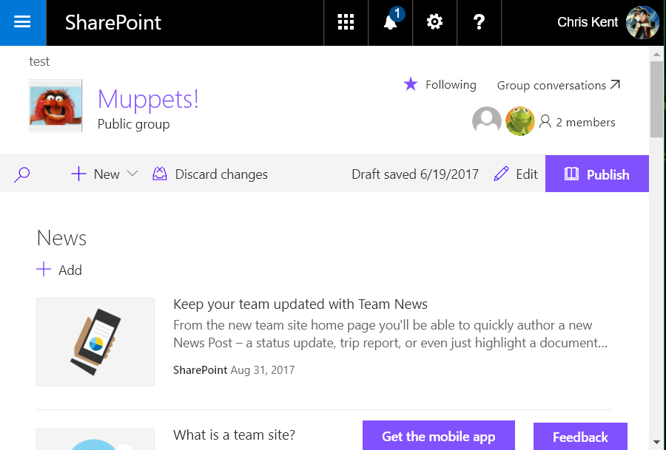


Application Customizers
Adds scripts to the page
Provides access to Placeholders
  Top (formerly PageHeader)
  Bottom (formerly PageFooter)
https://github.com/SharePoint/sp-dev-fx-extensions

Slide 3


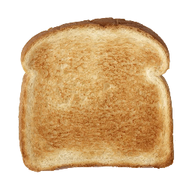
jQuery Application Toastr
Shows Toast notifications configured from a SharePoint List
Loading jQuery and jQuery based modules from a CDN
Loading 3rd Party CSS from a CDN
Using Toastr in an Application Customizer
Separating logic into a static service
Accessing components through a custom barrel
Adapting Office UI Fabric styles
Caching data using localStorage
Promise chaining with Exception bubbling
Theme syntax for applying official colors to custom CSS classes
Optionally, PnP Remote Provisioning PowerShell list deployment
https://github.com/SharePoint/sp-dev-fx-extensions/tree/master/samples/jquery-application-toastr

Slide 4
Code Flow
Loads jQuery & Toastr from CDNs
Loads Toastr CSS using SPComponentLoader
Retrieves Toast from SharePoint List using the ToastService
  ensureToasts
    localStorage or the List
  reduceToasts
    Adjusts the list based on what’s been acknowledge and the Toast’s frequency
Configures Toastr
Show some Toast!
  acknowledgeToast

Slide 5
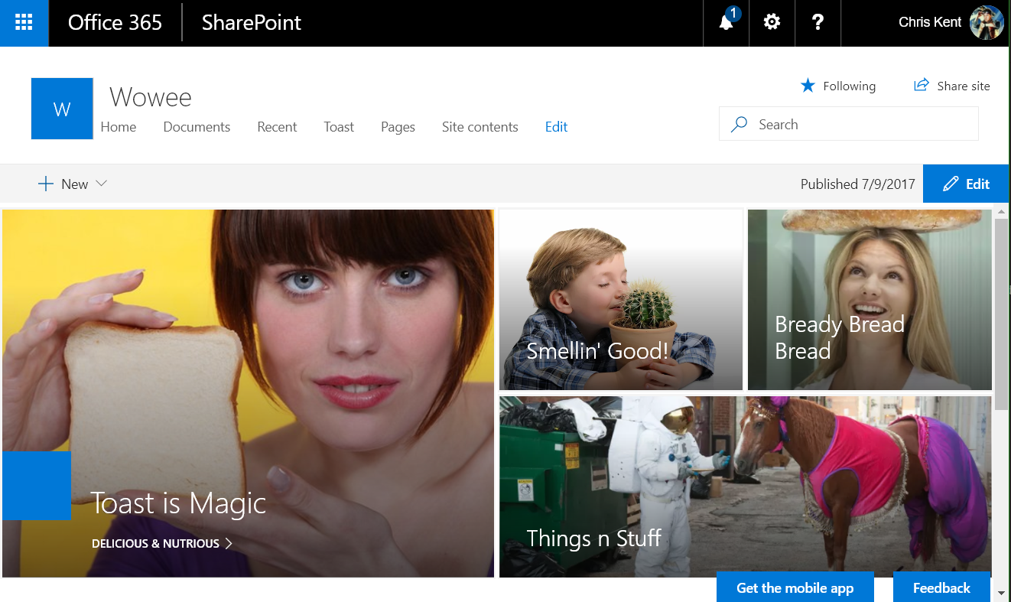
Notes:
A communications site without the Toastr Application Customizer applied

Slide 6
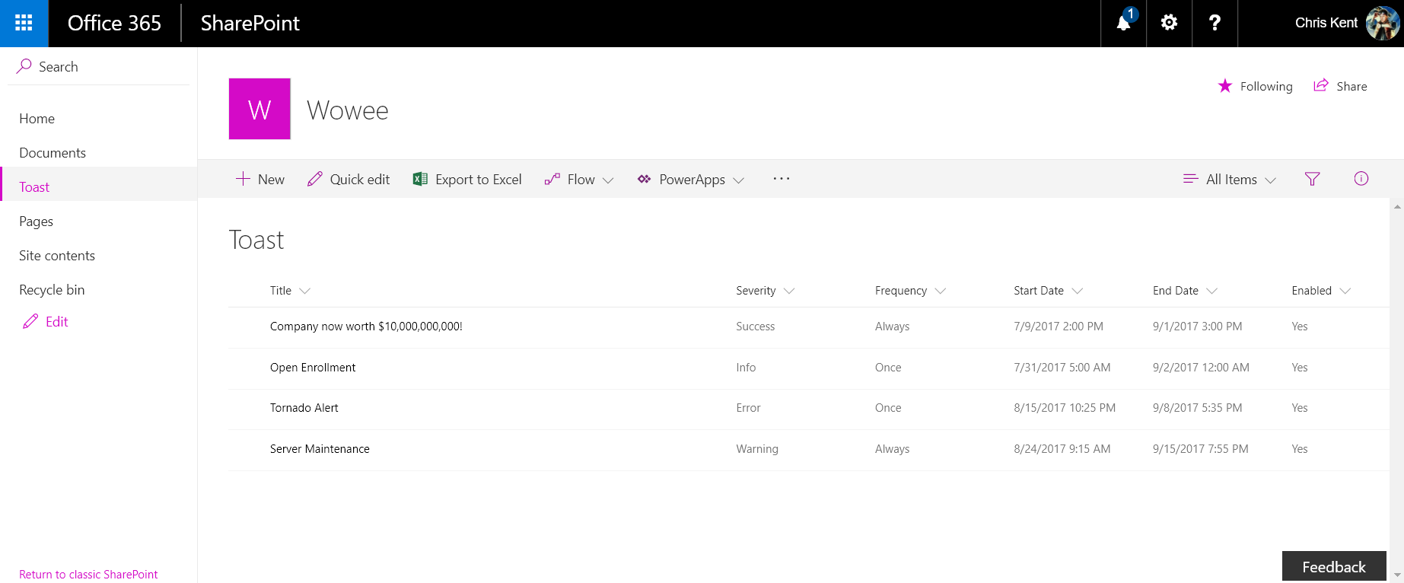
Notes:
The backing list for Toast. The toast colors are determined by Severity, the Frequency controls how often the toast show up, and the other columns determine when the toast is displayed.

Slide 7
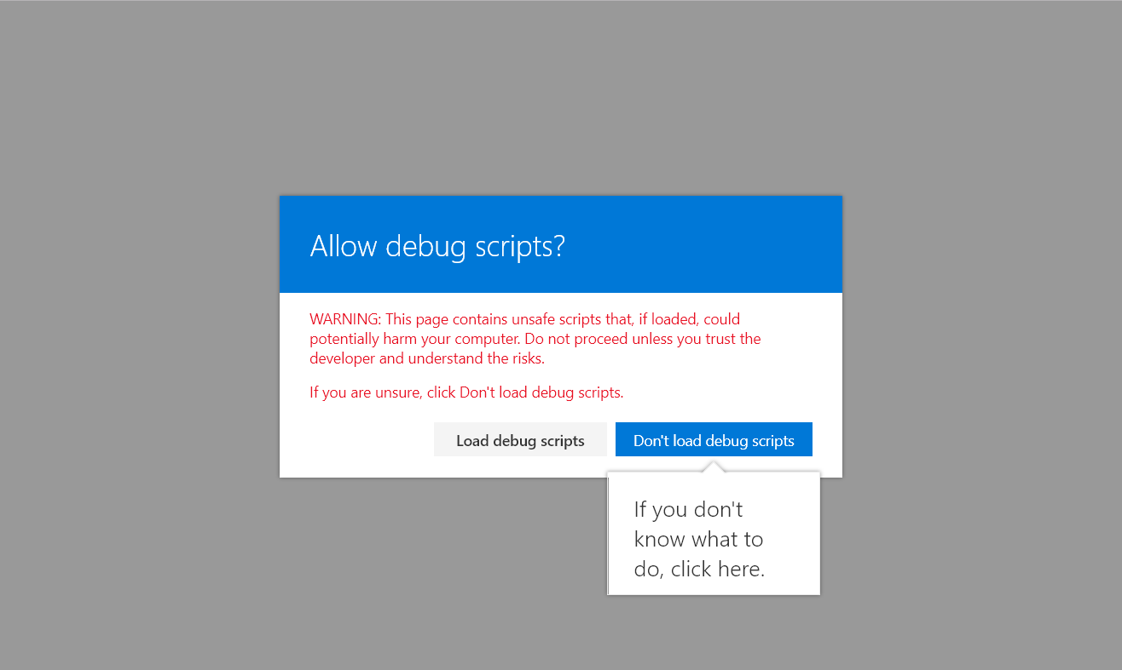
Notes:
The warning when using the debug query strings

Slide 8
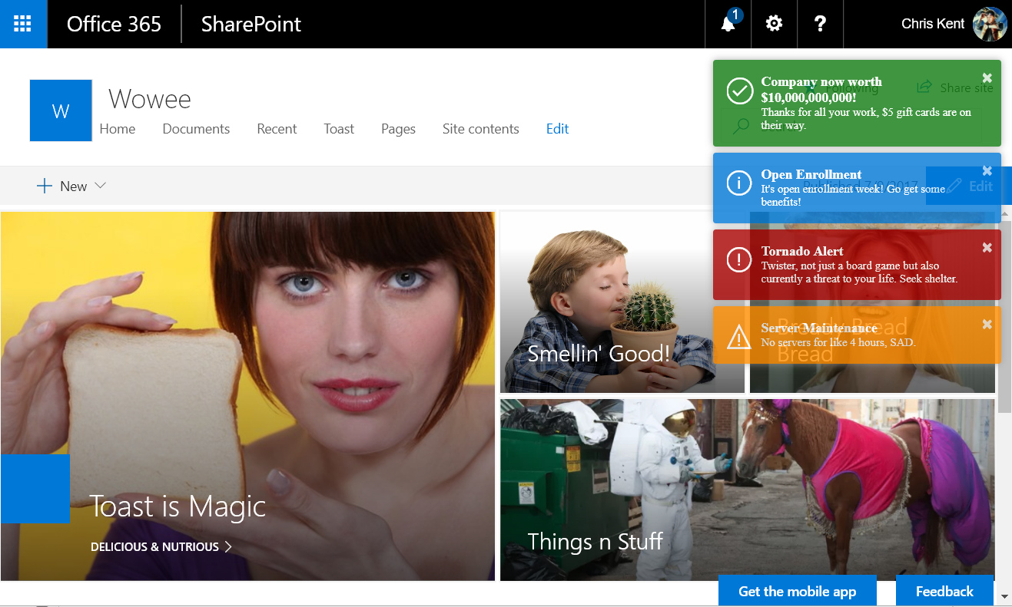
Notes:
Toast!
Query String:
?loadSPFX=true&debugManifestsFile=https://localhost:4321/temp/manifests.js&customActions={"a861c815-e425-416d-9520-04bcdf557e27":{"location":"ClientSideExtension.ApplicationCustomizer","properties":{}}}

