Slide 1
Understanding SharePoint Framework Extensions
Chris Kent
SharePoint Practice Lead, DMI

Slide 2
Agenda
Title Slide
Agenda
Chris reading the agenda to you
Amazing Slide Transition

Slide 3
goals

Slide 4
SharePoint Framework
What it is | When to use it

Slide 5
SharePoint Framework
EXTENSIONS
Know the Types | Purpose

Slide 6
Patterns &
Practices
Samples | Guidance

Slide 7




Chris Kent
@theChrisKent
theChrisKent.com
Notes:
Can I possibly get my name on a single slide even more? Wow.

Slide 8

dminc.com
Notes:
I work for them! Wow!

Slide 9

HUMAN NEEDS FOR FELLOW HUMANS
Questions
OTHER HUMAN NEEDS
Slides will be Available on my website
Survey
Part 2

Slide 10













Sponsors
Platinum
Gold
Bronze

Slide 11

@CASPUG
#spsclt17

Slide 12
Audience Participation!
Your
Role(s)
IT Pro
Versions of SharePoint
2003
Experience with SPFx
Huh?
Do you like pretty colors?
Yes
Management
Developer
Other
2007
2010
2013
2016
O365
None
Heard of it
Messed with it
Made something in Production
Extensions and More!
You Bet!

Slide 13














SharePoint Development
A Brief History

Slide 14






SharePoint as a Platform
Branding
User Experience
Business Intelligence
APIs
Processes
Packaging & Deployment

Slide 15






SharePoint as a Platform

Slide 16

SharePoint as a Platform
SP 2010
On-Premises Only
New
Themes
Alternate CSS
PowerPivot
Excel Services
CSOM & JSOM
Reporting Services
Web Services
2010 Workflows
Custom Master Page
Server Side APIs
PerformancePoint
Declarative Sandbox
OOTB Web Parts
Event Receivers
.NET Sandbox
InfoPath & SPD
SSIS
Full Trust Solutions

Slide 17
SharePoint as a Platform
SP 2013
On-Premises Only
New
Themes
Power BI
Alternate CSS
PowerPivot
REST
PnP Provisioning
Composed Looks
Client Side Rendering
Excel Services
CSOM & JSOM
2013 Workflows
PnP Partner Pack
JS Injection
Reporting Services
Web Services
2010 Workflows
Custom Actions
Add-ins
Custom Master Page
Server Side APIs
Remote Event Receivers
Add-in Parts
PerformancePoint
Declarative Sandbox
OOTB Web Parts
Event Receivers
.NET Sandbox
InfoPath & SPD
SSIS
Full Trust Solutions
ASP.NET 4.5 Integration

Slide 18
SharePoint as a Platform
O365
On-Premises Only
New
Themes
SPFx
Power BI
Microsoft Graph
Microsoft Flow
SPFx Client Side Solutions
Alternate CSS
Power Apps
PowerPivot
REST
Webhooks
PnP Provisioning
Composed Looks
Client Side Rendering
Excel Services
CSOM & JSOM
2013 Workflows
PnP Partner Pack
JS Injection
Reporting Services
Web Services
2010 Workflows
Custom Actions
Add-ins
Custom Master Page
Server Side APIs
Remote Event Receivers
Add-in Parts
PerformancePoint
Declarative Sandbox
SPFx Extensions
OOTB Web Parts
Event Receivers
.NET Sandbox
InfoPath & SPD
SSIS
Full Trust Solutions
ASP.NET 4.5 Integration

Slide 19
SharePoint as a Platform
Not Recommended
On-Premises Only
Newish
Themes
SPFx
Power BI
Microsoft Graph
Microsoft Flow
SPFx Client Side Solutions
Alternate CSS
Power Apps
PowerPivot
REST
Webhooks
PnP Provisioning
Composed Looks
Client Side Rendering
Excel Services
CSOM & JSOM
2013 Workflows
PnP Partner Pack
JS Injection
Reporting Services
Web Services
2010 Workflows
Custom Actions
Add-ins
Custom Master Page
Server Side APIs
Remote Event Receivers
Add-in Parts
PerformancePoint
Declarative Sandbox
SPFx Extensions
OOTB Web Parts
Event Receivers
.NET Sandbox
InfoPath & SPD
SSIS
Full Trust Solutions
ASP.NET 4.5 Integration

Slide 20




Modern Pages
Kiss your postbacks goodbye

Slide 21
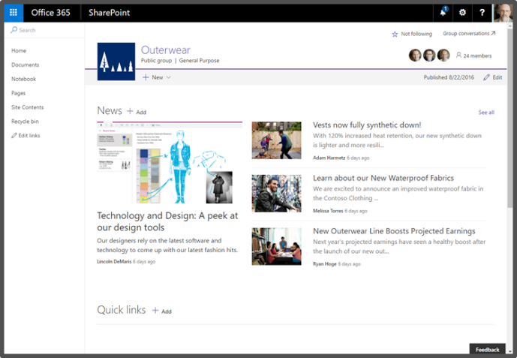
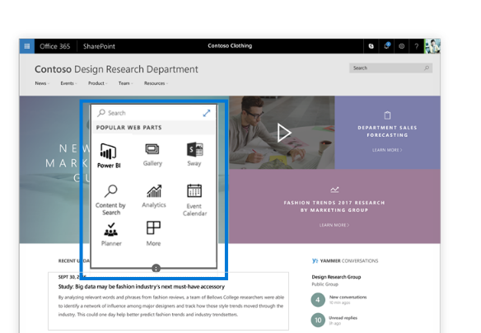
Modern SharePoint Pages
Better OOTB User Experience
Built using SPFx
Instant update experience
Works on most devices and modern browsers
Pages and Web Parts are responsive by design
Supports existing add-ins (Apps)

Slide 22
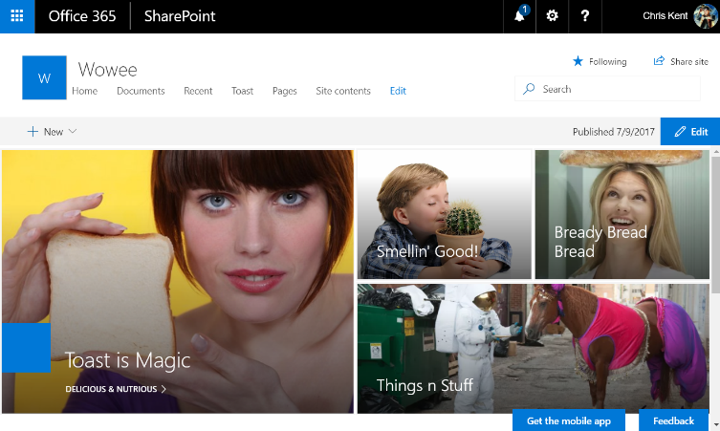
Modern Sites
Modern Pages
Modern Team Sites
  Associated with an O365 Group
Communication Sites
Modern Pages
  Add Webparts
  Sections & Columns
Modern List Views
Modern Admin Pages
  Site Contents

Slide 23
Demo
Modern Pages
Notes:
Very briefly showed off a Communications Site and a Modern Team Site. Also showed how to add a webpart to a new page.

Slide 24

The SharePoint Framework
SPF + mysterious x = SPFx

Slide 25
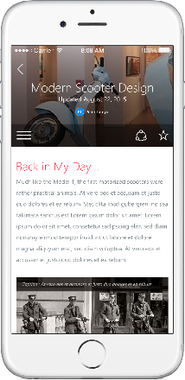
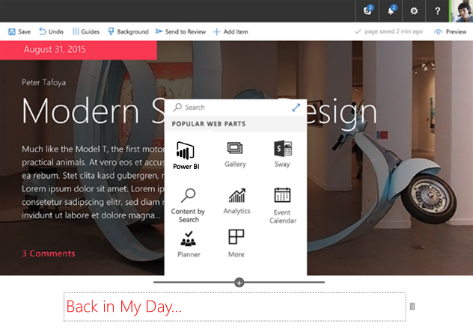
SharePoint Framework (SPFx)
Modern client-side development
Lightweight web and mobile
Powers OOTB experiences
Backward compatible*
Supports open source tools
and JavaScript web frameworks
SharePoint Framework
Microsoft Graph
LOB Systems and Cloud Services

Slide 26
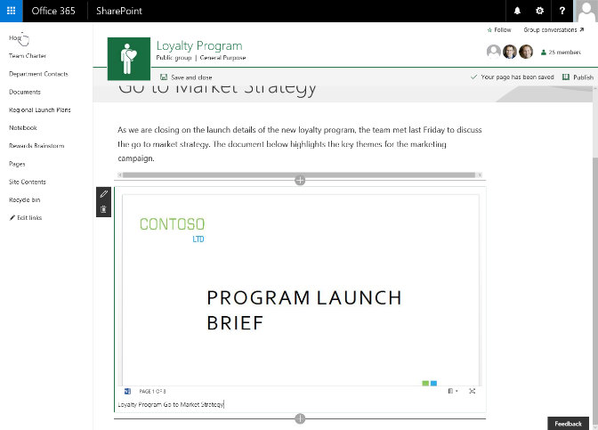
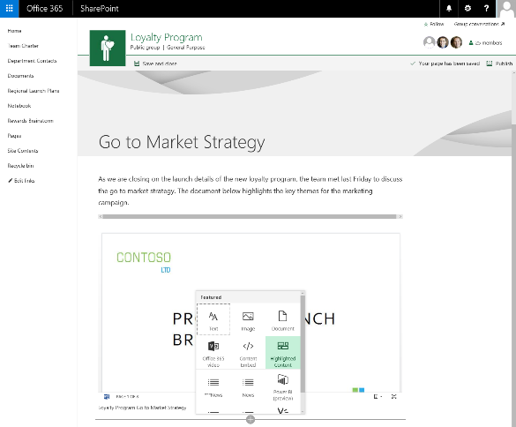
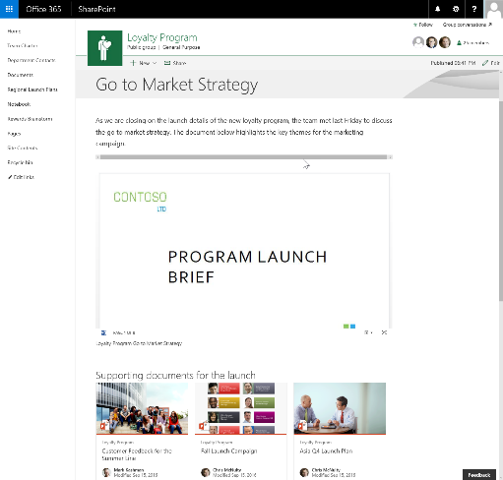
Client-side Web Parts
They are still web parts! (Mostly)
Built for the modern, JavaScript-driven web.
Runs directly inside a SharePoint Page.
(Even Classic pages)

Slide 27







Tool Comparison
IIS Express
C#
Traditional
MSBuild
Project Templates
Dev Server
Packages
Templates
Build Tasks
Language
Editor
SPFx
VS Code

Slide 28
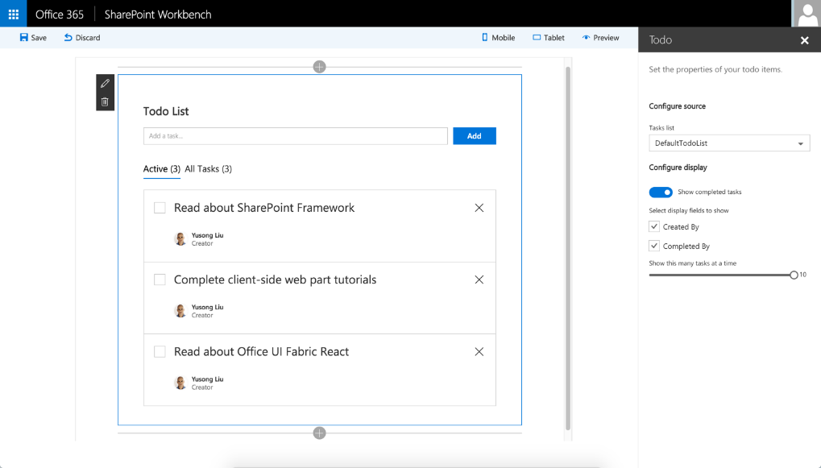
SharePoint Workbench
Developer tool to debug web parts
Local development experience
SharePoint Framework available offline
Available in SharePoint Online as well

Slide 29
Important npm Commands
Important Gulp Tasks
Install into your project
  npm install [THING] --save .
Install Globally
  npm install -g [THING] .
Install as Dev Dependency
  npm install [THING] --save-dev .
Check what Version You Have
  npm list –g [THING] .
See Available Versions
  npm view [THING] versions .
See available tasks
  gulp --tasks .
Start the local server
  gulp serve .
Start the local server with no WB
  gulp serve --nobrowser .
Generate the Bundle
  gulp bundle .
Generate the Solution
  gulp package-solution .

Slide 30


Development Environment Checklist
NodeJS
Yeoman
Gulp
Microsoft Generator SharePoint
Visual Studio Code

Slide 31
Demo
SharePoint Framework Web Part
Notes:
Basic Hello World web part. Added custom color property to better illustrate how the properties immediately change things.

Slide 32




SPFx Extensions
Extending Modern Pages

Slide 33
Types of SPFx Extensions
Application Customizer
  Injects your code on every page
  Provides Placeholders for custom markup
    Currently, Top & Bottom – eventually more
Field Customizer
  Allows you to customize the display of specific fields
  Only the list view is currently supported
    No form views
ListView Command Set
  Extend command bar and/or context menu
  Run code against selected items
Delegate Controls
Or
JavaScript Injection via Custom Action
~
~
Client Side Rendering for Fields
(JS Link)
~
Custom Actions

Slide 34
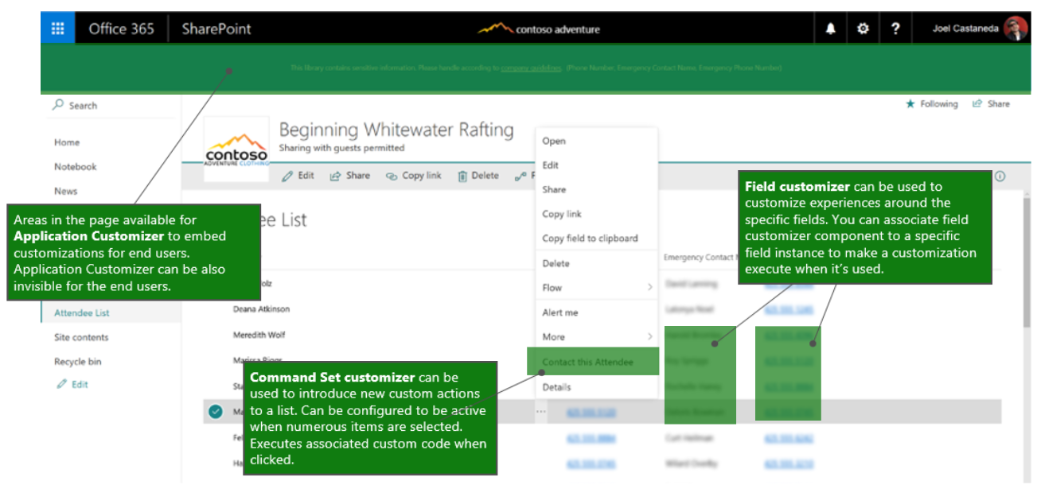
SPFx Extension Locations

Slide 35
Current Extension Limitations (the big ones)
Developer Tenant only! (not just a development site)
Application Customizers work on all Modern sites and pages
  Footers (Bottom) placeholders are not always present (for now)
Field Customizers & ListView Command Sets do NOT work on O365 based group sites
  Classic sites with Modern ListViews is where it’s at!
ListView Command Set icons don’t work
RC1 is in Progress as we speak!
  Things are in preview, and will change (slightly)
  You code WILL need to be updated for GA

Slide 36
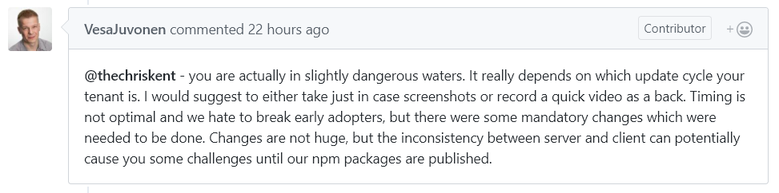
SPFx Extension Demos Disclaimer
https://github.com/SharePoint/sp-dev-docs/issues/805

Slide 37
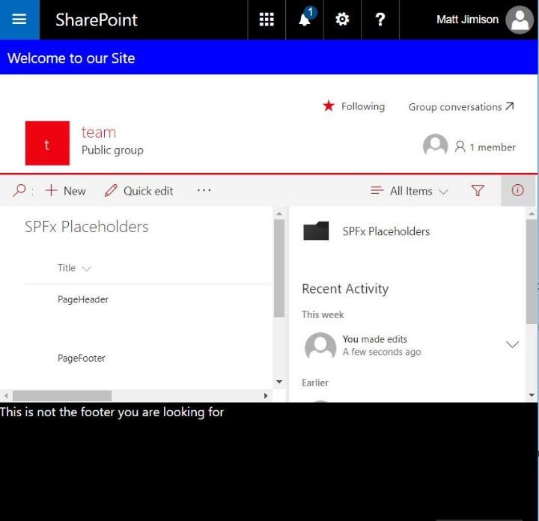

List Driven Placeholders
DEMO
Application Customizer
List to manage content
Caching with localStorage
Supports future Placeholders
Matt Jimison
@mjimison

Slide 38
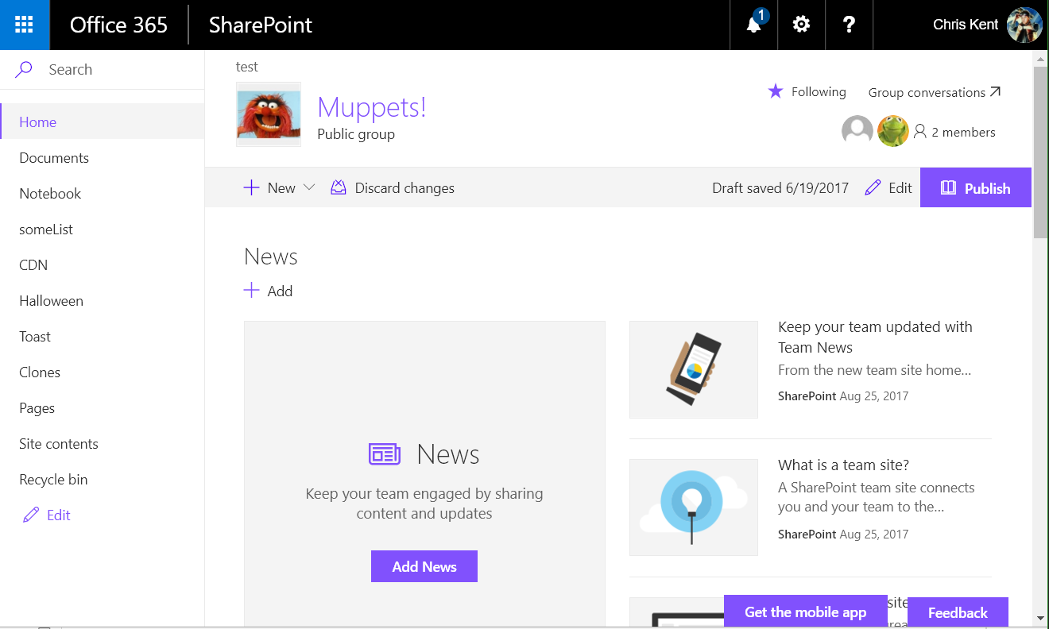
Notes:
Modern page without placeholders

Slide 39
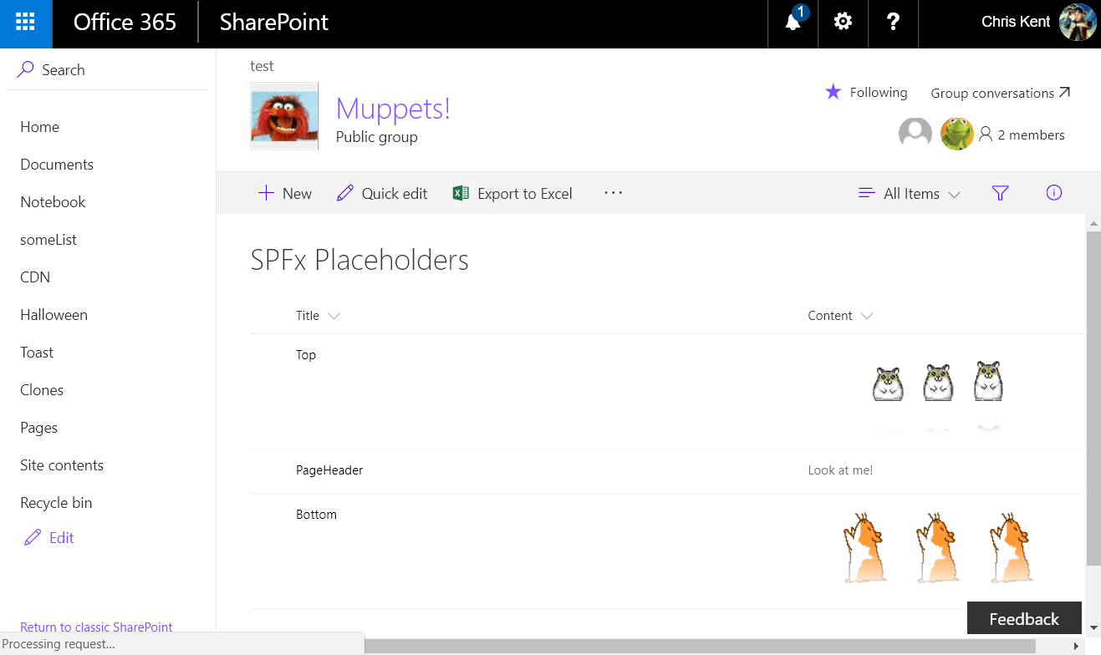
Notes:
The backing list. Only the Top and Bottom entries are important here.

Slide 40
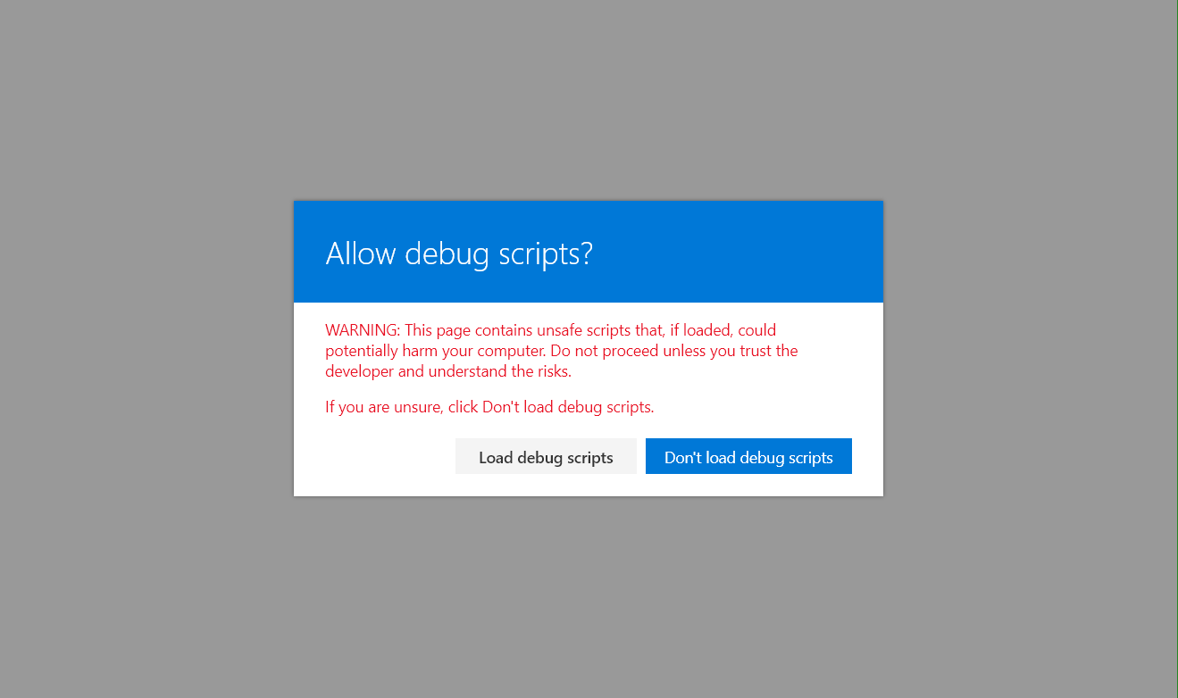
Notes:
The warning when using the debug query strings

Slide 41
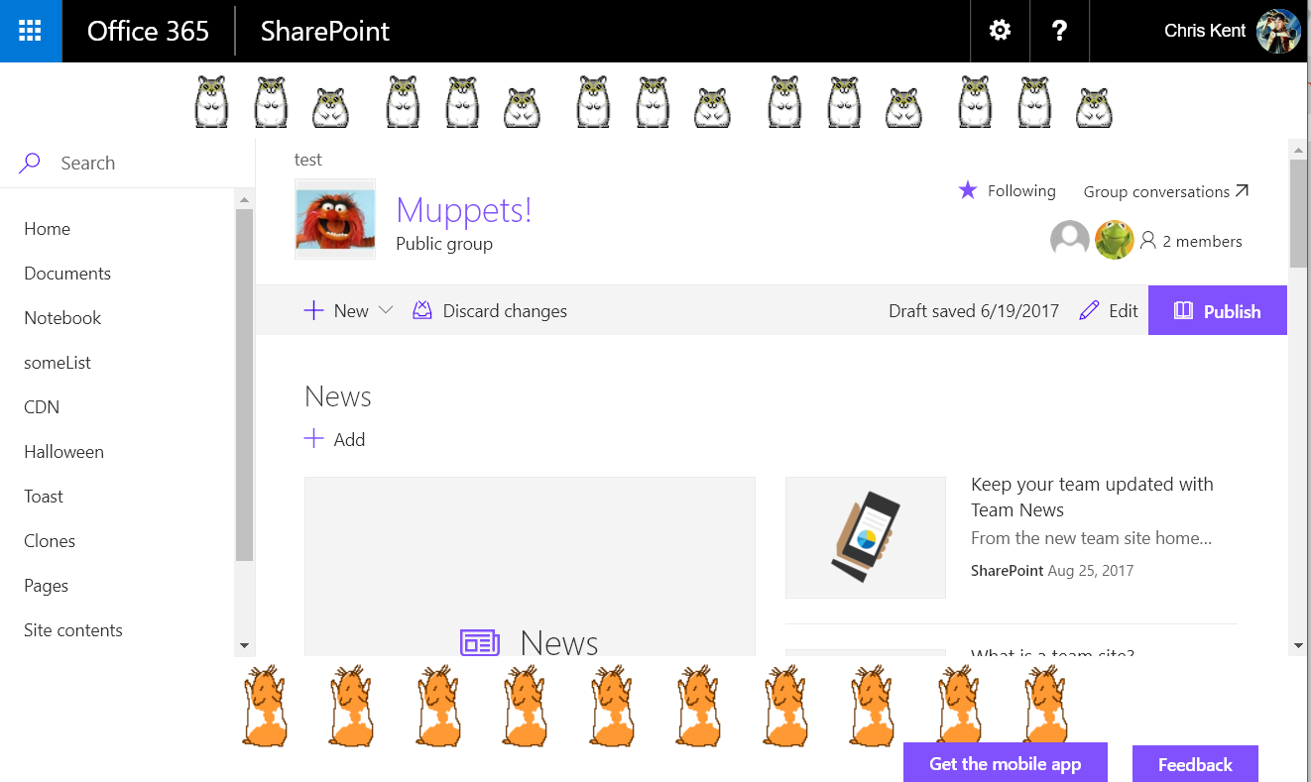
Notes:
The placeholders in action! Why would I include the hamster animations from hamsterdance.com?
Query String:
?loadSPFX=true&debugManifestsFile=https://localhost:4321/temp/manifests.js&customActions={"b58ca197-a89a-47a9-b283-7c1df361eaf3":{"location":"ClientSideExtension.ApplicationCustomizer","properties":{}}}

Slide 42
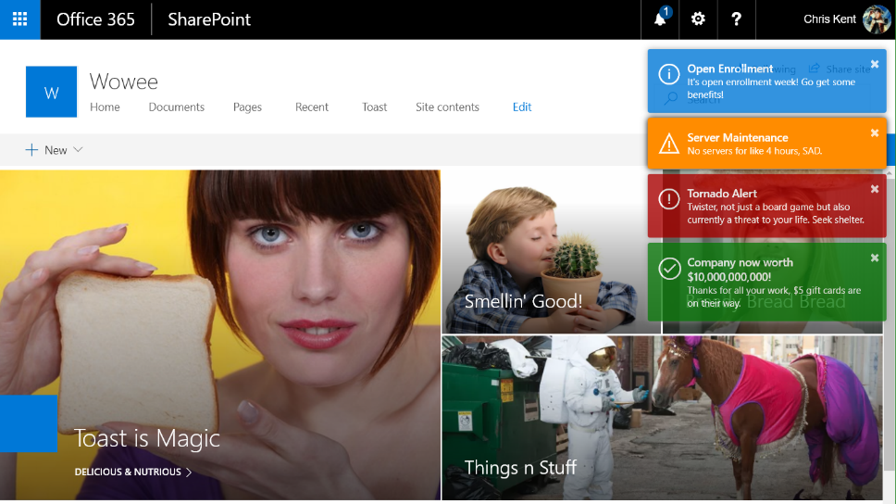
Toastr Notifications
DEMO
Application Customizer
List to manage content
Caching with localStorage
Static Service & Barrel Logic
Chris Kent
@thechriskent

Slide 43

Notes:
A communications site without the Toastr Application Customizer applied

Slide 44
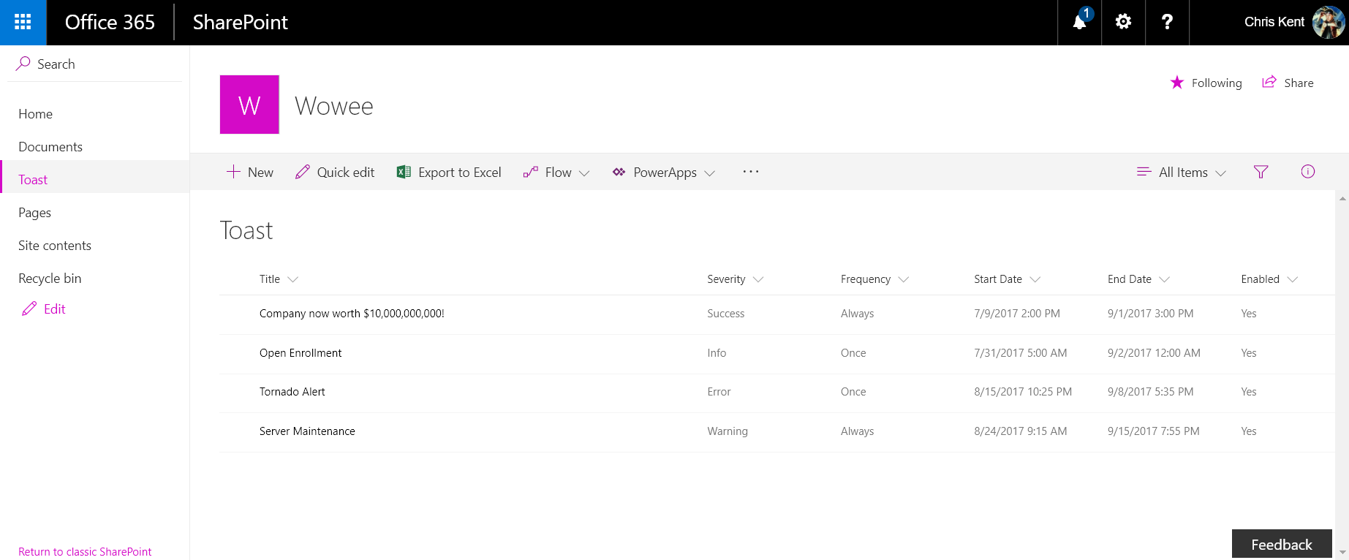
Notes:
The backing list for Toast. The toast colors are determined by Severity, the Frequency controls how often the toast show up, and the other columns determine when the toast is displayed.

Slide 45
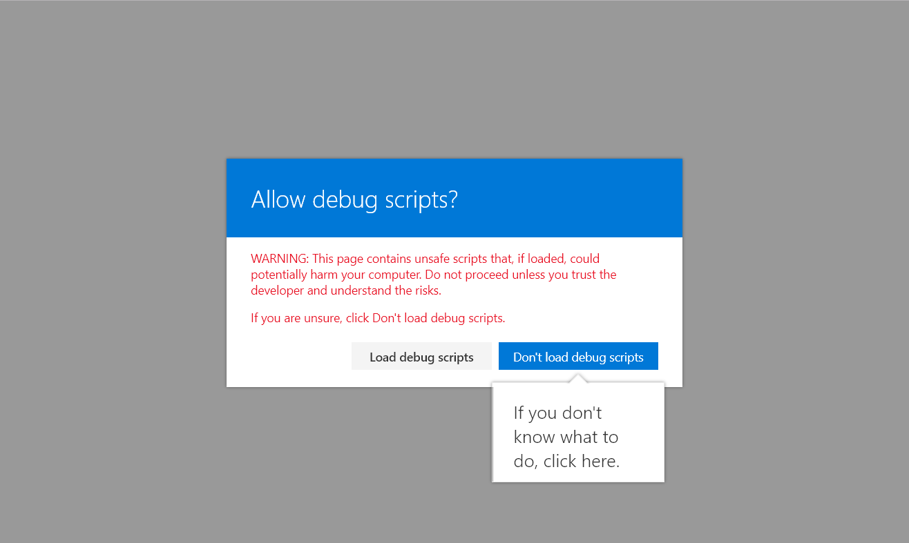
Notes:
The warning when using the debug query strings

Slide 46
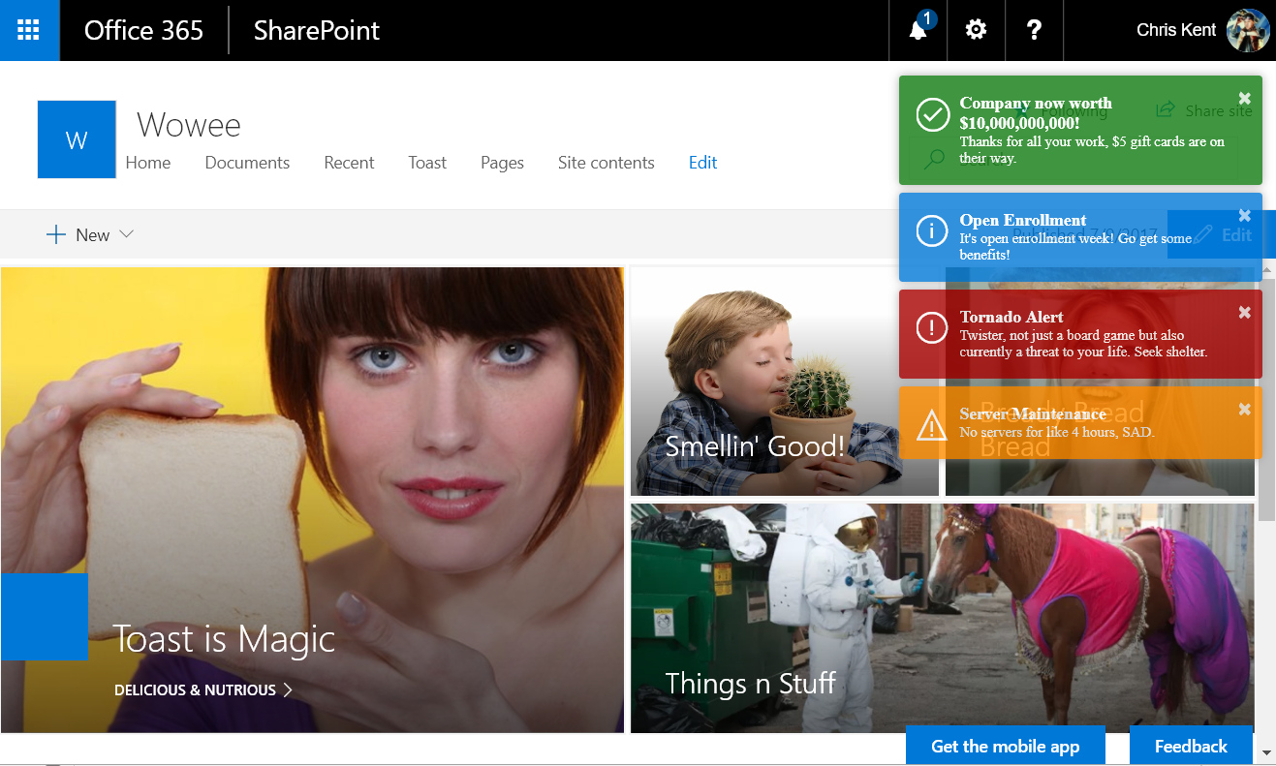
Notes:
Toast!
Query String:
?loadSPFX=true&debugManifestsFile=https://localhost:4321/temp/manifests.js&customActions={"a861c815-e425-416d-9520-04bcdf557e27":{"location":"ClientSideExtension.ApplicationCustomizer","properties":{}}}

Slide 47
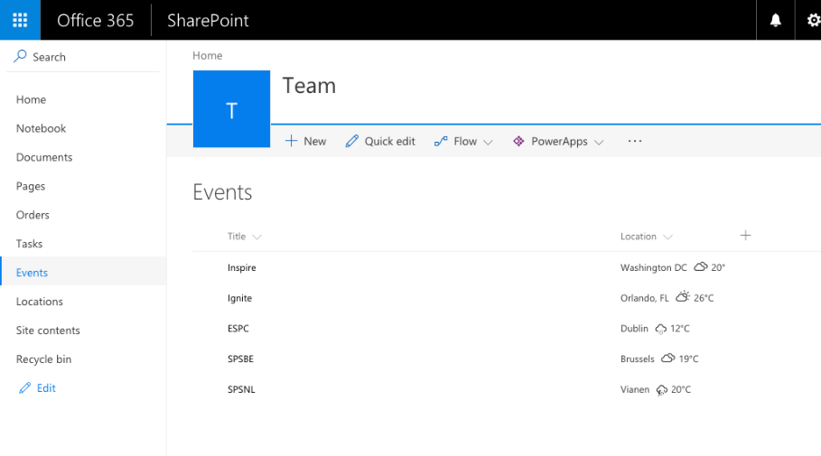

Weather Field
DEMO
Field Customizer
Custom CSS for Cells
jQuery Plugin Usage
Config Through Parameters
Waldek Mastykarz
@waldekm

Slide 48
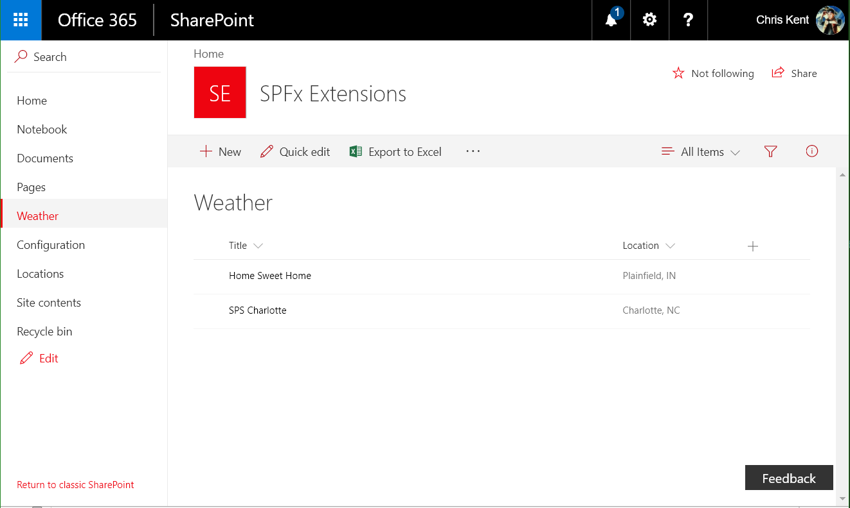
Notes:
A list without the Field Customizer applied (specifically the Location column)

Slide 49
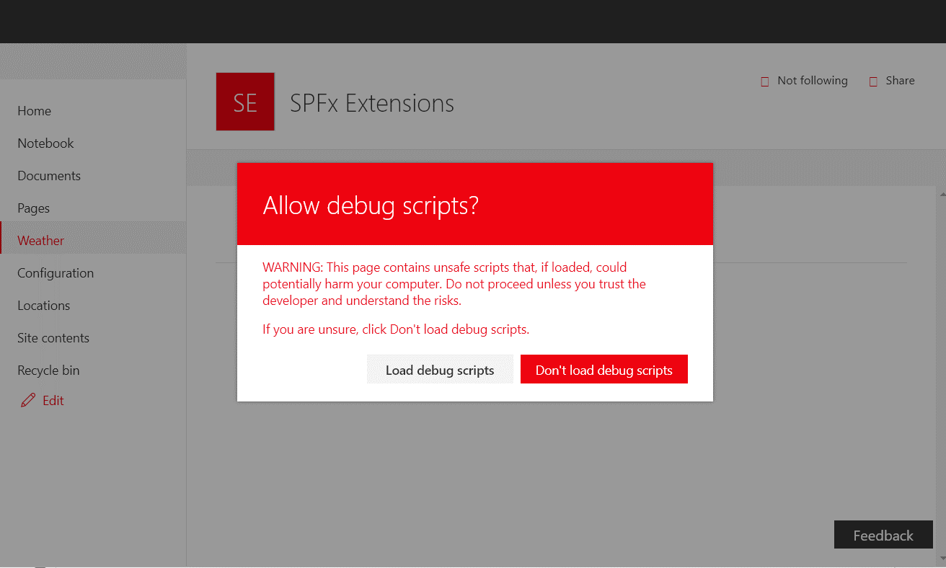
Notes:
The warning when using the debug query strings

Slide 50
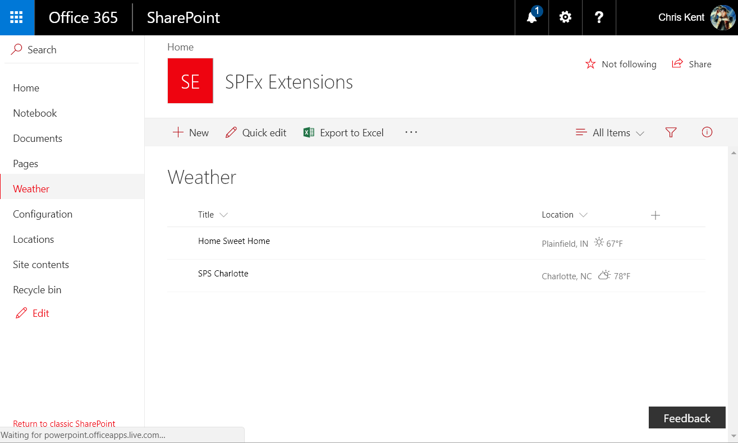
Notes:
Weather in Fahrenheit
Query String:
?loadSPFX=true&debugManifestsFile=https://localhost:4321/temp/manifests.js&fieldCustomizers={"Location":{"id":"b754b644-6821-4ce7-94b4-e374e7b657e0","properties":{"unit":"f"}}}

Slide 51
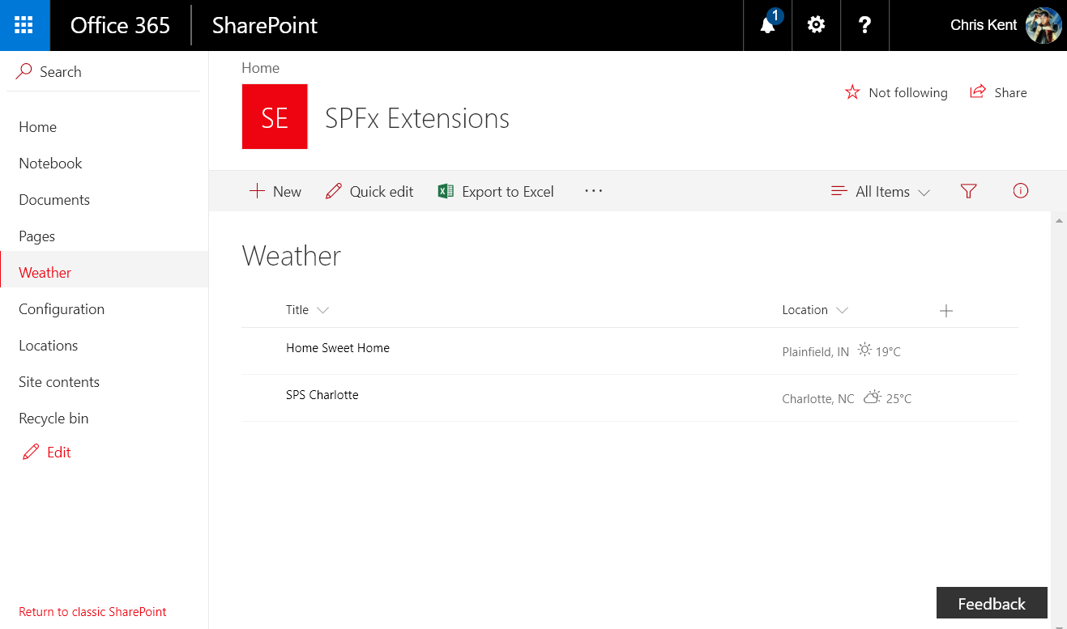
Notes:
Weather in Celsius
Query String:
?loadSPFX=true&debugManifestsFile=https://localhost:4321/temp/manifests.js&fieldCustomizers={"Location":{"id":"b754b644-6821-4ce7-94b4-e374e7b657e0","properties":{"unit":"c"}}}

Slide 52
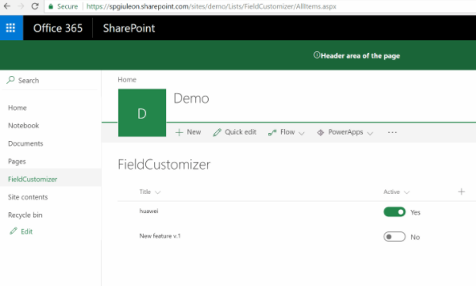

Toggle Field
DEMO
Field Customizer
Office UI Fabric React Components
Inline Editing from View
Giuliano De Luca
@giuleon

Slide 53
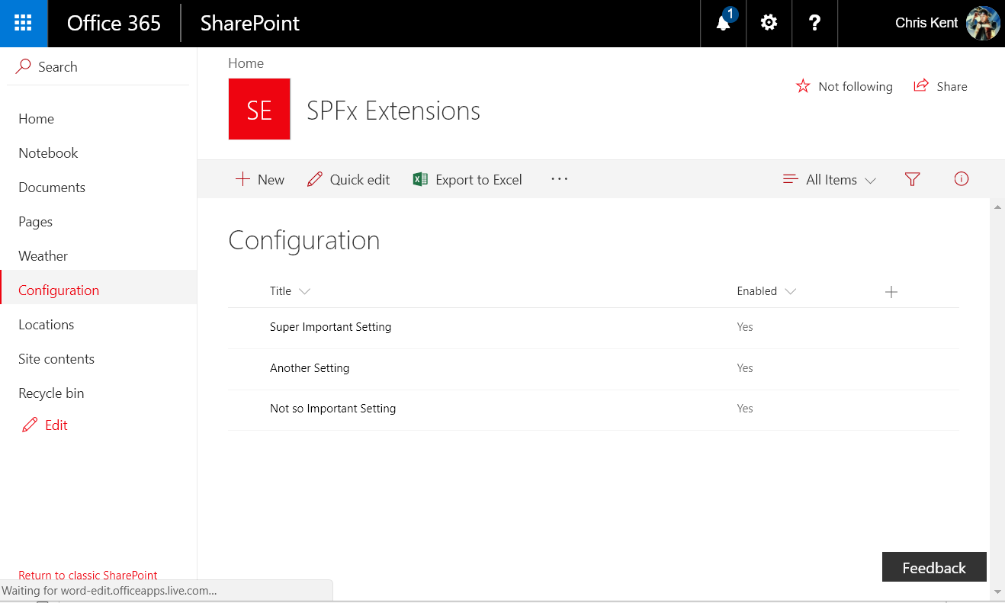
Notes:
List without the Field Customizer applied (specifically the Enabled field)

Slide 54
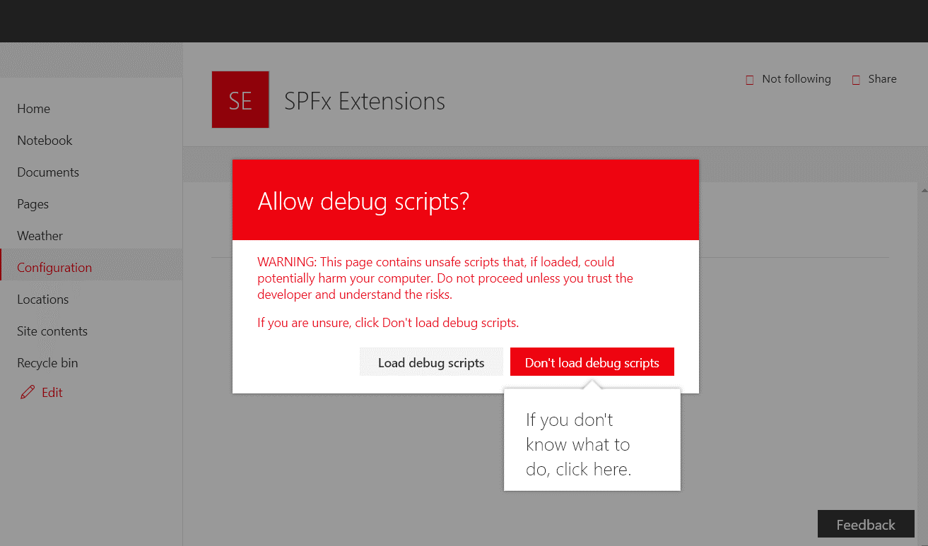
Notes:
The warning when using the debug query strings

Slide 55
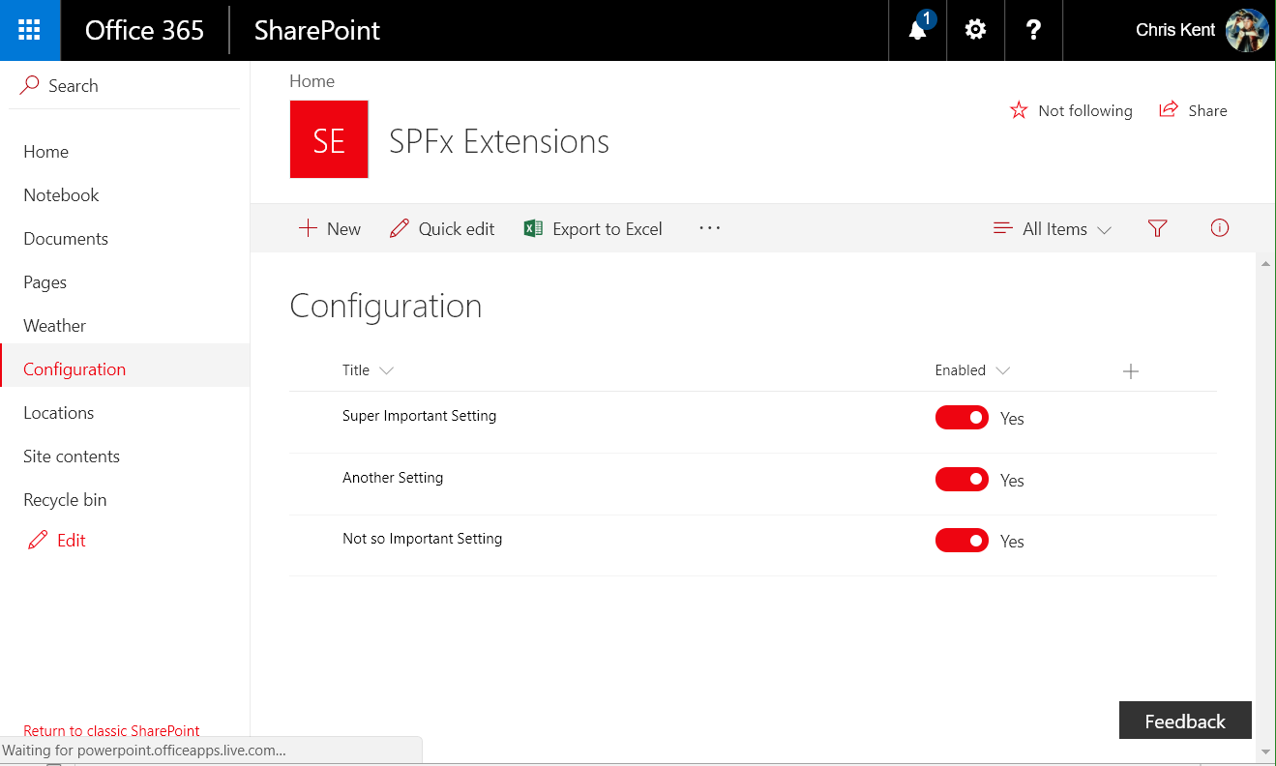
Notes:
Toggled!
Query String:
?loadSPFX=true&debugManifestsFile=https://localhost:4321/temp/manifests.js&fieldCustomizers={"Enabled":{"id":"972be477-1d2a-4656-a83a-63eb02552556","properties":{}}}

Slide 56
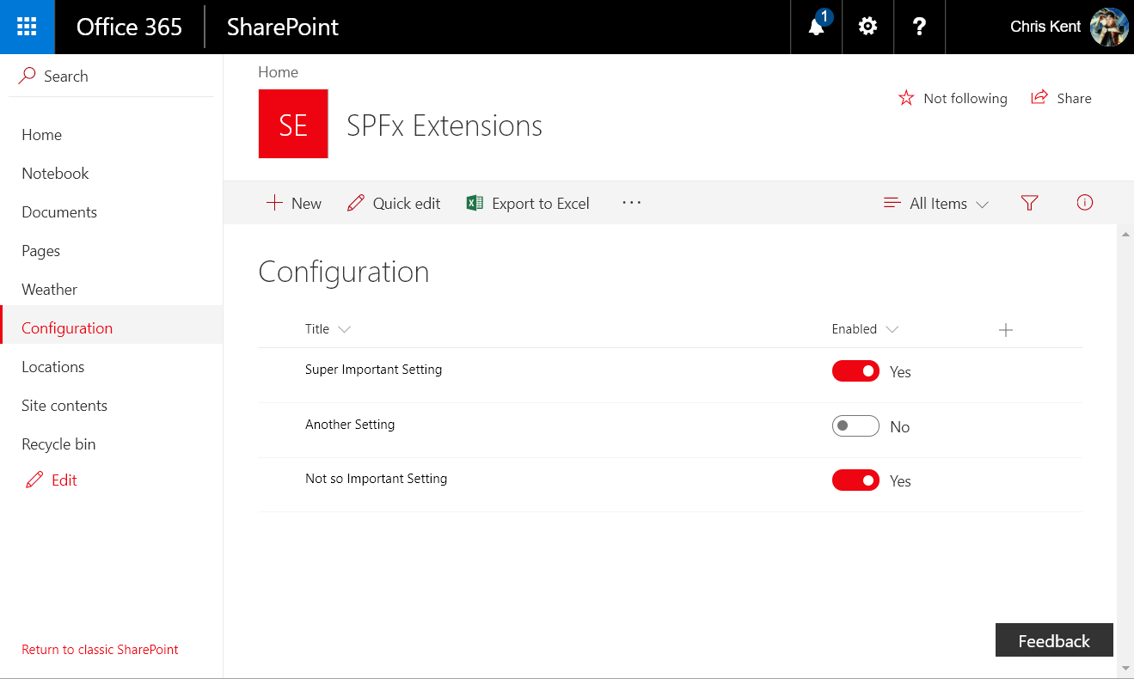
Notes:
You can switch the toggle right from the list view

Slide 57
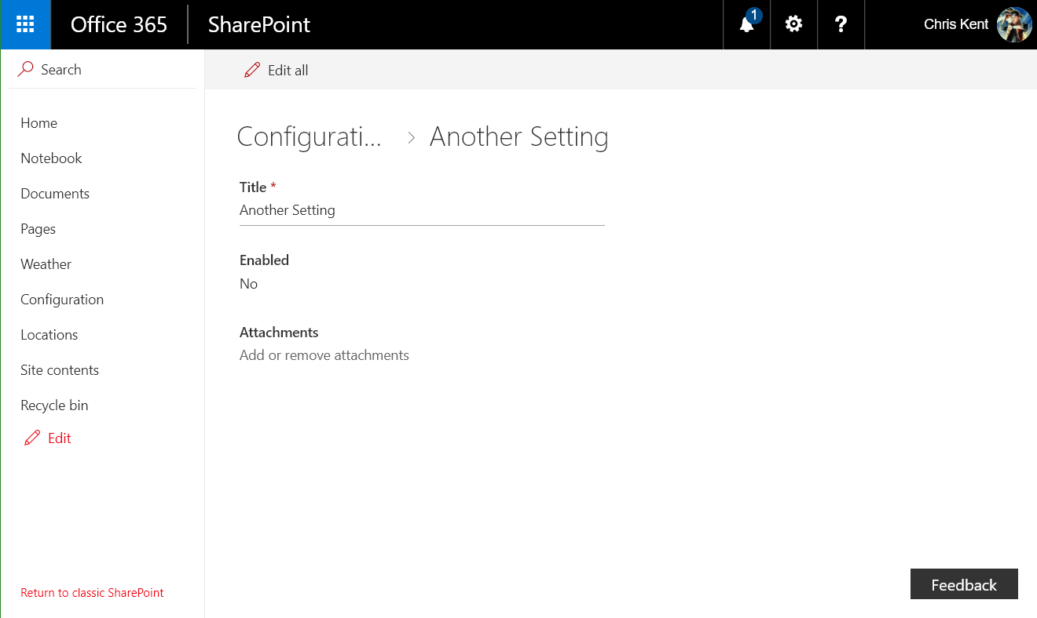
Notes:
The changes were actually applied!

Slide 58
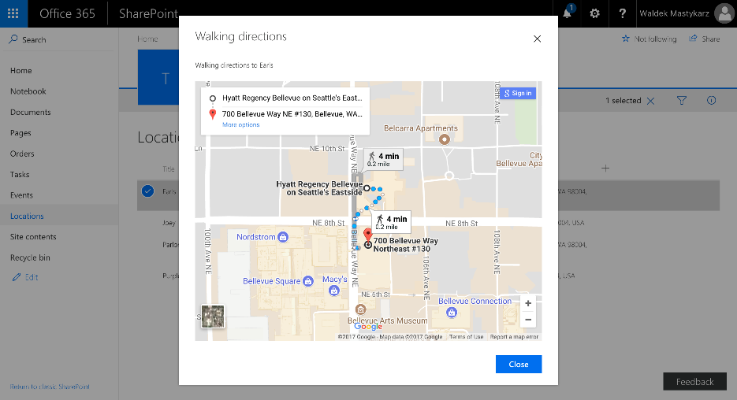
Directions Command
DEMO
ListView Command Set
Custom Dialog Component
Config Through Parameters
Conditional Command
Waldek Mastykarz
@waldekm

Slide 59
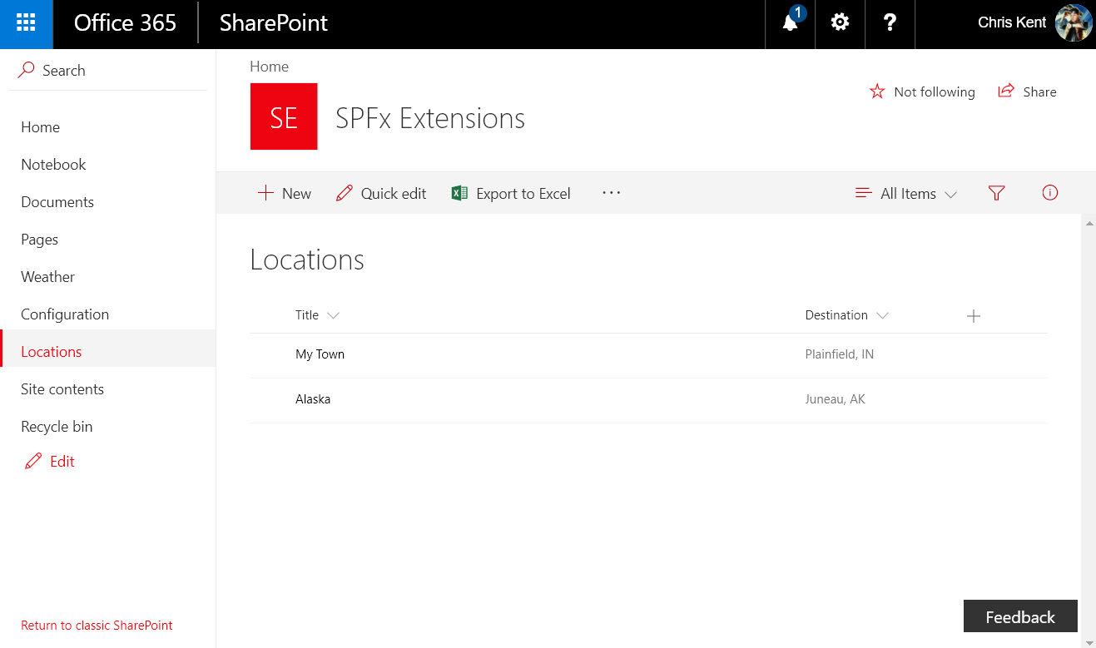
Notes:
The list view without the Command Set

Slide 60
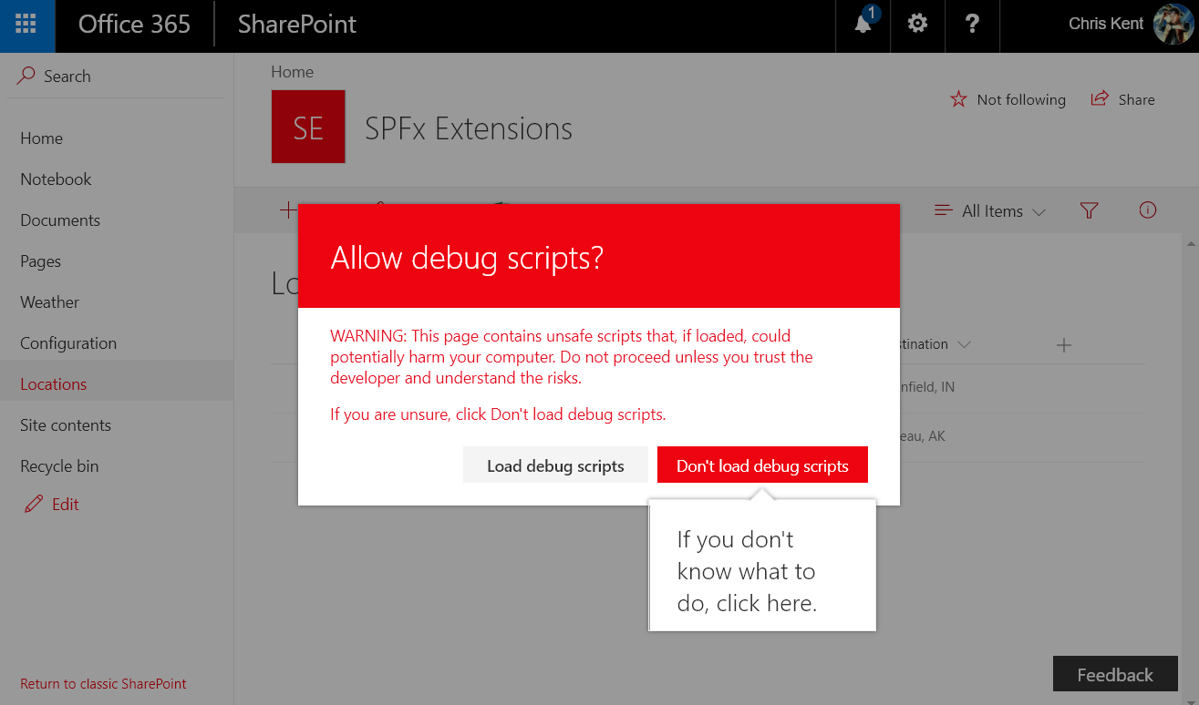
Notes:
The warning when using the debug query strings

Slide 61
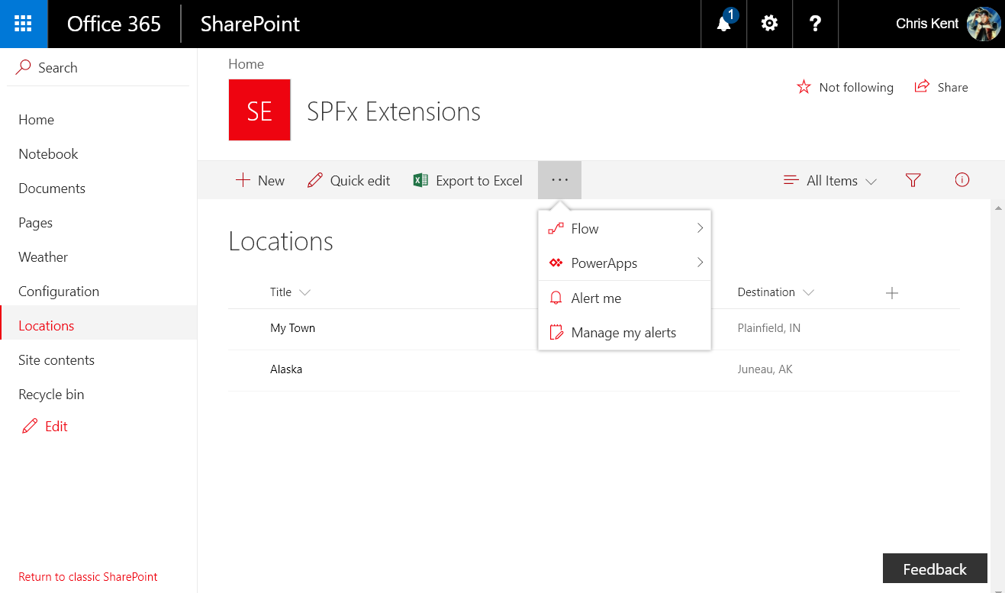
Notes:
The command set doesn’t show up until you’ve selected an item

Slide 62
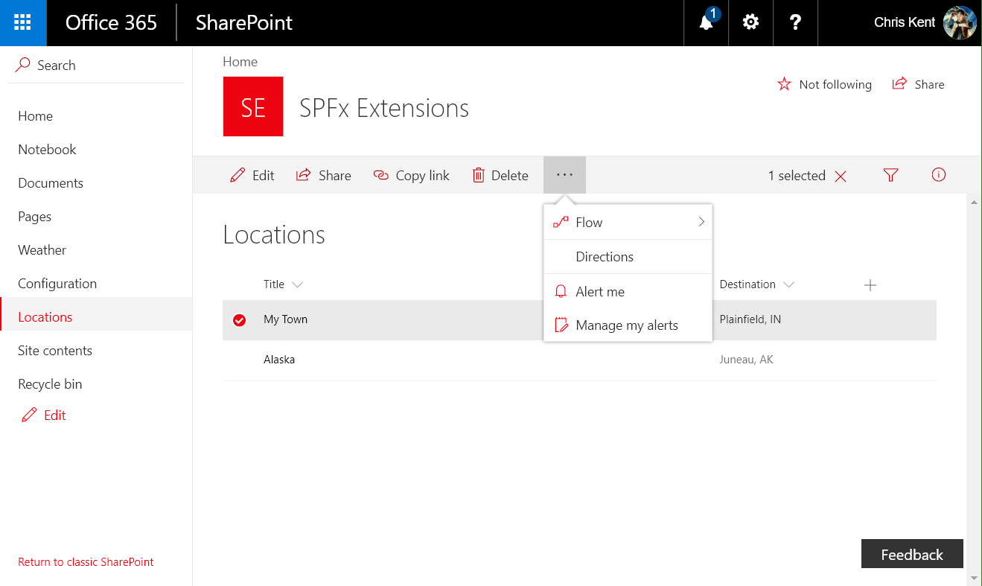
Notes:
The Directions command set
Query String:
?loadSPFX=true&debugManifestsFile=https://localhost:4321/temp/manifests.js&customActions={"0fdd064c-5ded-433c-9078-332226423322":{"location":"ClientSideExtension.ListViewCommandSet.CommandBar","properties":{"startingLocation":"Charlotte, NC","addressColumnName":"Destination","title":"All Roads Lead Home","message":"Directions to ","mode":"walking","mapsApiKey":“PROVIDE YOUR OWN GOOGLE MAPS API KEY HERE"}}}

Slide 63
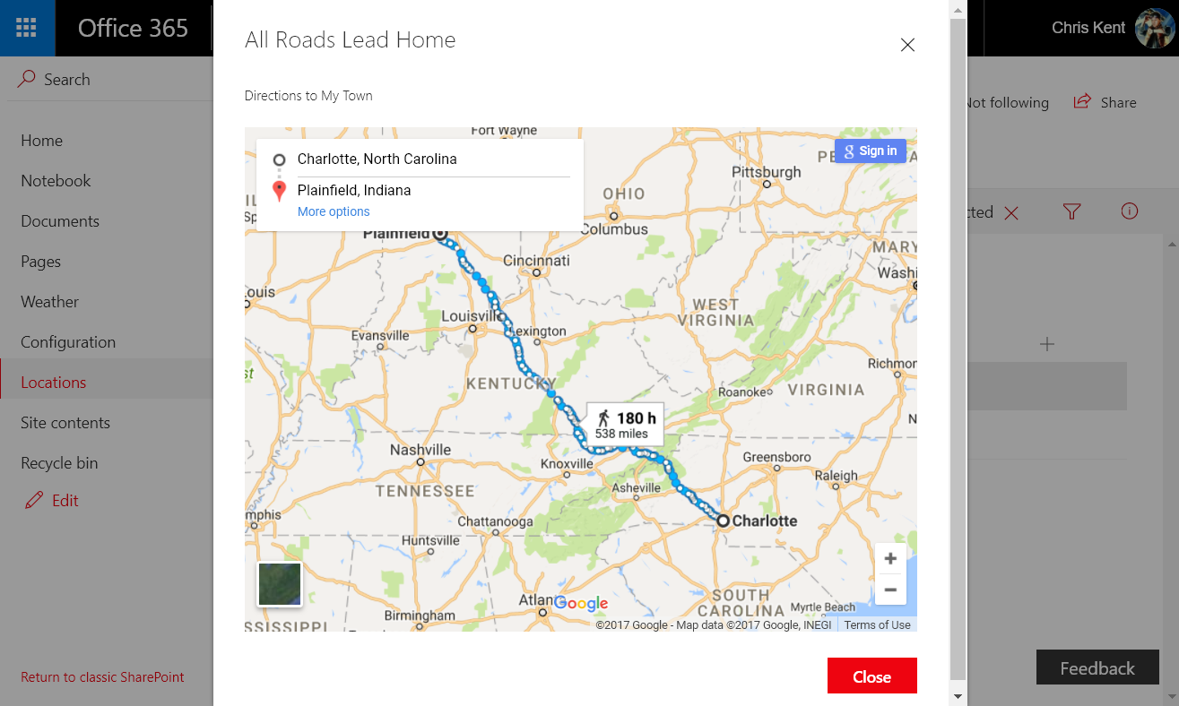
Notes:
Directions to Plainfield, IN!
Query String:
?loadSPFX=true&debugManifestsFile=https://localhost:4321/temp/manifests.js&customActions={"0fdd064c-5ded-433c-9078-332226423322":{"location":"ClientSideExtension.ListViewCommandSet.CommandBar","properties":{"startingLocation":"Charlotte, NC","addressColumnName":"Destination","title":"All Roads Lead Home","message":"Directions to ","mode":"walking","mapsApiKey":“PROVIDE YOUR OWN GOOGLE MAPS API KEY HERE"}}}

Slide 64
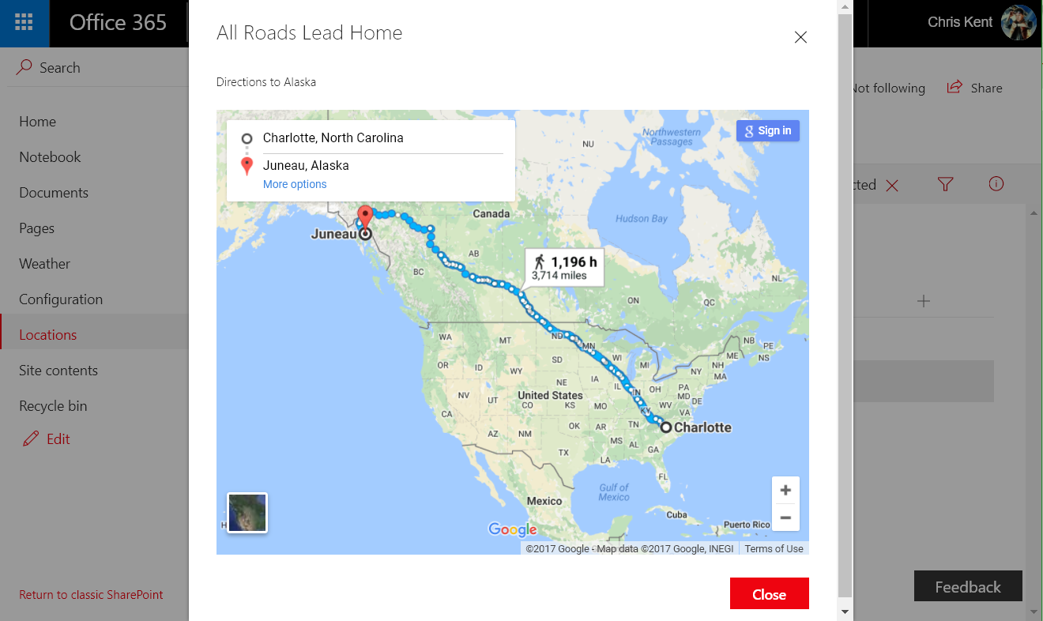
Notes:
Directions to Juneau, AK! Just a short walk.
Query String:
?loadSPFX=true&debugManifestsFile=https://localhost:4321/temp/manifests.js&customActions={"0fdd064c-5ded-433c-9078-332226423322":{"location":"ClientSideExtension.ListViewCommandSet.CommandBar","properties":{"startingLocation":"Charlotte, NC","addressColumnName":"Destination","title":"All Roads Lead Home","message":"Directions to ","mode":"walking","mapsApiKey":“PROVIDE YOUR OWN GOOGLE MAPS API KEY HERE"}}}

Slide 65
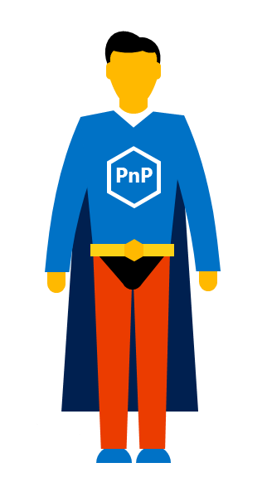
SharePoint Patterns & Practices (PnP)
Documentation
Guidance
  Tutorials
  Videos
  Samples
Tools
Reusable Components

Slide 66
What’s in PnP (Selective Highlights)
PnP Core - https://github.com/SharePoint/PnP-Sites-Core
PnP PowerShell - https://github.com/SharePoint/PnP-PowerShell
PnP Remote Provisioning - https://github.com/SharePoint/PnP-Provisioning-Schema
PnP JS-Core - https://github.com/SharePoint/PnP-JS-Core
SharePoint Docs - https://github.com/SharePoint/sp-dev-docs
SPFx Web Part Samples - https://github.com/SharePoint/sp-dev-fx-webparts
SPFx Extension Samples - https://github.com/SharePoint/sp-dev-fx-extensions
PnP Partner Pack - https://github.com/SharePoint/PnP-Partner-Pack
PnP Tools - https://github.com/SharePoint/PnP-Tools

Slide 67
Staying Up to Date with PnP
https://dev.office.com/pnp
Join the calls (or watch on YouTube later)
  https://www.youtube.com/channel/UC_mKdhw-V6CeCM7gTo_Iy7w
  Monthly Update call
  Bi Weekly Special Interest Groups
    JavaScript
    Core & PowerShell
Read the Updates
  http://dev.office.com/blogs
Visit the Tech Community
  http://aka.ms/sppnp-community

Slide 68

Attend “Part 2”
Modern UI Extensions with the SharePoint Framework – Command Sets, Application and Field Customizers
2:30 pm
Room 901
Andrew Connell
@andrewconnell

Slide 69

SharePint
Happy Hour after SPCLT

Slide 70
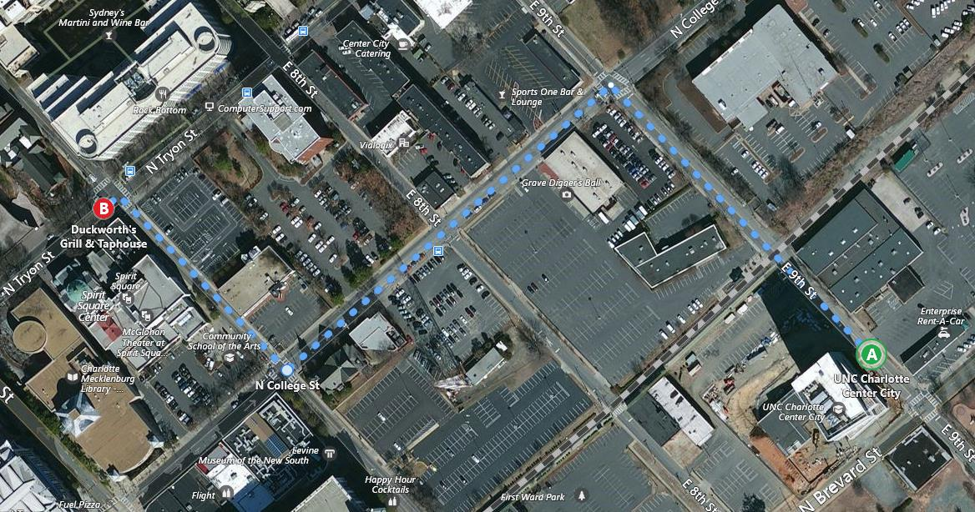

Getting to SharePint
Go East on 9th St.
Turn Left onto N College St.
Turn Right onto E 7th St.
Have a Good Time!
Notes:
Elaborate and Unnecessary!

Slide 71
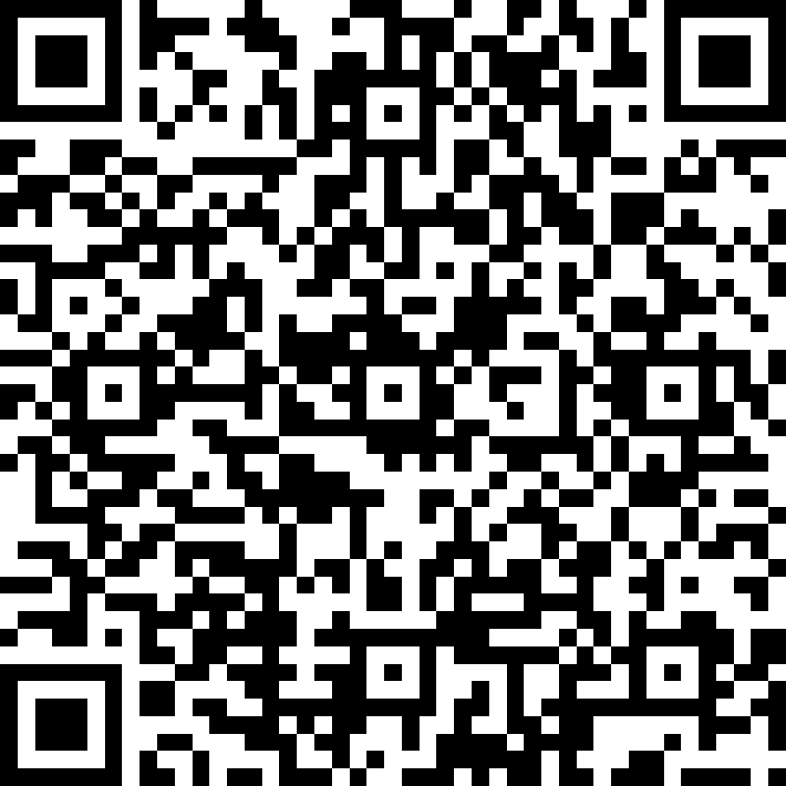
Session Survey
Thank You!
http://bit.ly/SPSCLT17-2

Slide 72

SharePoint Release History
SharePoint
Portal Server 2001
SharePoint
Portal Server 2003
Office SharePoint
Server 2007
SharePoint
Server 2010
SharePoint
Server 2013
SharePoint
Server 2016
2001
2003
2006
2009
2012
2016
Microsoft
Managed Solutions
Microsoft
Online Services
Office 365
Core
Collaboration
Content
Management
Cloud and Enterprise
Social
Cloud-Inspired
Experiences

Slide 73
SharePoint Framework Governance
Strive for a simple (1-2 pages) document that outlines the following
For Customers | For Developers
Standardize Client-side libraries | Development practices
External scripts policy | Testing approach
Hosting location | Deployment to production
Explicit agreements with ISVs | Updates and support

Slide 74











Office UI Fabric
Standardized Iconography, Fonts, & Colors
Responsive Grid System
Reusable Components
Powers OOTB Experiences
Fonts, icons
Colors
Components
Grid
Office 365 Consumers
SharePoint
Delve
Project
OneDrive
Office 365
Outlook

Slide 75

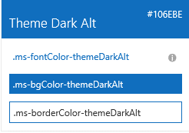

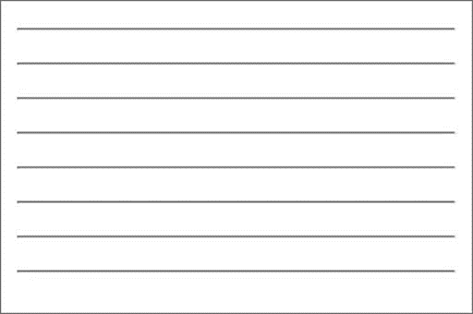

Fabric Core styling
Fonts and typography
Segoe font family + type ramp, official Office 365 iconography
Color
Official Office 365 color palette
Branded assets
Product symbols + product filetype symbols
Animations
Official Office 365 selection of easings and animations
Responsive grid
Tailored to Office 365 silhouettes

Slide 76
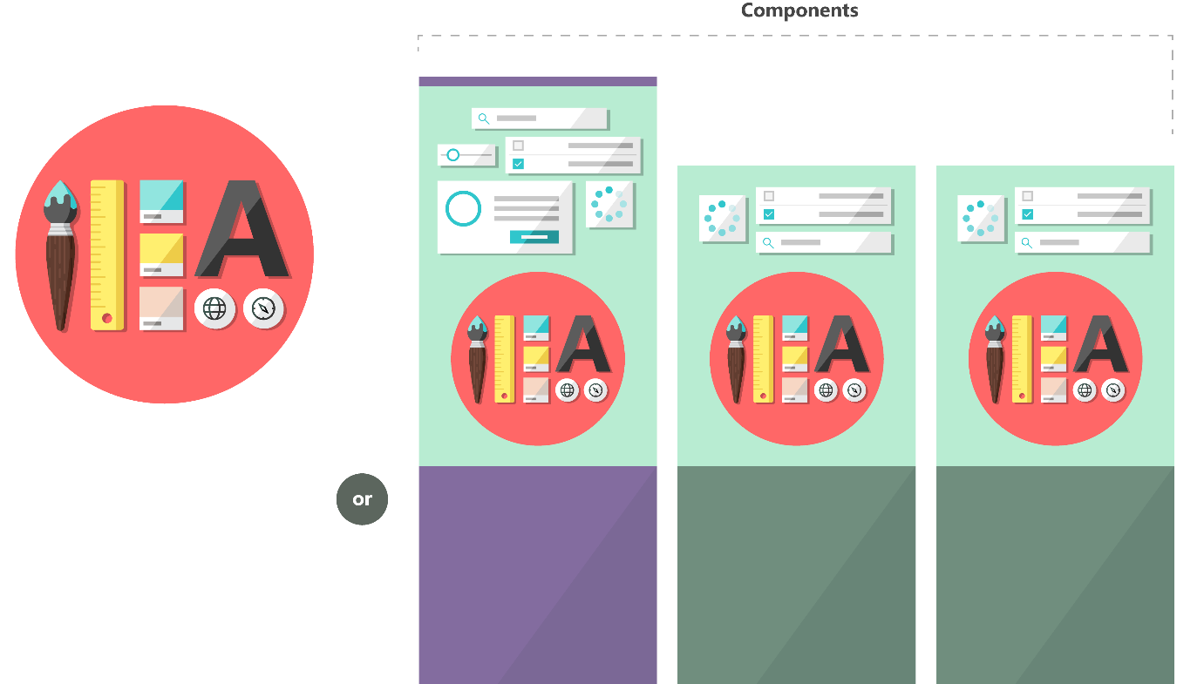

Fabric and its sub-projects
All depending on the Core, all open source
Community built
Fabric Core
Fabric React
Fabric JS
ngFabric
Fabric iOS
Core elements of the design language including icons, colors, type, and the grid
Robust, up-to-date components built with the React framework.
Simple, visuals-focused components that you can extend, rework, and build on.
Community-driven project to build components for Angular-based apps.
Native Swift colors, type ramp, and components for building iOS apps.

Slide 77



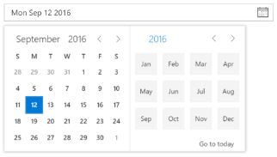
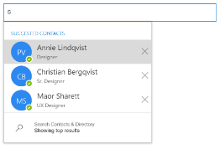
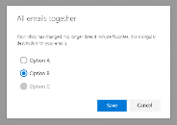
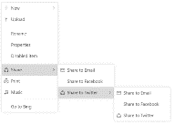
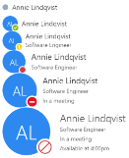
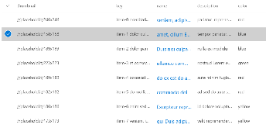



Fabric components - overview
Inputs
Buttons, textfields, dropdowns, etc.
Pickers
DatePicker, PeoplePicker
Layout
CommandBar, Dialogs, ContextualMenu, Callout, Panel
Content and People
Lists, Personas, FacePile
Informational
ProgressIndicator, Spinner, MessageBar

Slide 78
Additional Resources
Getting a Developer Tenant for Office 365
  https://dev.office.com/sharepoint/docs/spfx/set-up-your-developer-tenant
Overview of the SharePoint Framework
  https://dev.office.com/sharepoint/docs/spfx/sharepoint-framework-overview
SharePoint Framework Roadmap
  https://dev.office.com/sharepoint/docs/spfx/roadmap
Office Dev Patterns and Practices (PnP)
  https://dev.office.com/patterns-and-practices
SharePoint Framework Code Samples (PnP)
  https://dev.office.com/code-samples#?filters=sharepoint%20framework%20app
SharePoint Framework CRUD Samples
  https://blog.mastykarz.nl/sharepoint-crud-operations-sharepoint-framework-client-side-web-parts/
SharePoint Framework Reference
  https://dev.office.com/sharepoint/reference/spfx/sharepoint-framework-reference-overview
PnP JS Core
  https://github.com/SharePoint/PnP-JS-Core

