Slide 1




Me
@theChrisKent
theChrisKent.com

Slide 2

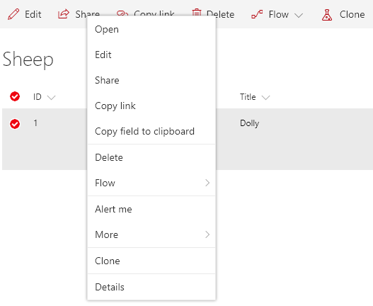

ListView Command Sets
Adds 1 or more Commands to a modern List View
Commands can be added to:
  Context Menu
    ClientSideExtension.ListViewCommandSet.ContextMenu
  Command Bar
    ClientSideExtension.ListViewCommandSet.CommandBar
  Both
    ClientSideExtension.ListViewCommandSet
https://github.com/SharePoint/sp-dev-fx-extensions

Slide 3


JS Command Clone
Command that allows users to Clone one or more list items
Loads PnP JS Core from a CDN
Conditionally shows based on
  Number of selected rows
  User’s permission level
Batches Get requests for list items
Adds multiple items in a single Batch
Field specific formats for REST operations
https://github.com/SharePoint/sp-dev-fx-extensions/tree/master/samples/js-command-clone

Slide 4

Code Flow
Loads sp-pnp-js from CDN
onInit
  Builds Field Exclusions
  Initializes PnP JS Core with the spfxContext
onListViewUpdated
  Sets visibility based on selectedRows && addListItems permission
onExecute
  Ensures the List Schema (Fields)
  Gets all the field values for each of the selected items (Batched)
  Translates the result values to be used for adding
  Adds copies of each of the selected items (Batched)
  Refreshes the page (Someday just the list view)
Behold the power of SCIENCE!

Slide 5
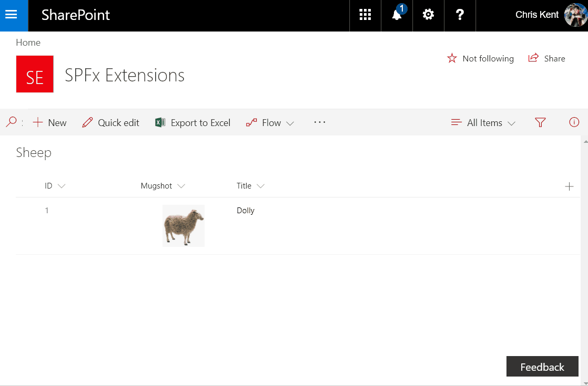
Notes:
Makin’ Sheep!
Query String:
?loadSPFX=true&debugManifestsFile=https://localhost:4321/temp/manifests.js&customActions={"bf6645bd-42e4-4a30-aad7-6ff12d61fa1f":{"location":"ClientSideExtension.ListViewCommandSet"}}

