Slide 1

S
harePoin
t
Patterns & Practices
SharePoint Practice Lead
Director of Platform Solutions
CHRIS KENT
MATT JIMISON

Slide 3

Agenda
Mee-OW!
Title Slide
Agenda
Me reading the agenda to you

Slide 4
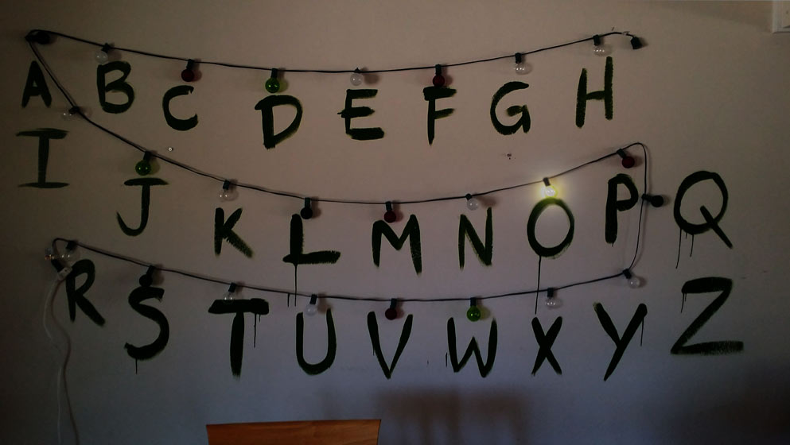
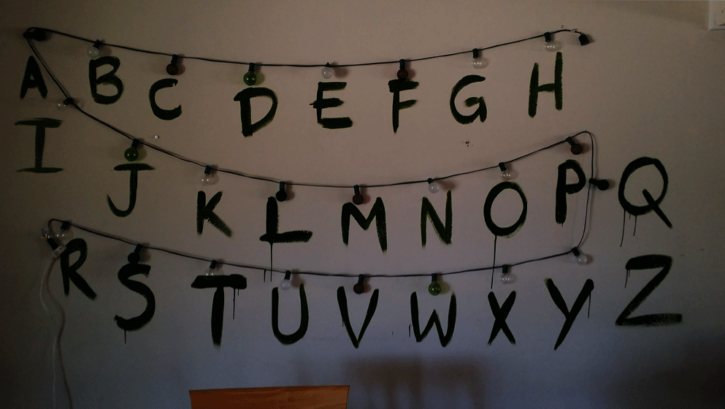
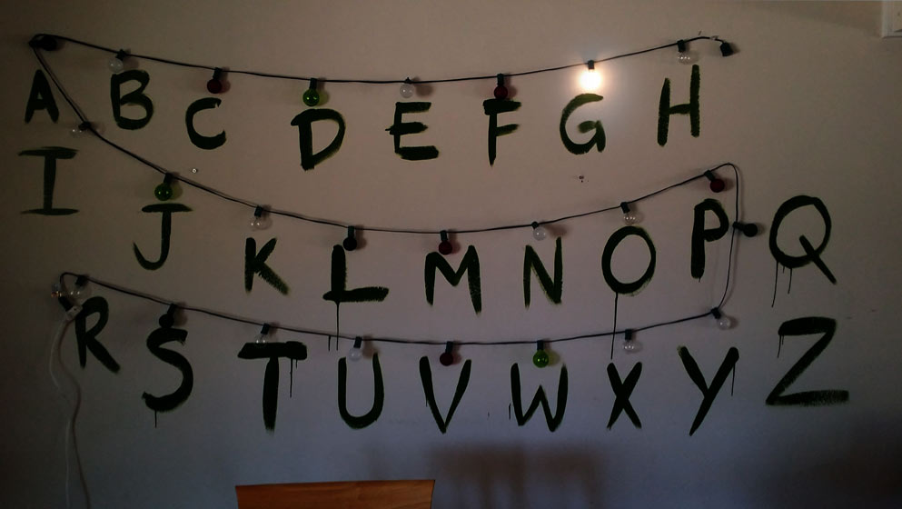
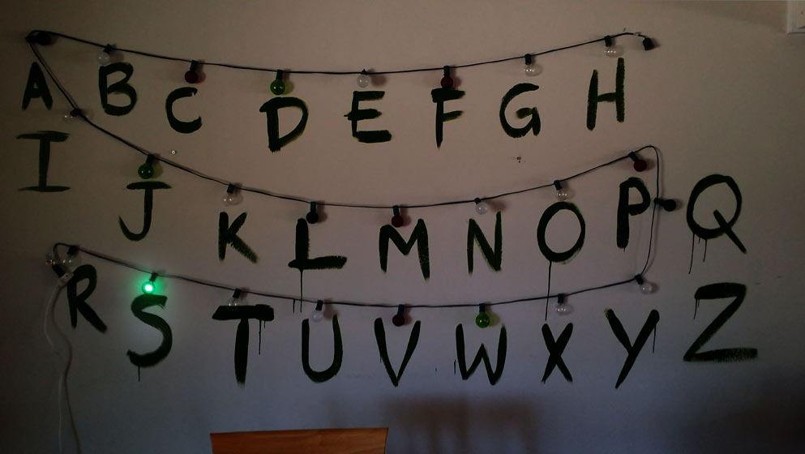
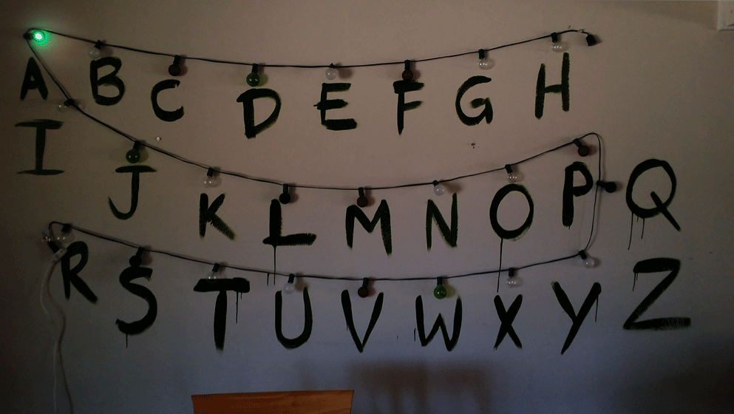
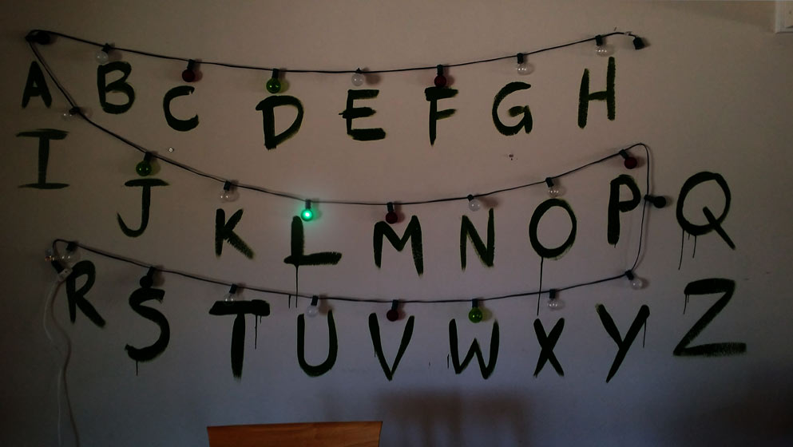
GOALS

Slide 6
Patterns & Practices
Why | What | How

Slide 7
Staying INFORMED
Videos | Calls | Updates

Slide 8
SHARING IS CARING
How to Contribute

Slide 10





Chris Kent
@theChrisKent
theChrisKent.com
Notes:
Can I possibly get my name on a single slide even more? Wow.

Slide 11



Matt Jimison
@mjimison
MattJimison.com

Slide 12

dminc.com
Notes:
We work for them! Wow!

Slide 13




Our Personal
Areas of Contribution
Documentation
Grammar Fixes
Updates
Samples
WebParts
Application Customizers
Field Customizers
ListView Command Sets
Presentations
Internal
External
SIG Calls
Code
Bug Fixes
New Features
Issue Submission

Slide 14
Our Personal
Areas of Contribution
- Official PnP Repositories -
SP-Dev-Docs
SharePoint Developer Documentation
SP-Dev-Fx-Extensions
SPFx Extension Code Samples
SP-Dev-Fx-Property-Controls
Reusable SPFx Property Pane Controls
PnP-JS-Core
JS Core Component for SP Rest and MS Graph
PnP-PowerShell
SP/O365 PnP PowerShell CmdLets
PnP-Guidance
PnP Guidance for MSDN
- Other Areas -
SPFx WebParts, Client Side Rendering, VS Code Debugging, Remote Provisioning, Traditional SP Development, etc.

Slide 15


HUMAN NEEDS FOR FELLOW HUMANS
Questions
OTHER HUMAN NEEDS
Slides will be Available on our
websites

Slide 16









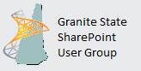

Thanks to our Sponsors

Slide 17
@SPSNewEngland
#SPSNE

Slide 18
Audience Participation!
Your
Role(s)
IT Pro
Versions of SharePoint
2003
Experience with PnP
Huh?
PnP Interest
None
Management
Developer
Other
2007
2010
2013
2016
O365
None
Heard of it
Used 1 or more parts
Contributor
Not Sure
SPFx Guidance
Use it all the time!
Remote Provisioning
PnP PowerShell
Samples
Tools

Slide 19

SharePoint
Patterns & Practices
Learn. Reuse. Share.

Slide 20

Wouldn’t it be great, if you had peers to share with and learn from?

Slide 21


Practical lessons shared by the community for the community

Slide 22
Learn
Reuse
Share

Slide 25
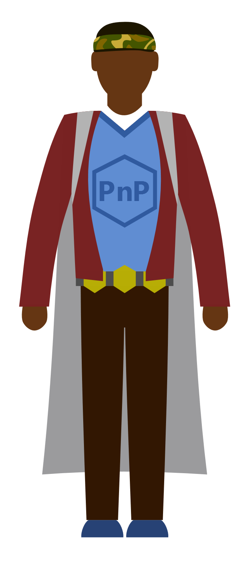
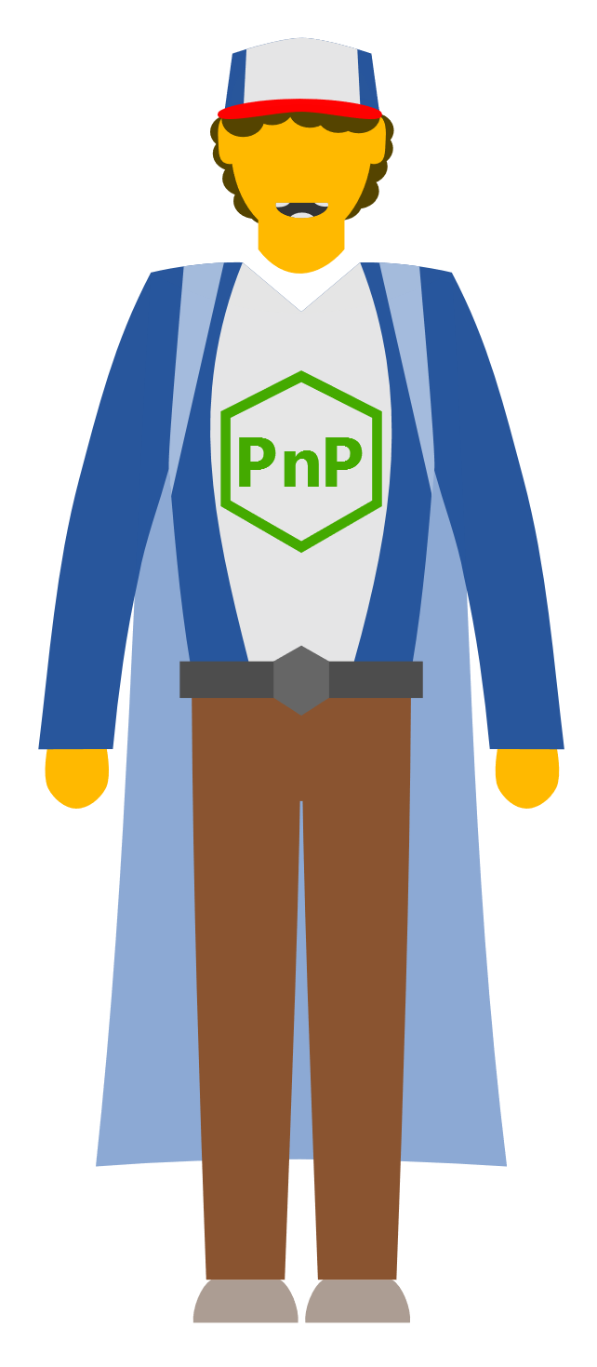
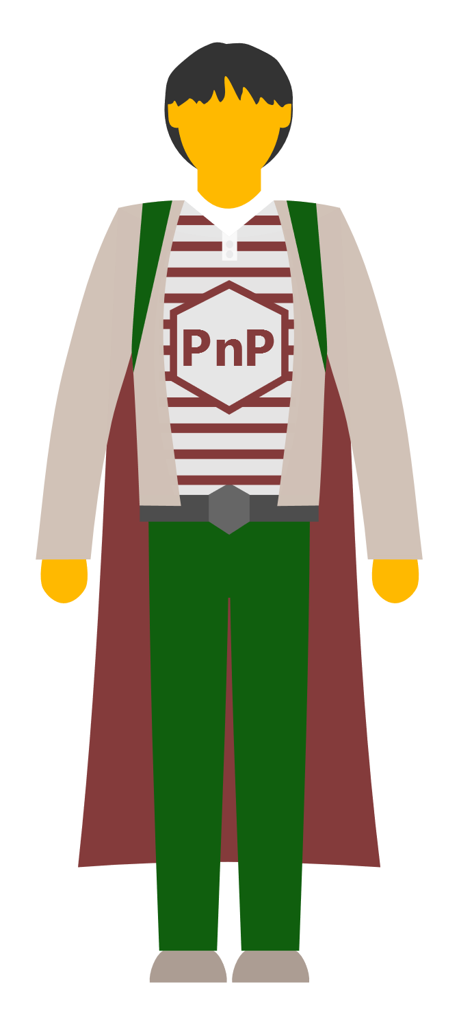
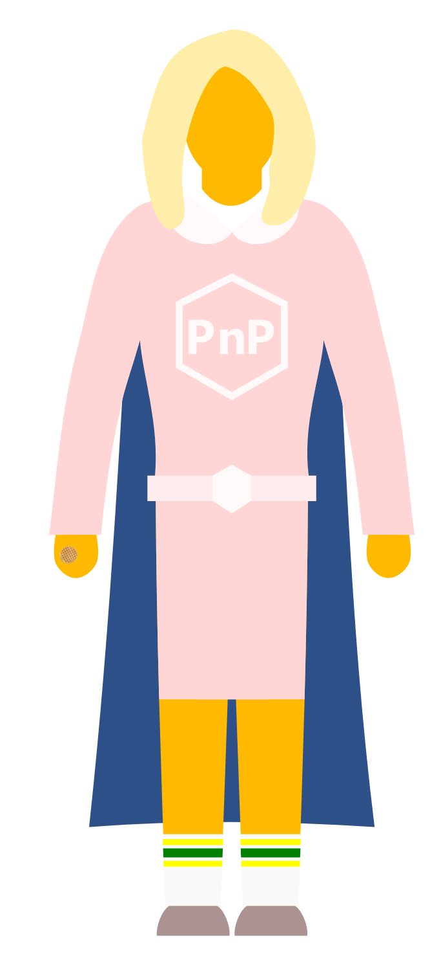

Slide 27
SharePoint
Patterns and Practices
He put himself in danger to help the party.
What does it mean Practically speaking?!

Slide 28

“The SharePoint Patterns and Practices (PnP) is an open source initiative coordinated by SharePoint engineering”
Libraries
Reusable Components
Tutorials
Videos
Samples
Documentation

Slide 29
2013
Internal
Internal initiative in Microsoft to start collecting learnings from add-in model
2014
Going public
Going first public in CodePlex, then moved to GitHub. Concentration on add-in model enterprise scenarios.
2015
Reusability
PnP Provisioning Engine introduced. Reusable components and solutions, like PnP Partner Pack introduced. Weekly webcasts started.
2016
Partnership
PnP ownership moved to engineering, team works with a partnership on aligning roadmap. Work with SP Framework starts.
2017
Integration
SharePoint Dev Ecosystem = SharePoint PnP. End-to-end coordination of the SharePoint development guidance and community activities.
More than 4.2 billion requests using PnP reusable controls during August 2017-
More than 250 samples to learn from and take advantage of in your work
More than 300 contributors in SharePoint GitHub organization.
More than 29,000 unique
visitors during past 2 weeks in SharePoint organization repositories
More than 20,000 tenants have used PnP reusable components and controls in SharePoint Online.

Slide 30
PnP Components
This is the monster killer!
A Selective Tour through the PnP Wonderland

Slide 31
What’s in PnP (Selective Highlights)
PnP Core - https://github.com/SharePoint/PnP-Sites-Core
PnP PowerShell - https://github.com/SharePoint/PnP-PowerShell
PnP Remote Provisioning - https://github.com/SharePoint/PnP-Provisioning-Schema
PnP JS-Core - https://github.com/SharePoint/PnP-JS-Core
SharePoint Docs - https://github.com/SharePoint/sp-dev-docs
SPFx Web Part Samples - https://github.com/SharePoint/sp-dev-fx-webparts
SPFx Extension Samples - https://github.com/SharePoint/sp-dev-fx-extensions
PnP Partner Pack - https://github.com/SharePoint/PnP-Partner-Pack
PnP Tools - https://github.com/SharePoint/PnP-Tools

Slide 32

Tenant Administration
(inc. groups and users)
Configure SP Programmatically
To learn more:
Get-Help
Remote Provisioning
What Can You Do With:
PNP PowerShell

Slide 33
PnP-PowerShell Cmdlets
240+ CmdLets
Apps (3)
Base Cmdlets (12)
Branding (18)
Client-Side Pages (8)
Content Types (9)
Document Sets (5)
Event Receivers (3)
Features (4)
Fields (7)
Files and Folders (18)
Information Management (4)
Lists, Views, & Items (18)
Microsoft Graph (5)
Provisioning (13)
Publishing (13)
Records Management (6)
Search (4)
SharePoint Recycle Bin (5)
SharePoint WebHooks (4)
Sites (9)
Taxonomy (17)
Tenant Administration (9)
User and Group Management (11)
User Profiles (3)
Utilities (1)
Web Parts (7)
Webs (17)
Workflows (8)
https://github.com/SharePoint/PnP-PowerShell/blob/master/Documentation/readme.md

Slide 34

Important Basic Cmdlets
Cmdlet | Description | Platforms
Connect-PnPOnline | Connects to a SharePoint site and creates a context that is required for other PnP Cmdlets (Do this first) | All
Disconnect-PnPOnline | Disconnects the context (Do this last) | All
Get-PnPContext | Returns a Client Side Object Model context | All
Connect-PnPOnline https://mytenant.sharepoint.com/sites/MySite -CurrentCredentials

Slide 35
Demo: PnP PowerShell

Slide 36

PnP Provisioning Engine
Uses the Client Side Object Model (CSOM) to provision artifacts instead of using the Feature Framework
  Removes the need to use declarative XML!
Can use the SharePoint UI to create artifacts
Creates a Template file
  XML with resources, or a PnP archive
Site Columns
Content Types
List Definitions & Instances
Data Rows
Composed Looks
Pages

Slide 37

Remote Provisioning Supported Environments
SharePoint 2013
  Minimum required version: April 2015 CU
  Full functionality required version: January 2016 CU
SharePoint 2016
SharePoint Online
  Best Coverage
  Includes full support for SPFx Web Parts & extensions
  Modern pages can be created, but not exported (yet)

Slide 38

Important Provisioning Cmdlets
Cmdlet | Description | Platforms
Get-PnPProvisioningTemplate | Generates a provisioning template from a web | All
Apply-PnPProvisioningTemplate | Applies a provisioning template to a web | All
Connect-PnPOnline https://mytenant.sharepoint.com/sites/MySite -CurrentCredentials
Get-PnPProvisioningTemplate -Out MyTemplate.xml
Disconnect-PnPOnline

Slide 39
Demo: Remote
Provisioning

Slide 40

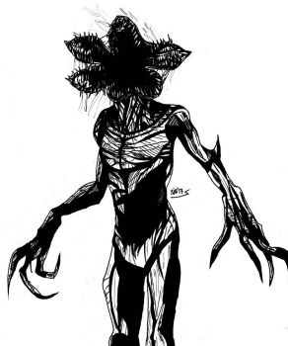
Fluent API
Caching
Batching
SP-PNP-JS
What Is:

Slide 41

Demo: SP-PNP-JS

Slide 42
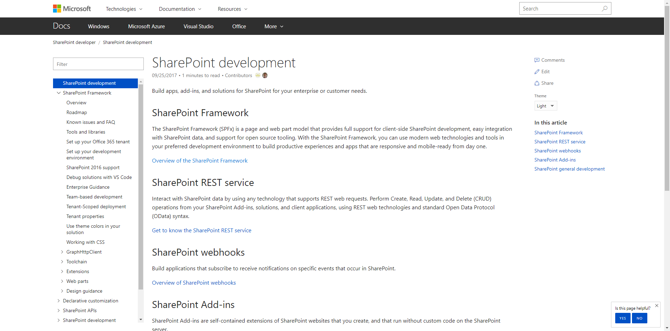
Documentation and guidance
aka.ms/spdev-docs
  Consolidated location for documentation and guidance
  SharePoint Framework, including API reference
  SharePoint add-ins
  Declarative customizations, etc.

Slide 43

Documentation and guidance
aka.ms/spdev-docs
  Consolidated location for documentation and guidance
  SharePoint Framework, including API reference
  SharePoint add-ins
  Declarative customizations, etc.
Great spot to start contributing!

Slide 44

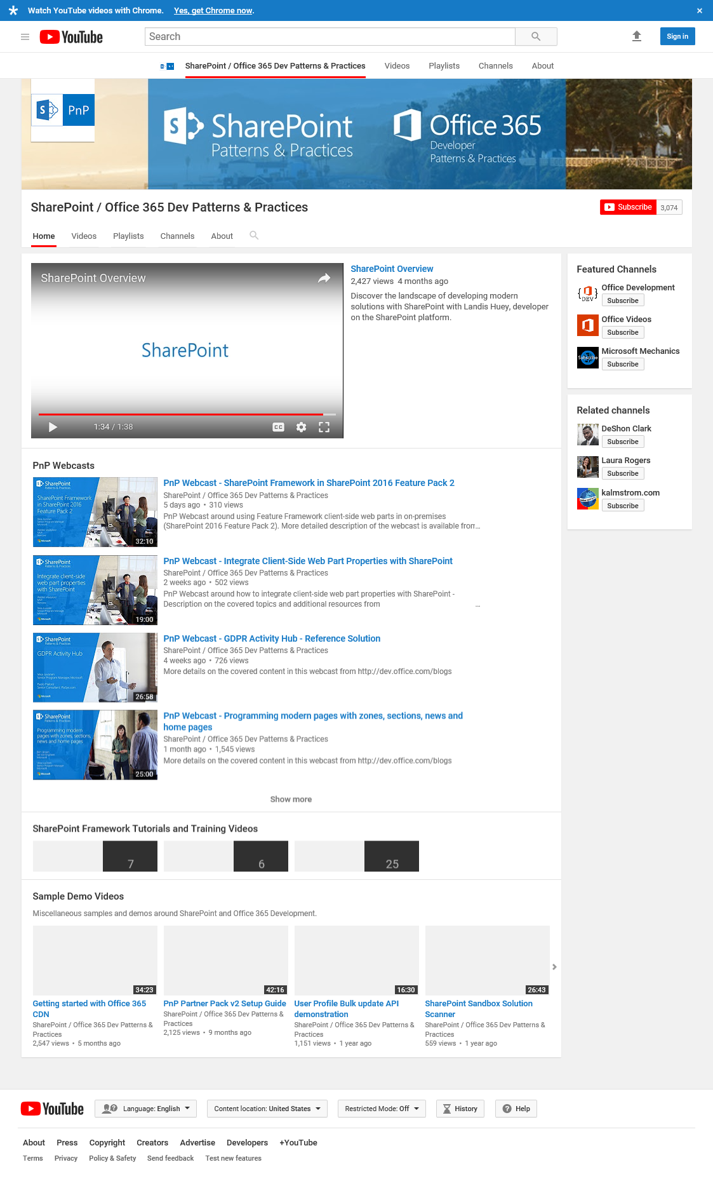

Videos &
Webcasts
aka.ms/spdev-videos
200+ Videos!
  Web cast recordings
  Quick Guidance Videos
  Tutorial Videos
  Training Videos
  Weekly and monthly community call recordings

Slide 45

What if I told you there are hundreds of examples and solutions to learn from and reuse?

Slide 46
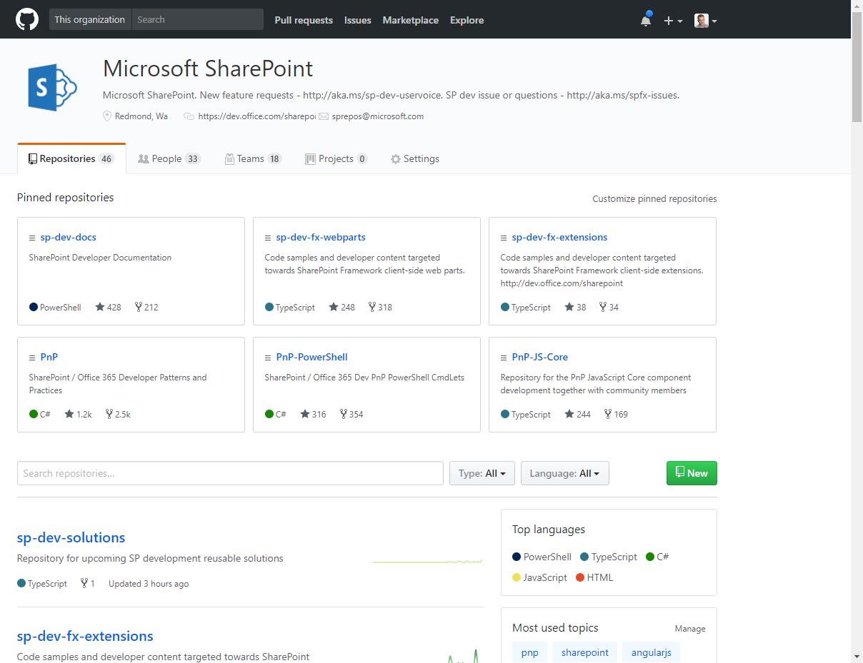
Samples and
Solutions
github.com/sharepoint
300+ Samples!
  SharePoint Framework
  Provider hosted Add-ins
  Reusable controls and components
  PnP PowerShell and Scripts
  Build extensions

Slide 47
Staying Informed
Why are you keeping this curiosity door locked?
Keeping up to date with PnP

Slide 48
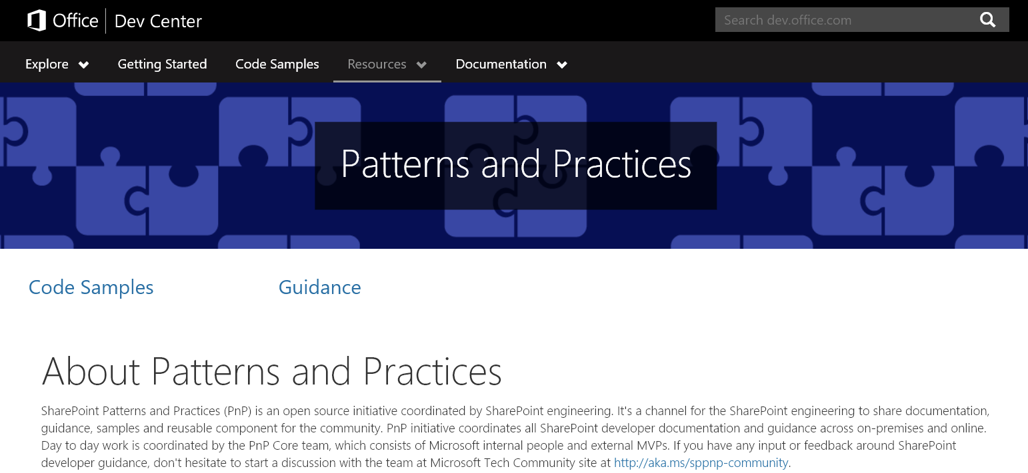
aka.ms/sppnp

Slide 49

Join the Calls! aka.ms/sppnp-videos
  Monthly Update call
  Bi Weekly Special Interest Groups
    JavaScript & SPFx
    Core & PowerShell

Slide 50



CONSUME & INTERACT
Official Blog
dev.office.com/blogs
Twitter
@OfficeDevPnP
Tech Community
aka.ms/sppnp-community
Also
@thechriskent
@mjimison

Slide 51
Sharing is Caring
Friends don’t lie.
Contributing to Patterns and Practices

Slide 52


How to participate to the PnP initiative?
Get visibility in the internal and external community
Help others on their journey to recommended patterns
Find peers who work on similar topics and engage with customers and partners also using this channel
Report and fix issues
Contribute with new samples, guidance and documentation
Participate on the discussion around needed capabilities
aka.ms/SPPnP
Microsoft
Tech
Community

Slide 53


























Why contribute?
Get acknowledged as contributors in communications
  dev.office.com blog posts
  Monthly community calls
  MSDN pages
Help others by sharing your knowledge of Office 365 and SharePoint development

Slide 54
Demo: Contribution

Slide 55
S
harePoin
t
Patterns & Practices
SharePoint Practice Lead
Director of Platform Solutions
CHRIS KENT
MATT JIMISON

