Slide 1

S
harePoin
t
Framework
GETTING STARTED
SharePoint Practice Lead
CHRIS KENT

Slide 3

Agenda
Title Slide
Agenda
Me reading the agenda to you

Slide 4




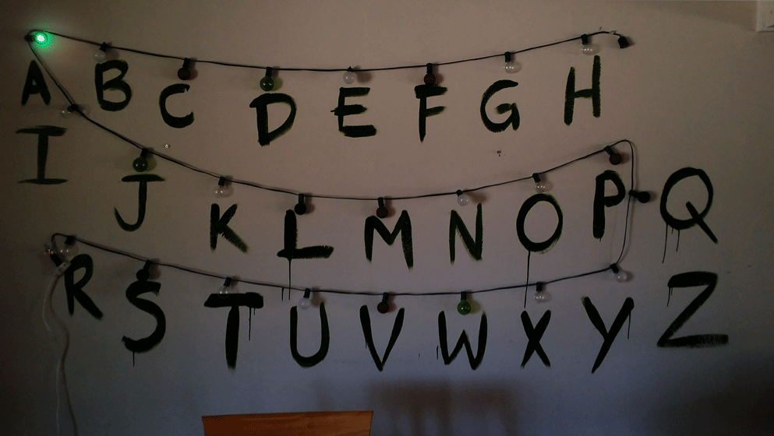

GOALS

Slide 6
SharePoint Framework
What it is | When to use it

Slide 7
SharePoint Framework
EXTENSIONS
Know the Types | Purpose

Slide 8
SharePoint Framework development
Setup | Tooling | Quick Tips

Slide 9
Patterns
And
Practices
Samples | Guidance

Slide 11






Chris Kent
@theChrisKent
theChrisKent.com
#SPSDetroit
Notes:
Can I possibly get my name on a single slide even more? Wow.

Slide 12

dminc.com
Notes:
We work for them! Wow!

Slide 13




HUMAN NEEDS FOR FELLOW HUMANS
Questions
OTHER HUMAN NEEDS
Slides will be Available on my
website
Survey
You will need to be connected to the Internet (WSU-Public)
Follow the Steps

Slide 14












PLATINUM
SILVER
Thank you to our
Sponsors
BRONZE
#SPSDetroit

Slide 15
@SPSDetroit_2017
#SPSDetroit

Slide 16
Audience Participation!
Your
Role(s)
IT Pro
Versions of SharePoint
2003
Experience with SPFx
Huh?
SPFx Plans?
None
Management
Developer
Other
2007
2010
2013
2016
O365
None
Heard of it
Messed with it
Made something in Production
Extensions and More!
Not Sure
SP 2016
O365

Slide 18

1. Installing NodeJS LTS
https://nodejs.org
If already installed, check version with:
  node -v .
  If using a Mac, use homebrew to install and manage
SPFx Build Pipeline does NOT support npm v5.x!
Use npm v3 or v4
NodeJS LTS (v6.11.4) installs 3.x so just don’t update it
Homebrew (Macs Only)
  http://brew.sh
https://dev.office.com/sharepoint/docs/spfx/set-up-your-development-environment
#SPSDetroit

Slide 19


2. Installing VS Code
https://code.visualstudio.com
Recommended Extensions
Debugger for Chrome
VSCode Great Icons
Import Cost
Instant Markdown
You can also use
  Atom
  Webstorm
  Visual Studio
  Notepad
Runs on Mac and Linux too
https://dev.office.com/sharepoint/docs/spfx/set-up-your-development-environment
1. NodeJS LTS: nodejs.org

Slide 20














SharePoint Development
A Brief History
1. NodeJS LTS: nodejs.org | 2. VS Code: code.visualstudio.com

Slide 21






SharePoint as a Platform
Branding
User Experience
Business Intelligence
APIs
Processes
Packaging & Deployment
1. NodeJS LTS: nodejs.org | 2. VS Code: code.visualstudio.com

Slide 22






SharePoint as a Platform
1. NodeJS LTS: nodejs.org | 2. VS Code: code.visualstudio.com

Slide 23

SharePoint as a Platform
SP 2010
On-Premises Only
Recent
Excel Services
PowerPivot
Reporting Services
CSOM & JSOM
2010 Workflows
Themes
Web Services
Alternate CSS
PerformancePoint
Declarative Sandbox
Server Side APIs
OOTB Web Parts
Event Receivers
.NET Sandbox
InfoPath & SPD
SSIS
Full Trust Solutions
Custom Master Page
1. NodeJS LTS: nodejs.org | 2. VS Code: code.visualstudio.com

Slide 24
SharePoint as a Platform
SP 2013
On-Premises Only
Recent
Power BI
Excel Services
PnP PowerShell
PnP Provisioning
Client Side Rendering
PowerPivot
REST
2013 Workflows
PnP Partner Pack
Reporting Services
CSOM & JSOM
2010 Workflows
Themes
Custom Actions
Add-ins
Web Services
Remote Event Receivers
Alternate CSS
Add-in Parts
PerformancePoint
Declarative Sandbox
Server Side APIs
Composed Looks
OOTB Web Parts
Event Receivers
.NET Sandbox
JS Injection
InfoPath & SPD
SSIS
Full Trust Solutions
Custom Master Page
ASP.NET 4.5 Integration
1. NodeJS LTS: nodejs.org | 2. VS Code: code.visualstudio.com

Slide 25
SharePoint as a Platform
SP2016
On-Premises Only
Recent
SPFx
Power BI
SPFx Client Side Solutions
Excel Services
PnP PowerShell
PnP Provisioning
Client Side Rendering
PowerPivot
REST
2013 Workflows
PnP Partner Pack
Reporting Services
CSOM & JSOM
2010 Workflows
Themes
Custom Actions
Add-ins
Web Services
Remote Event Receivers
Alternate CSS
Add-in Parts
PerformancePoint
Declarative Sandbox
Server Side APIs
Composed Looks
OOTB Web Parts
Event Receivers
.NET Sandbox
JS Injection
InfoPath & SPD
SSIS
Full Trust Solutions
Custom Master Page
ASP.NET 4.5 Integration
1. NodeJS LTS: nodejs.org | 2. VS Code: code.visualstudio.com

Slide 26
SharePoint as a Platform
Not Recommended
On-Premises Only
On-Prem Opts
SPFx
Power BI
SPFx Client Side Solutions
Excel Services
PnP PowerShell
PnP Provisioning
Client Side Rendering
PowerPivot
REST
2013 Workflows
PnP Partner Pack
Reporting Services
CSOM & JSOM
2010 Workflows
Themes
Custom Actions
Add-ins
Web Services
Remote Event Receivers
Alternate CSS
Add-in Parts
PerformancePoint
Declarative Sandbox
Server Side APIs
Composed Looks
OOTB Web Parts
Event Receivers
.NET Sandbox
JS Injection
InfoPath & SPD
SSIS
Full Trust Solutions
Custom Master Page
ASP.NET 4.5 Integration
1. NodeJS LTS: nodejs.org | 2. VS Code: code.visualstudio.com

Slide 27
SharePoint as a Platform
O365
On-Premises Only
Recent
Site Designs
SPFx
Power BI
Microsoft Graph
Microsoft Flow
SPFx Client Side Solutions
SPFx Extensions
Power Apps
Excel Services
PnP PowerShell
Webhooks
PnP Provisioning
Column Formatting
Client Side Rendering
PowerPivot
REST
2013 Workflows
PnP Partner Pack
CSOM & JSOM
2010 Workflows
Themes
Custom Actions
Add-ins
Web Services
Remote Event Receivers
Alternate CSS
Add-in Parts
Composed Looks
OOTB Web Parts
JS Injection
InfoPath & SPD
Custom Master Page
1. NodeJS LTS: nodejs.org | 2. VS Code: code.visualstudio.com

Slide 28
SharePoint as a Platform
Not Recommended
On-Premises Only
O365 Opts
Site Designs
SPFx
Power BI
Microsoft Graph
Microsoft Flow
SPFx Client Side Solutions
SPFx Extensions
Power Apps
Excel Services
PnP PowerShell
Webhooks
PnP Provisioning
Column Formatting
Client Side Rendering*
PowerPivot
REST
2013 Workflows
PnP Partner Pack
CSOM & JSOM
2010 Workflows
Themes
Custom Actions*
Add-ins
Web Services
Remote Event Receivers
Alternate CSS
Add-in Parts
Composed Looks
OOTB Web Parts
JS Injection
InfoPath & SPD
Custom Master Page
*Classic Pages Only
1. NodeJS LTS: nodejs.org | 2. VS Code: code.visualstudio.com

Slide 29




Modern Pages
Kiss your postbacks goodbye
1. NodeJS LTS: nodejs.org | 2. VS Code: code.visualstudio.com

Slide 30
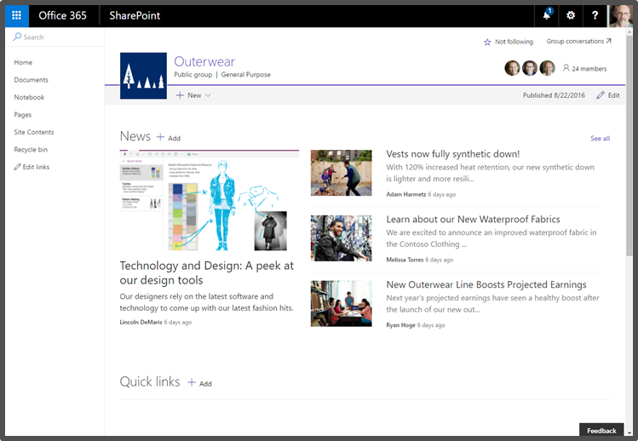
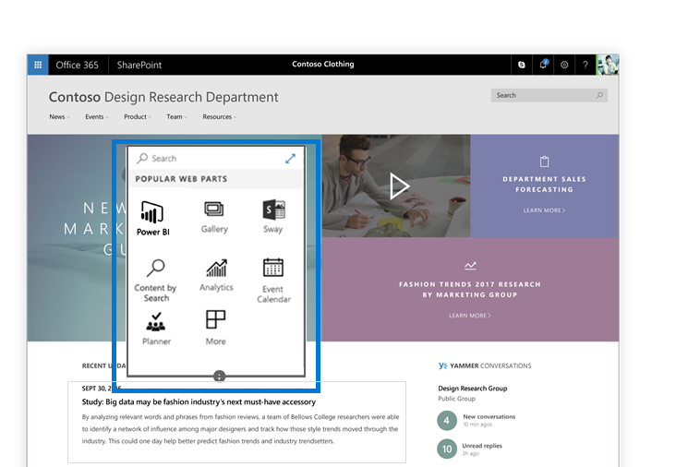
Modern SharePoint Pages
Better OOTB User Experience
Built using SPFx
Instant update experience
Pages and Web Parts are responsive by design
Supports existing add-ins (Apps)
Office 365 Only
1. NodeJS LTS: nodejs.org | 2. VS Code: code.visualstudio.com

Slide 31
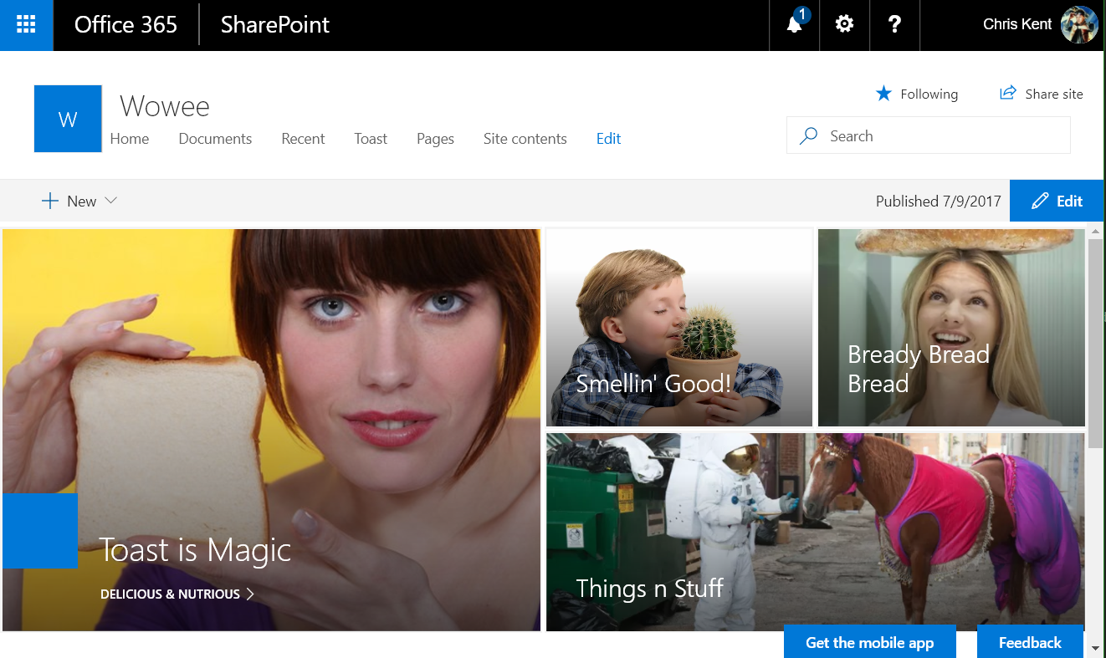
Modern Sites
Modern Pages
Modern Team Sites
  Associated with an O365 Group
Communication Sites
Modern Pages
  Add Webparts
  Sections & Columns
Modern List Views
Modern Admin Pages
  Site Contents
1. NodeJS LTS: nodejs.org | 2. VS Code: code.visualstudio.com

Slide 32
Demo
Modern Pages
1. NodeJS LTS: nodejs.org | 2. VS Code: code.visualstudio.com
Notes:
Very briefly showed off a Communications Site and a Modern Team Site. Also showed how to add a webpart to a new page.

Slide 33
1. NodeJS LTS: nodejs.org | 2. VS Code: code.visualstudio.com

Slide 34


3. Installing Yeoman & Gulp
From a Command Prompt use this command:
npm install -g yo gulp .
You can also use the VS Code Terminal (View > Terminal)
http://yeoman.io
http://gulpjs.com
https://dev.office.com/sharepoint/docs/spfx/set-up-your-development-environment
1. NodeJS LTS: nodejs.org | 2. VS Code: code.visualstudio.com

Slide 35

The SharePoint Framework
SPF + mysterious x = SPFx
3. From a Command Prompt: npm install -g yo gulp

Slide 36
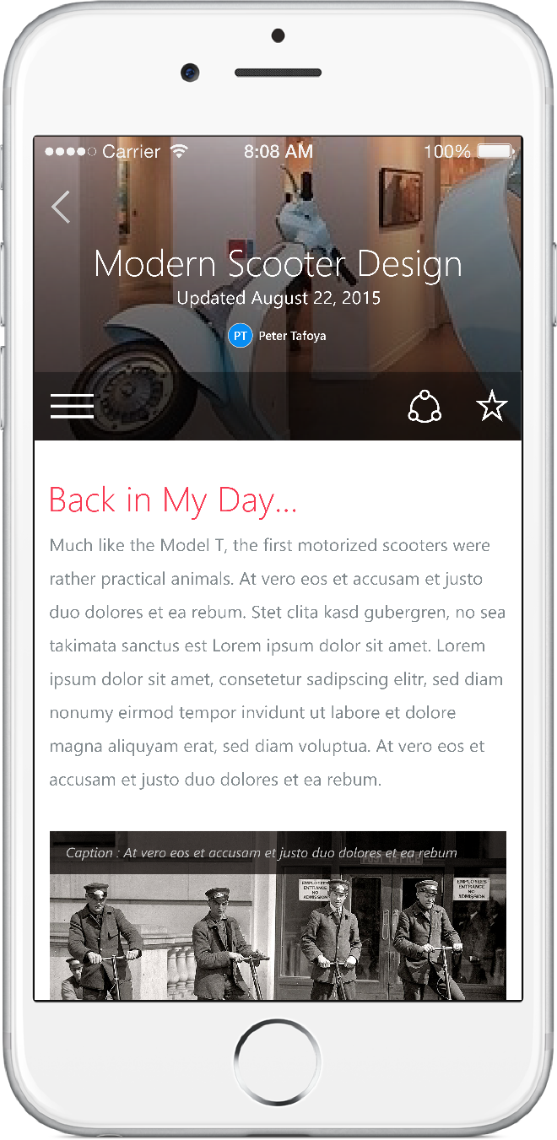
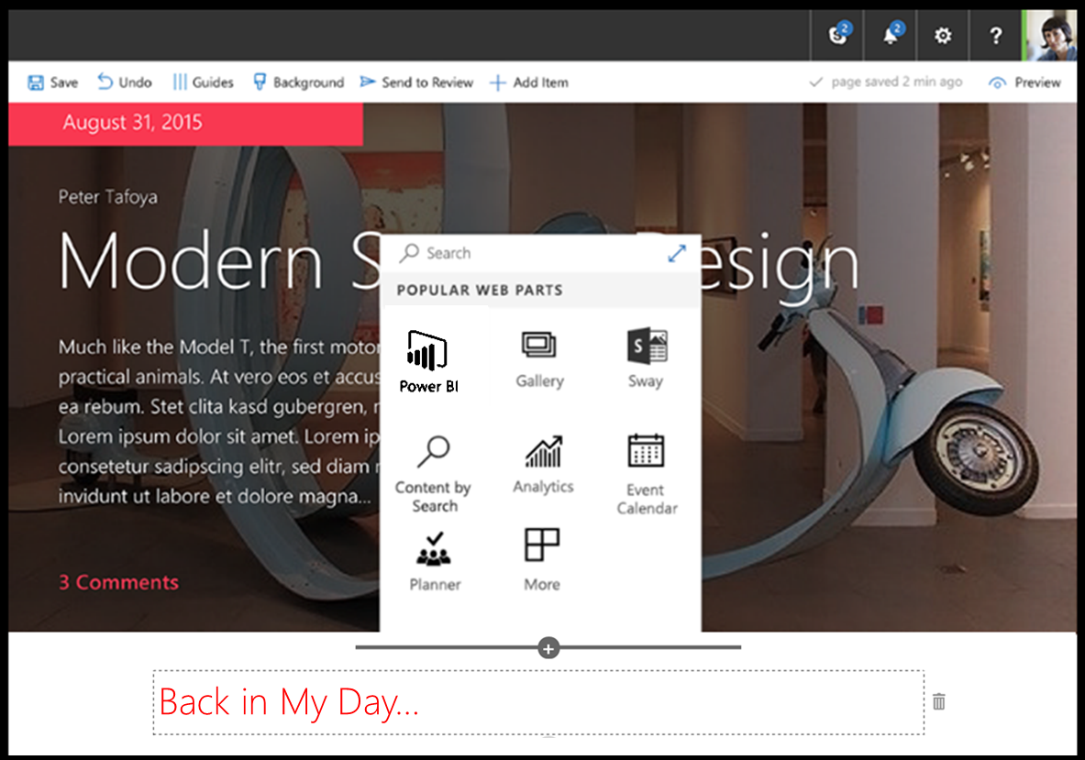
SharePoint Framework (SPFx)
Modern client-side development
Lightweight web and mobile
Powers OOTB experiences
Backward compatible*
Supports open source tools
and JavaScript web frameworks
SharePoint Framework
Microsoft Graph
LOB Systems and Cloud Services
3. From a Command Prompt: npm install -g yo gulp

Slide 37
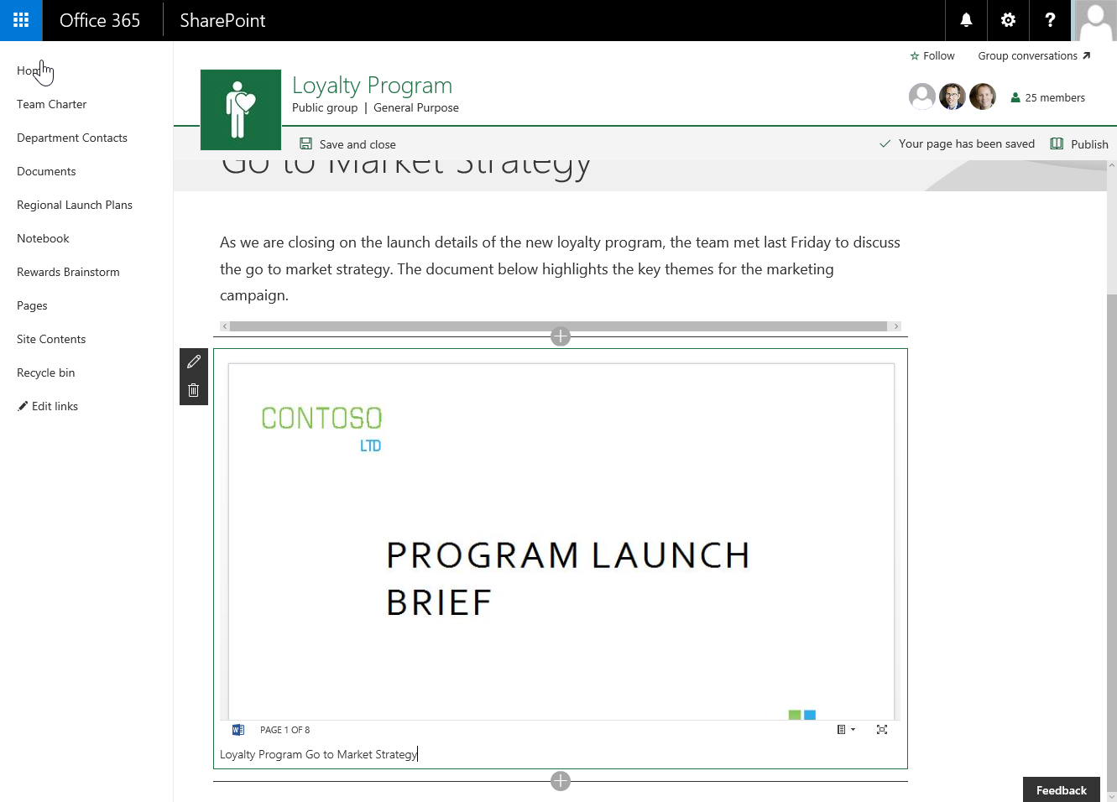
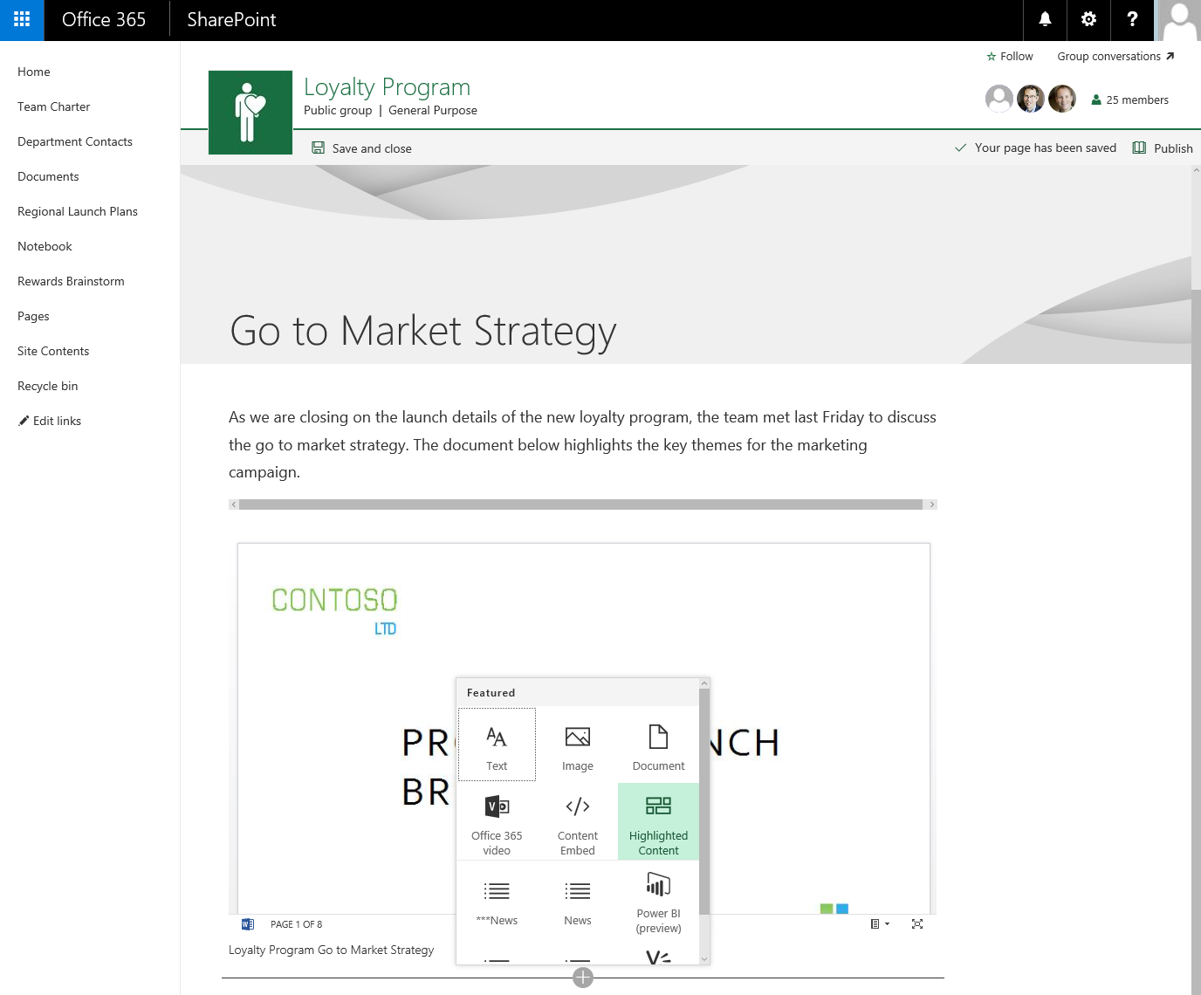
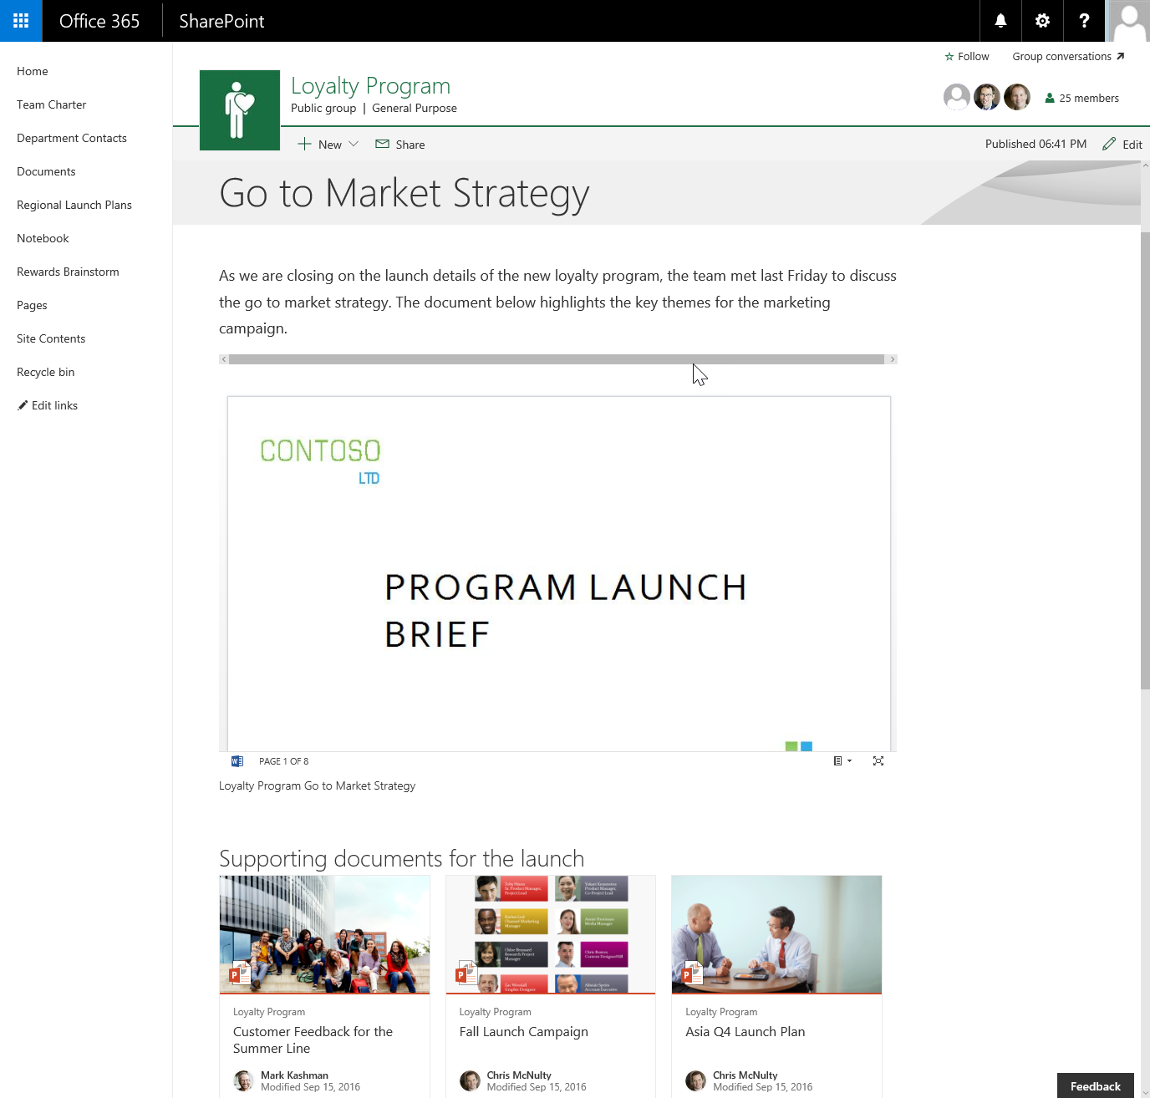
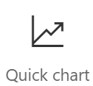
Client-side Web Parts
They are still web parts! (Mostly)
Built for the modern, JavaScript-driven web.
Runs directly inside a SharePoint Page.
(Even Classic pages)
3. From a Command Prompt: npm install -g yo gulp

Slide 38
SPFx Extensions
Application Customizer
  Injects your code on every page
  Provides Placeholders for custom markup
    Top & Bottom – eventually more
Field Customizer
  Customize the display of specific fields
  Only the list view is currently supported
    No form views
ListView Command Set
  Extend command bar and/or context menu
  Run code against selected items
Delegate Controls
Or
JavaScript Injection via Custom Action
~
~
Client Side Rendering for Fields
(JS Link)
~
Custom Actions
3. From a Command Prompt: npm install -g yo gulp

Slide 39
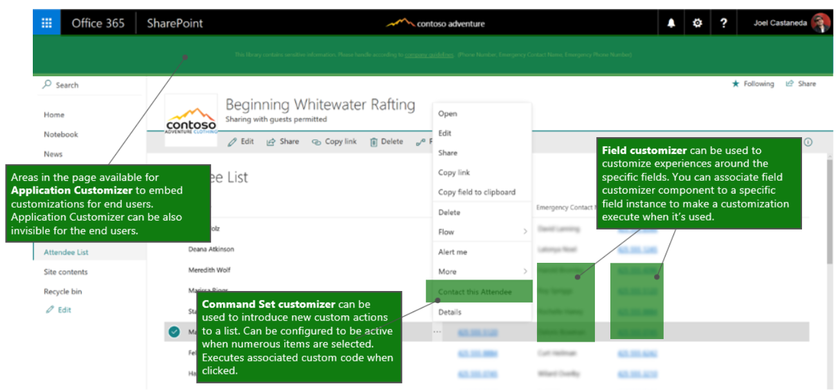
SPFx Extension Locations
3. From a Command Prompt: npm install -g yo gulp

Slide 40
3. From a Command Prompt: npm install -g yo gulp

Slide 41


4. Installing the SPFx Generator
From a Command Prompt use this command:
npm install -g @microsoft/generator-sharepoint.
You can also use the VS Code Terminal (View > Terminal)
Same generator is used for O365 & SP2016
https://dev.office.com/sharepoint/docs/spfx/set-up-your-development-environment
3. From a Command Prompt: npm install -g yo gulp

Slide 42




Tool Comparison
IIS Express
C#
MSBuild
Traditional
Project Templates
Dev Server
Templates
Packages
Editor
Language
Build Tasks
SPFx
VS Code
4. From a Command Prompt: npm install -g @microsoft/generator-sharepoint

Slide 43

Tool Comparison
IIS Express
C#
MSBuild
Traditional
Project Templates
Dev Server
Templates
Packages
Editor
Language
Build Tasks
SPFx
VS Code
4. From a Command Prompt: npm install -g @microsoft/generator-sharepoint

Slide 44
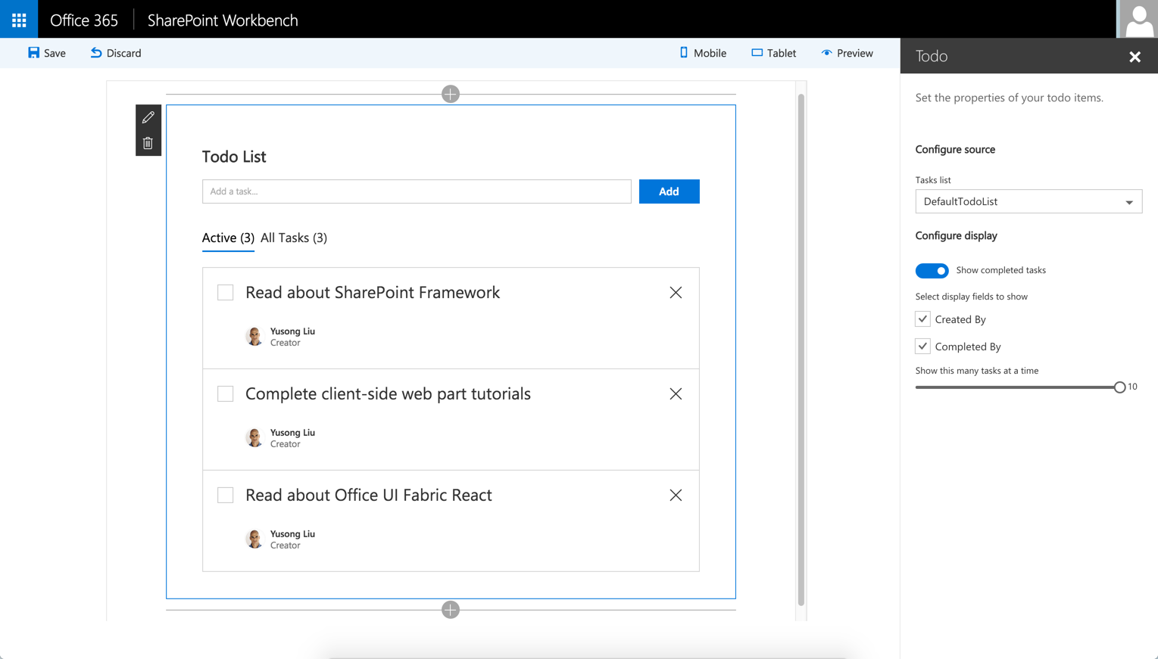
SharePoint Workbench
Developer tool to debug web parts
Local development experience
SharePoint Framework available offline
Available in SharePoint Online/2016 as well
Client-Side Web Parts Only
4. From a Command Prompt: npm install -g @microsoft/generator-sharepoint

Slide 45
4. From a Command Prompt: npm install -g @microsoft/generator-sharepoint

Slide 46
Development Environment Checklist
NodeJS http://nodejs.org
Visual Studio Code https://code.visualstudio.com
Yeoman
Gulp
Microsoft Generator SharePoint
npm install -g yo gulp
npm install -g @microsoft/generator-sharepoint

Slide 47
Demo
Creating your first WebPart
Notes:
Very briefly showed off a Communications Site and a Modern Team Site. Also showed how to add a webpart to a new page.

Slide 48
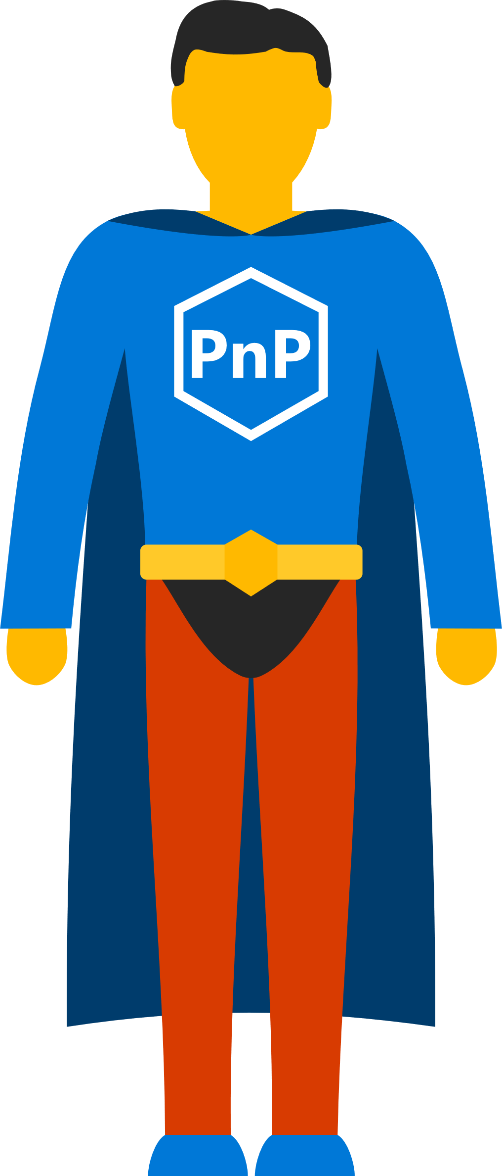
SharePoint Patterns & Practices (PnP)
Documentation
Guidance
  Tutorials
  Videos
  Samples
Tools
Reusable Components
#SPSDetroit

Slide 49
What’s in PnP (Selective Highlights)
PnP Core - https://github.com/SharePoint/PnP-Sites-Core
PnP PowerShell - https://github.com/SharePoint/PnP-PowerShell
PnP Remote Provisioning - https://github.com/SharePoint/PnP-Provisioning-Schema
PnP JS-Core - https://github.com/SharePoint/PnP-JS-Core
SharePoint Docs - https://github.com/SharePoint/sp-dev-docs
SPFx Web Part Samples - https://github.com/SharePoint/sp-dev-fx-webparts
SPFx Extension Samples - https://github.com/SharePoint/sp-dev-fx-extensions
PnP Partner Pack - https://github.com/SharePoint/PnP-Partner-Pack
PnP Tools - https://github.com/SharePoint/PnP-Tools
#SPSDetroit

Slide 50
Staying Up to Date with PnP
https://dev.office.com/pnp
Join the calls (or watch on YouTube later)
  http://aka.ms/sppnp-videos
  Monthly Update call
  Bi Weekly Special Interest Groups
    JavaScript
    Core & PowerShell
Read the Updates
  http://dev.office.com/blogs
Visit the Tech Community
  http://aka.ms/sppnp-community
#SPSDetroit

Slide 51
S
harePoin
t
Framework
GETTING STARTED
SharePoint Practice Lead
CHRIS KENT

Slide 52
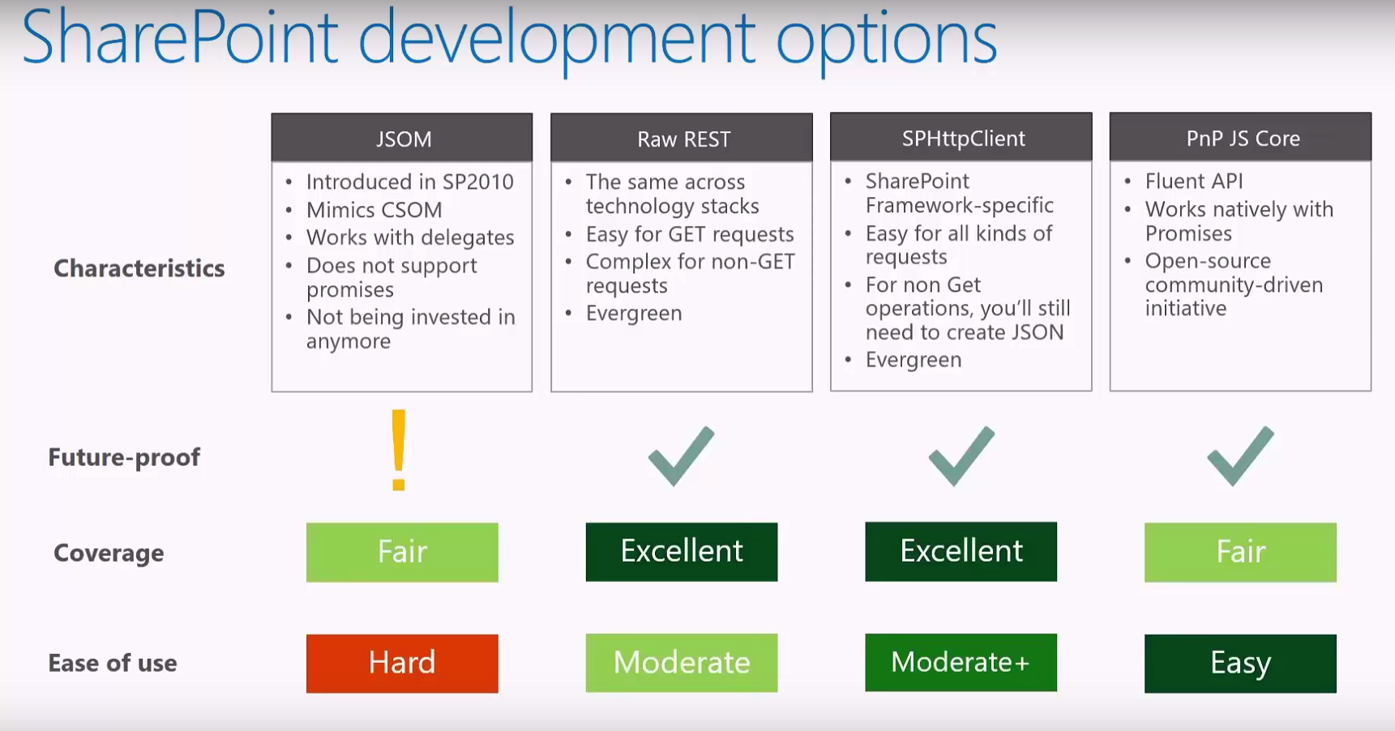
Reading SharePoint Data
JSOM
REST
SPHttpClient
PnP JS Core

Slide 53
Important npm Commands
Important Gulp Tasks
Install into your project
  npm install [THING] --save .
Install Globally
  npm install -g [THING] .
Install as Dev Dependency
  npm install [THING] --save-dev .
Check what Version You Have
  npm list –g [THING] .
See Available Versions
  npm view [THING] versions .
See available tasks
  gulp --tasks .
Start the local server
  gulp serve .
Start the local server with no WB
  gulp serve --nobrowser .
Generate the Bundle
  gulp bundle .
Generate the Solution
  gulp package-solution .

Slide 54

SharePoint Release History
SharePoint
Portal Server 2001
SharePoint
Portal Server 2003
Office SharePoint
Server 2007
SharePoint
Server 2010
SharePoint
Server 2013
SharePoint
Server 2016
2001
2003
2006
2009
2012
2016
Microsoft
Managed Solutions
Microsoft
Online Services
Office 365
Core
Collaboration
Content
Management
Cloud and Enterprise
Social
Cloud-Inspired
Experiences

Slide 55
SharePoint Framework Governance
Strive for a simple (1-2 pages) document that outlines the following
For Customers | For Developers
Standardize Client-side libraries | Development practices
External scripts policy | Testing approach
Hosting location | Deployment to production
Explicit agreements with ISVs | Updates and support

Slide 56











Office UI Fabric
Standardized Iconography, Fonts, & Colors
Responsive Grid System
Reusable Components
Powers OOTB Experiences
Fonts, icons
Colors
Components
Grid
Office 365 Consumers
SharePoint
Delve
Project
OneDrive
Office 365
Outlook

Slide 57
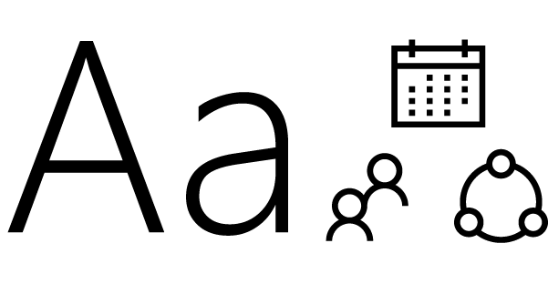
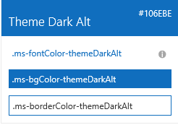

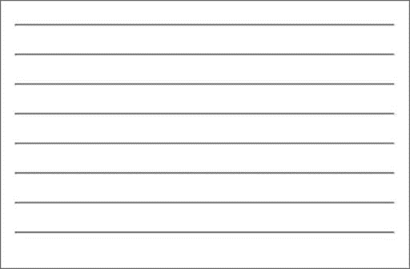

Fabric Core styling
Fonts and typography
Segoe font family + type ramp, official Office 365 iconography
Color
Official Office 365 color palette
Branded assets
Product symbols + product filetype symbols
Animations
Official Office 365 selection of easings and animations
Responsive grid
Tailored to Office 365 silhouettes

Slide 58
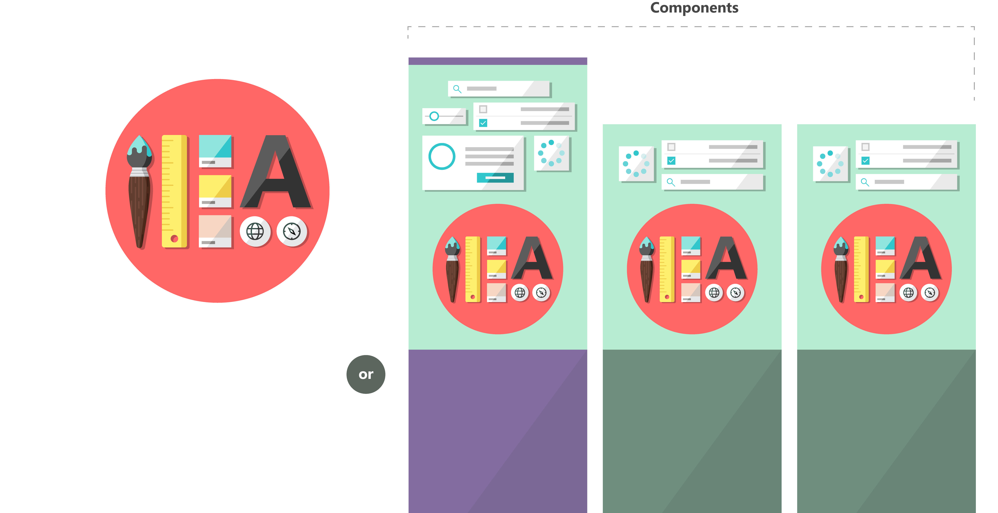

Fabric and its sub-projects
All depending on the Core, all open source
Community built
Fabric Core
Fabric React
Fabric JS
ngFabric
Fabric iOS
Core elements of the design language including icons, colors, type, and the grid
Robust, up-to-date components built with the React framework.
Simple, visuals-focused components that you can extend, rework, and build on.
Community-driven project to build components for Angular-based apps.
Native Swift colors, type ramp, and components for building iOS apps.

Slide 59



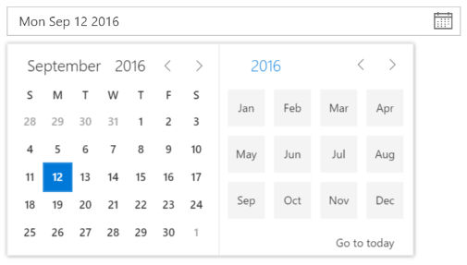
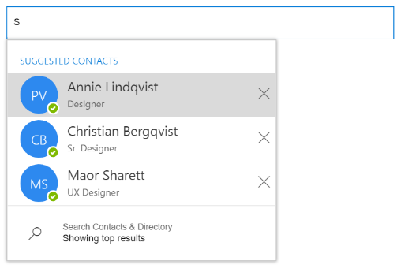
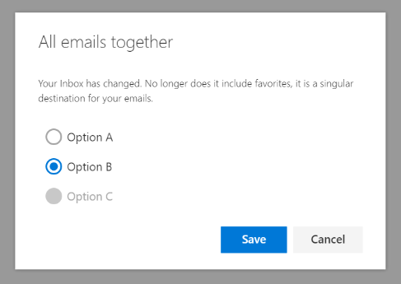
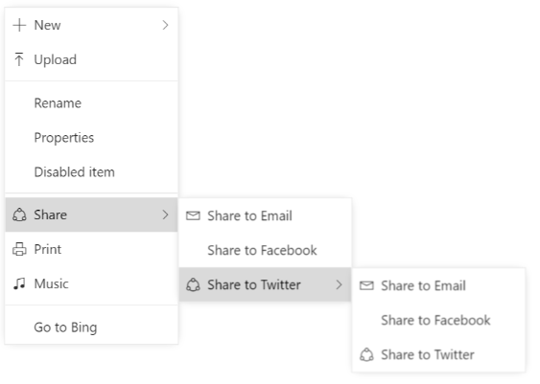
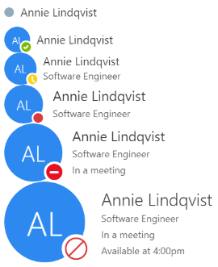
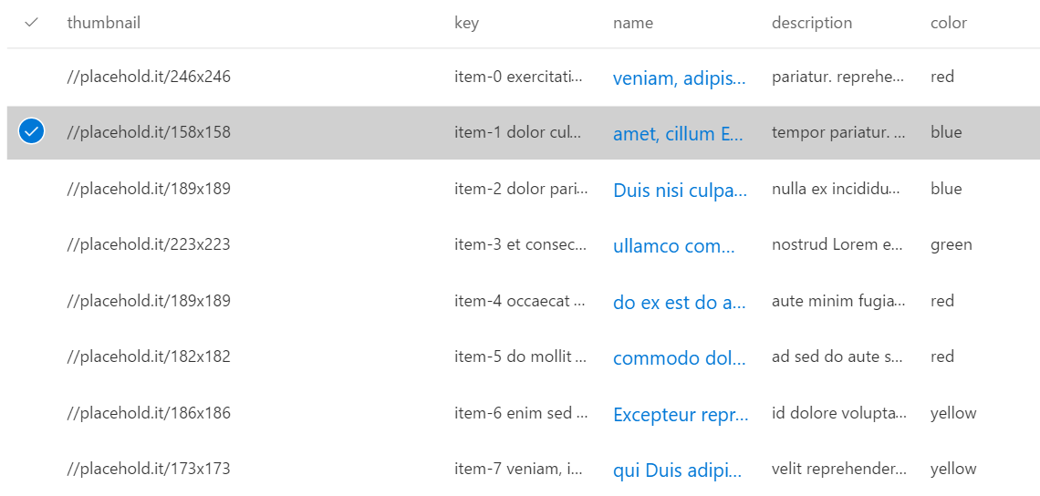
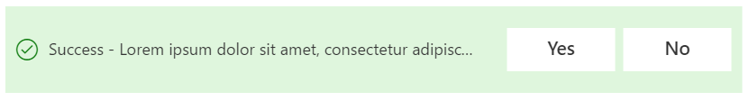

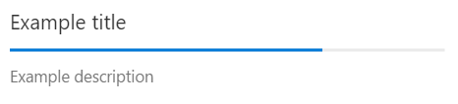
Fabric components - overview
Inputs
Buttons, textfields, dropdowns, etc.
Pickers
DatePicker, PeoplePicker
Layout
CommandBar, Dialogs, ContextualMenu, Callout, Panel
Content and People
Lists, Personas, FacePile
Informational
ProgressIndicator, Spinner, MessageBar

Slide 60
Additional Resources
Getting a Developer Tenant for Office 365
  https://dev.office.com/sharepoint/docs/spfx/set-up-your-developer-tenant
Overview of the SharePoint Framework
  https://dev.office.com/sharepoint/docs/spfx/sharepoint-framework-overview
SharePoint Framework Roadmap
  https://dev.office.com/sharepoint/docs/spfx/roadmap
Office Dev Patterns and Practices (PnP)
  https://dev.office.com/patterns-and-practices
SharePoint Framework Code Samples (PnP)
  https://dev.office.com/code-samples#?filters=sharepoint%20framework%20app
SharePoint Framework CRUD Samples
  https://blog.mastykarz.nl/sharepoint-crud-operations-sharepoint-framework-client-side-web-parts/
SharePoint Framework Reference
  https://dev.office.com/sharepoint/reference/spfx/sharepoint-framework-reference-overview
PnP JS Core
  https://github.com/SharePoint/PnP-JS-Core

Slide 61
md HelloDetroit
cd HelloDetroit
yo @microsoft/sharepoint
  Solution Name:
  hello-detroit
  Baseline:
  SharePoint Online only (latest)
  Use the current folder
  Tenant Deployment:
  y
  Type:
  WebPart
  Web part name: HelloDetroit
  Description:
  HelloDetroit description
  Framework:
  No JavaScript framework

Slide 62
gulp trust-dev-cert
code .
  Behold VS Code!
Return to Cmd
gulp serve
Look at that Local Workbench!
  Click the + button
  Choose HelloDetroit
  Hover over the WP
  Click the Pencil
  Change the Description

Slide 63
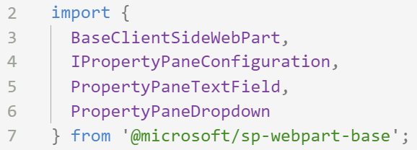
Return to VS Code
Expand src
Open HelloDetroitWebPart.ts
Scroll to line 5
  Add a comma and press enter
  Type PropertyPaneDropDown
  3. Look at that sweet Import!

Slide 64
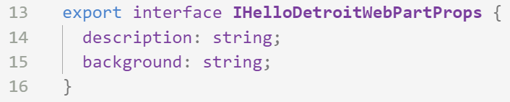
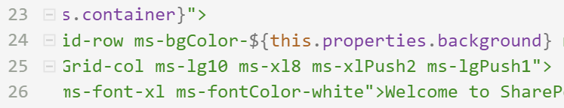
Scroll to line 14
  Press enter to add a new line
  Type
  background: string;
Scroll to line 24
  Replace themeDark with
  ${this.properties.background}

Slide 65
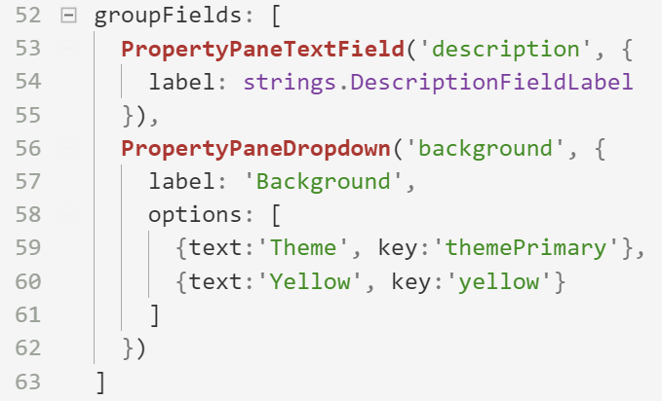
Scroll to line 55
  Add a comma and press enter
  Type
  PropertyPaneDropDown(‘background’, {
  label: ‘Background’,
  options: [
  {text:’Theme’, key:’themePrimary’},
  {text:’Yellow’, key:’yellow’}
  ]
  })
Save the file
Return to the browser

Slide 66
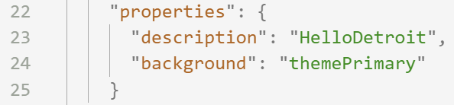
Open HelloDetroitWebPart.manifest.json
Scroll to line 23
  Add a comma and press enter
  Type
  “background”: “themePrimary”
Save the file

