Slide 1
Understanding
SharePoint
Framework Extensions
Chris Kent
Office 365 Practice Lead, DMI

Slide 3





Chris Kent
@theChrisKent
theChrisKent.com
Notes:
Can I possibly get my name on a single slide even more? Wow.

Slide 4

dminc.com

Slide 5


HUMAN NEEDS FOR FELLOW HUMANS
Questions
OTHER HUMAN NEEDS
Slides will be Available on my
website

Slide 6










SPS STL Sponsors
Gold
Silver
Bronze

Slide 7
@SPSStLouis
#SPSSTL

Slide 8
Goals

Slide 9
SharePoint Framework
What | When | Why

Slide 10
SharePoint Framework Extensions
Types | When | How

Slide 11
Patterns & Practices
Why | What | How

Slide 12
Audience Participation!
Your
Role(s)
IT Pro
Versions of SharePoint
2003
Experience with SPFx
Huh?
SPFx Plans
None
Management
Developer
Other
2007
2010
2013
2016
O365
None
Heard of it
Messed with it
Not Sure
SP 2016
Made something in Production
Extensions
Webparts
Customize Modern Pages

Slide 13














SharePoint Development
A Brief History

Slide 14






SharePoint as a Platform
Branding
User Experience
Business Intelligence
APIs
Processes
Packaging & Deployment

Slide 15






SharePoint as a Platform

Slide 16

SharePoint as a Platform
SP 2010
On-Premises Only
Recent
Excel Services
PowerPivot
Reporting Services
CSOM & JSOM
2010 Workflows
Themes
Web Services
Alternate CSS
PerformancePoint
Declarative Sandbox
Server Side APIs
OOTB Web Parts
Event Receivers
.NET Sandbox
InfoPath & SPD
SSIS
Full Trust Solutions
Custom Master Page

Slide 17
SharePoint as a Platform
SP 2013
On-Premises Only
Recent
Power BI
Excel Services
PnP PowerShell
PnP Provisioning
Client Side Rendering
PowerPivot
REST
2013 Workflows
PnP Partner Pack
Reporting Services
CSOM & JSOM
2010 Workflows
Themes
Custom Actions
Add-ins
Web Services
Remote Event Receivers
Alternate CSS
Add-in Parts
PerformancePoint
Declarative Sandbox
Server Side APIs
Composed Looks
OOTB Web Parts
Event Receivers
.NET Sandbox
JS Injection
InfoPath & SPD
SSIS
Full Trust Solutions
Custom Master Page
ASP.NET 4.5 Integration

Slide 18
SharePoint as a Platform
SP2016
On-Premises Only
Recent
SPFx
Power BI
SPFx Client Side Solutions
Excel Services
PnP PowerShell
PnP Provisioning
Client Side Rendering
PowerPivot
REST
2013 Workflows
PnP Partner Pack
Reporting Services
CSOM & JSOM
2010 Workflows
Themes
Custom Actions
Add-ins
Web Services
Remote Event Receivers
Alternate CSS
Add-in Parts
PerformancePoint
Declarative Sandbox
Server Side APIs
Composed Looks
OOTB Web Parts
Event Receivers
.NET Sandbox
JS Injection
InfoPath & SPD
SSIS
Full Trust Solutions
Custom Master Page
ASP.NET 4.5 Integration

Slide 19
SharePoint as a Platform
Not Recommended
On-Premises Only
On-Prem Opts
SPFx
Power BI
SPFx Client Side Solutions
Excel Services
PnP PowerShell
PnP Provisioning
Client Side Rendering
PowerPivot
REST
2013 Workflows
PnP Partner Pack
Reporting Services
CSOM & JSOM
2010 Workflows
Themes
Custom Actions
Add-ins
Web Services
Remote Event Receivers
Alternate CSS
Add-in Parts
PerformancePoint
Declarative Sandbox
Server Side APIs
Composed Looks
OOTB Web Parts
Event Receivers
.NET Sandbox
JS Injection
InfoPath & SPD
SSIS
Full Trust Solutions
Custom Master Page
ASP.NET 4.5 Integration

Slide 20
SharePoint as a Platform
O365
On-Premises Only
Recent
Site Designs
SPFx
Power BI
Microsoft Graph
Microsoft Flow
SPFx Client Side Solutions
SPFx Extensions
Power Apps
Excel Services
PnP PowerShell
Webhooks
PnP Provisioning
Column Formatting
Client Side Rendering
PowerPivot
REST
2013 Workflows
PnP Partner Pack
CSOM & JSOM
2010 Workflows
Themes
Custom Actions
Add-ins
Web Services
Remote Event Receivers
Alternate CSS
Add-in Parts
Composed Looks
OOTB Web Parts
JS Injection
InfoPath & SPD
Custom Master Page

Slide 21
SharePoint as a Platform
Not Recommended
On-Premises Only
O365 Opts
Site Designs
SPFx
Power BI
Microsoft Graph
Microsoft Flow
SPFx Client Side Solutions
SPFx Extensions
Power Apps
Excel Services
PnP PowerShell
Webhooks
PnP Provisioning
Column Formatting
Client Side Rendering*
PowerPivot
REST
2013 Workflows
PnP Partner Pack
CSOM & JSOM
2010 Workflows
Themes
Custom Actions*
Add-ins
Web Services
Remote Event Receivers
Alternate CSS
Add-in Parts
Composed Looks
OOTB Web Parts
JS Injection
InfoPath & SPD
Custom Master Page
*Classic Pages Only

Slide 22




Modern Pages
Kiss your postbacks goodbye

Slide 23
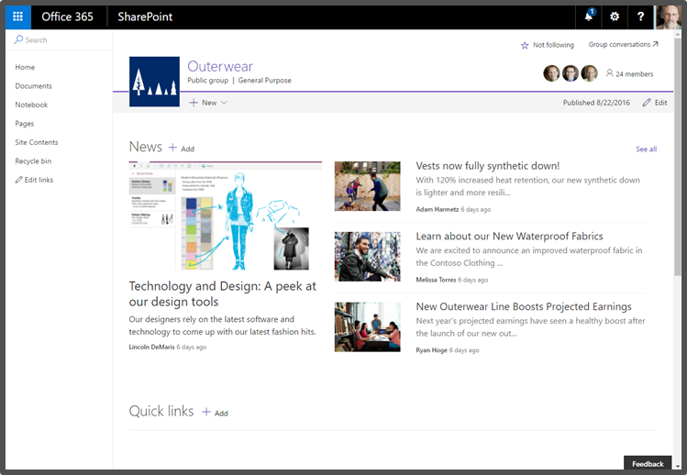
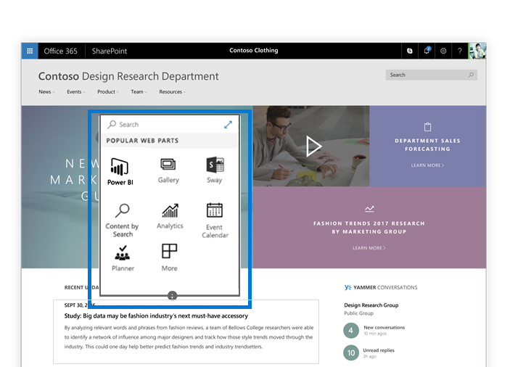
Modern SharePoint Pages
Better OOTB User Experience
Built using SPFx
Instant update experience
Pages and Web Parts are responsive by design
Supports existing add-ins (Apps)
Office 365 Only

Slide 24
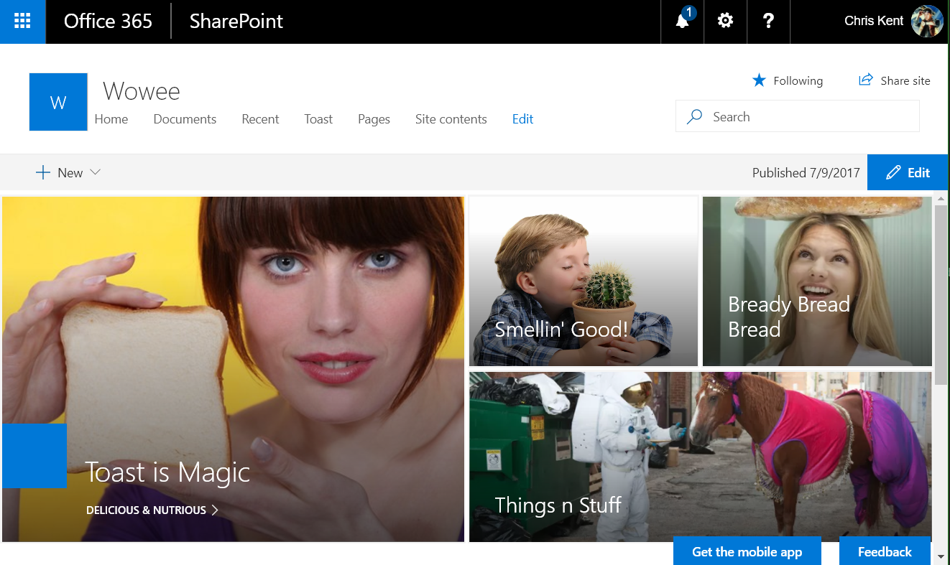
Modern Sites
Modern Pages
Modern Team Sites
  Associated with an O365 Group
Communication Sites
Modern Pages
  Add Webparts
  Sections & Columns
Modern List Views
Modern Admin Pages
  Site Contents

Slide 25
Demo
Modern Pages
Notes:
Very briefly showed off a Communications Site and a Modern Team Site. Also showed how to add a webpart to a new page.

Slide 26

The SharePoint Framework
SPF + mysterious x = SPFx

Slide 27
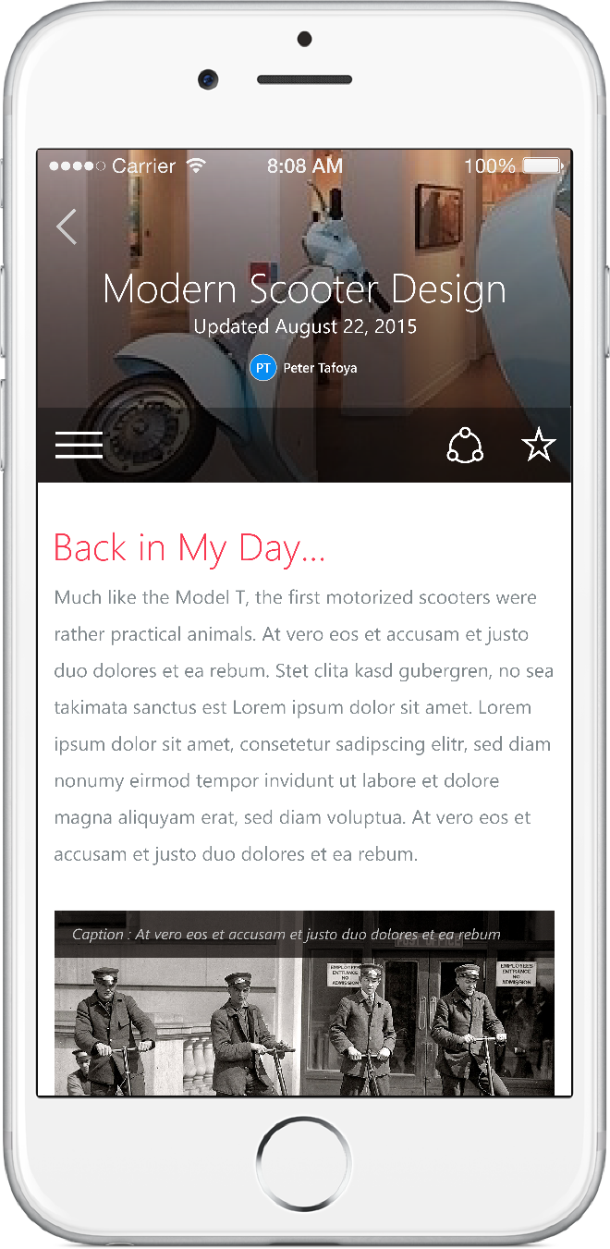
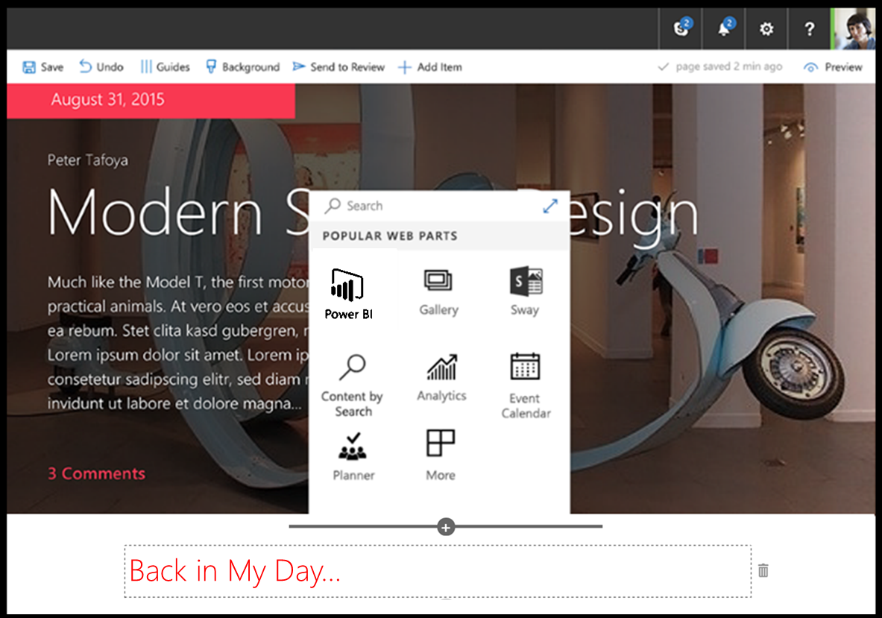
SharePoint Framework (SPFx)
Modern client-side development
Lightweight web and mobile
Powers OOTB experiences
Backward compatible*
Supports open source tools
and JavaScript web frameworks
SharePoint Framework
Microsoft Graph
LOB Systems and Cloud Services

Slide 28
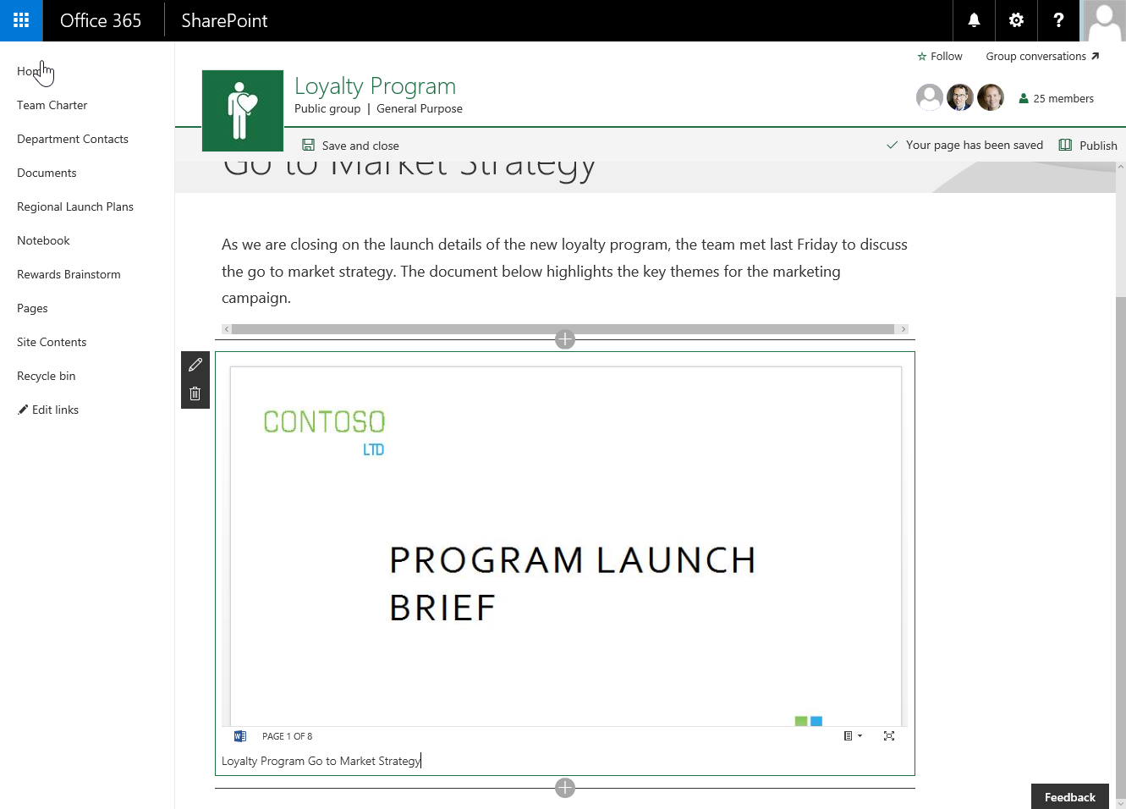
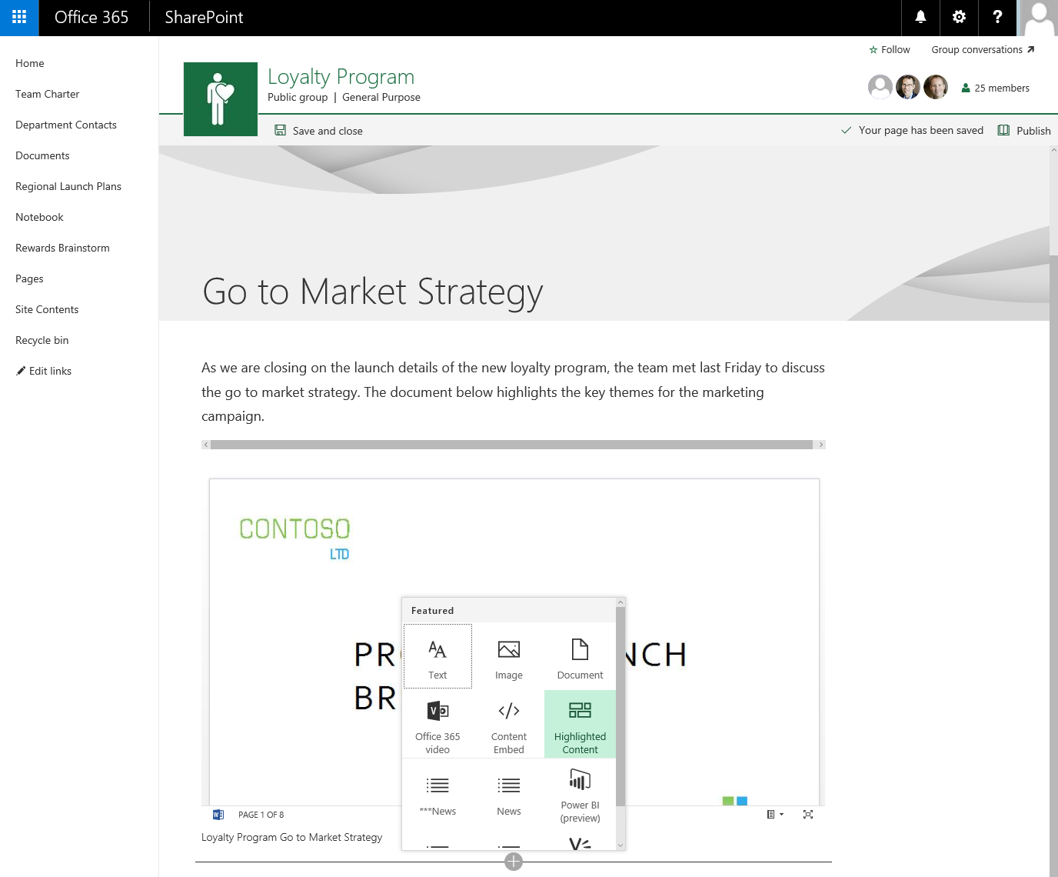
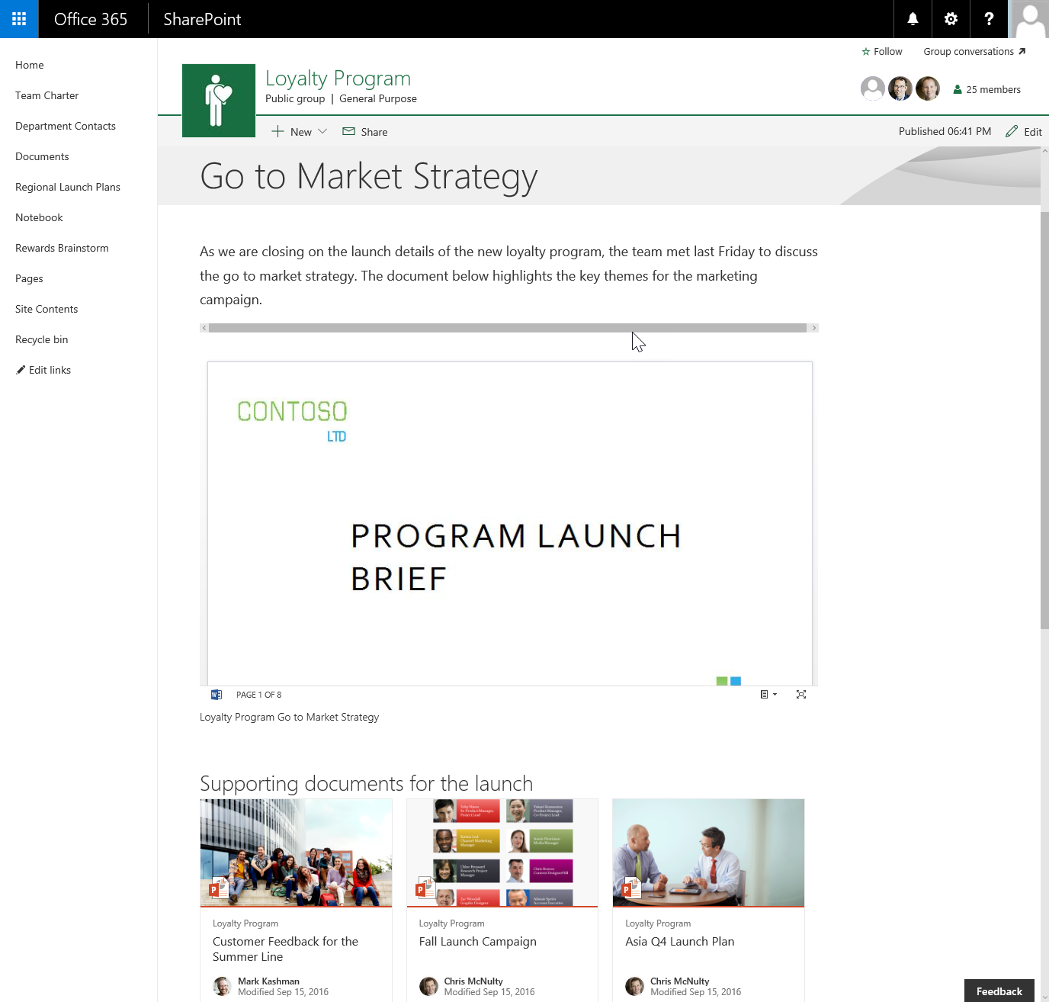
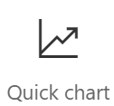
Client-side Web Parts
They are still web parts! (Mostly)
Built for the modern, JavaScript-driven web.
Runs directly inside a SharePoint Page.
(Even Classic pages)

Slide 29






Tool Comparison
IIS Express
C#
MSBuild
Traditional
Project Templates
Dev Server
Templates
Packages
Editor
Language
Build Tasks
SPFx
VS Code

Slide 30

Tool Comparison
IIS Express
C#
MSBuild
Traditional
Project Templates
Dev Server
Templates
Packages
Editor
Language
Build Tasks
SPFx
VS Code

Slide 31
Demo
SharePoint Framework Web Part
Notes:
Basic Hello World web part. Added custom color property to better illustrate how the properties immediately change things.

Slide 32




SPFx Extensions
Extending Modern Pages

Slide 33
Types of SPFx Extensions
Application Customizer
  Injects your code on every page
  Provides Placeholders for custom markup
    Currently, Top & Bottom – eventually more
Field Customizer
  Allows you to customize the display of fields
  Only the list view is currently supported
    No form views
ListView Command Set
  Extend command bar and/or context menu
  Run code against selected items
Delegate Controls
Or
JavaScript Injection via Custom Action
~
~
Client Side Rendering for Fields
(JS Link)
~
Custom Actions

Slide 34
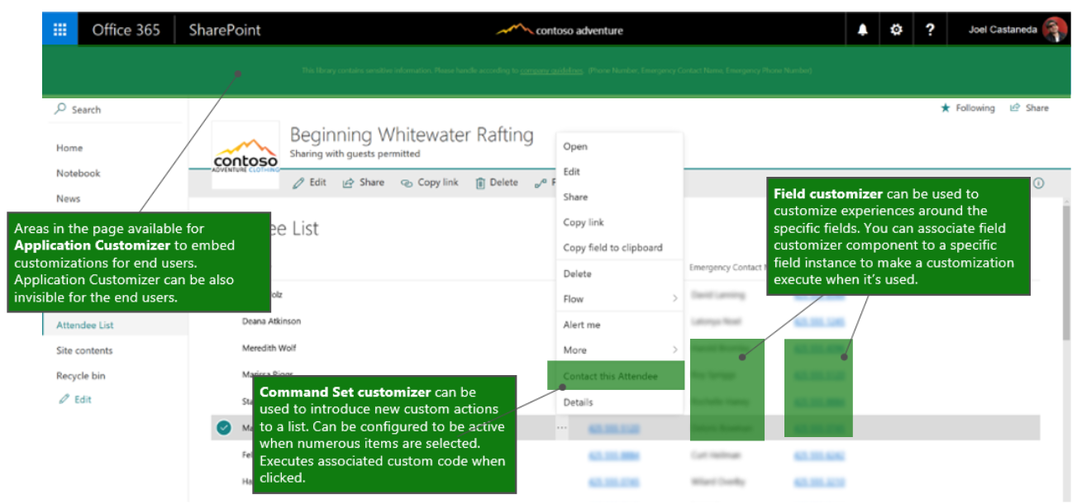
SPFx Extension Locations

Slide 35
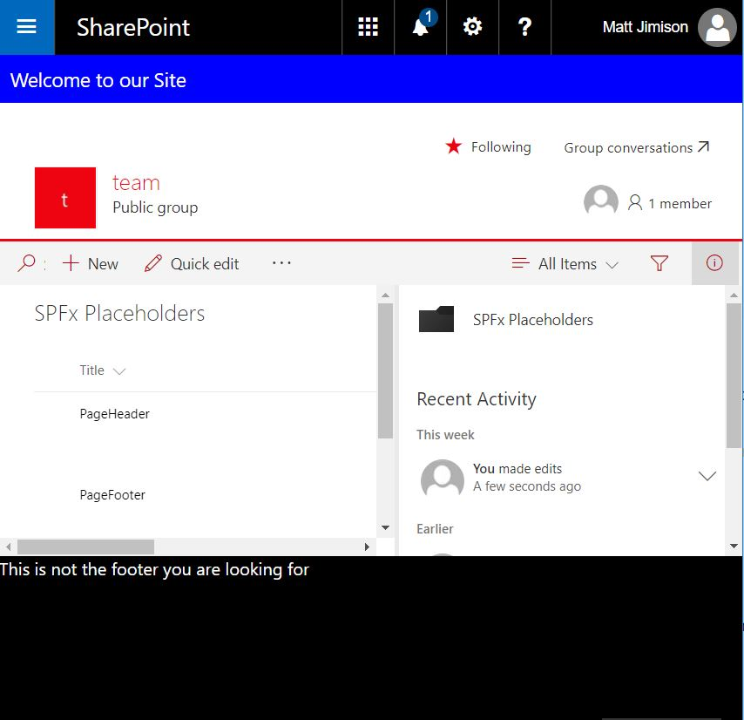

List Driven Placeholders
DEMO
Application Customizer
List to manage content
Caching with localStorage
Matt Jimison
@mjimison

Slide 36
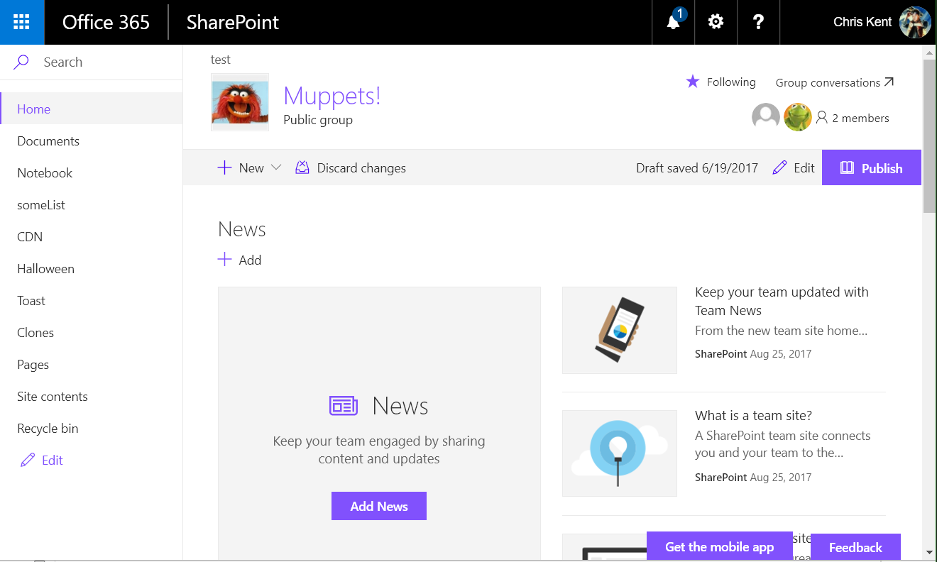
Notes:
Modern page without placeholders

Slide 37
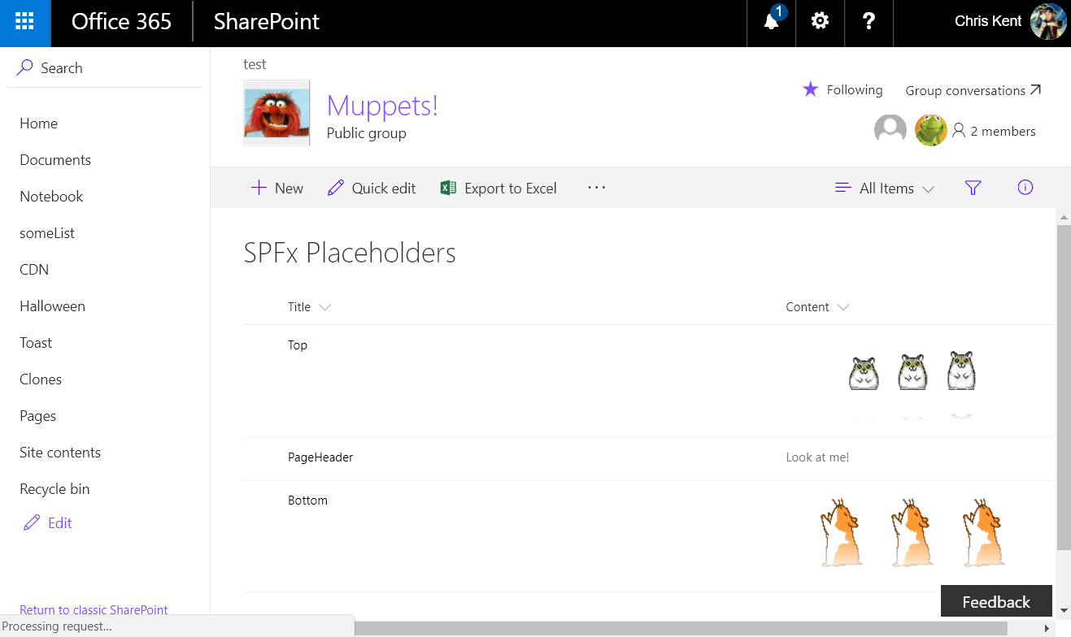
Notes:
The backing list. Only the Top and Bottom entries are important here.

Slide 38
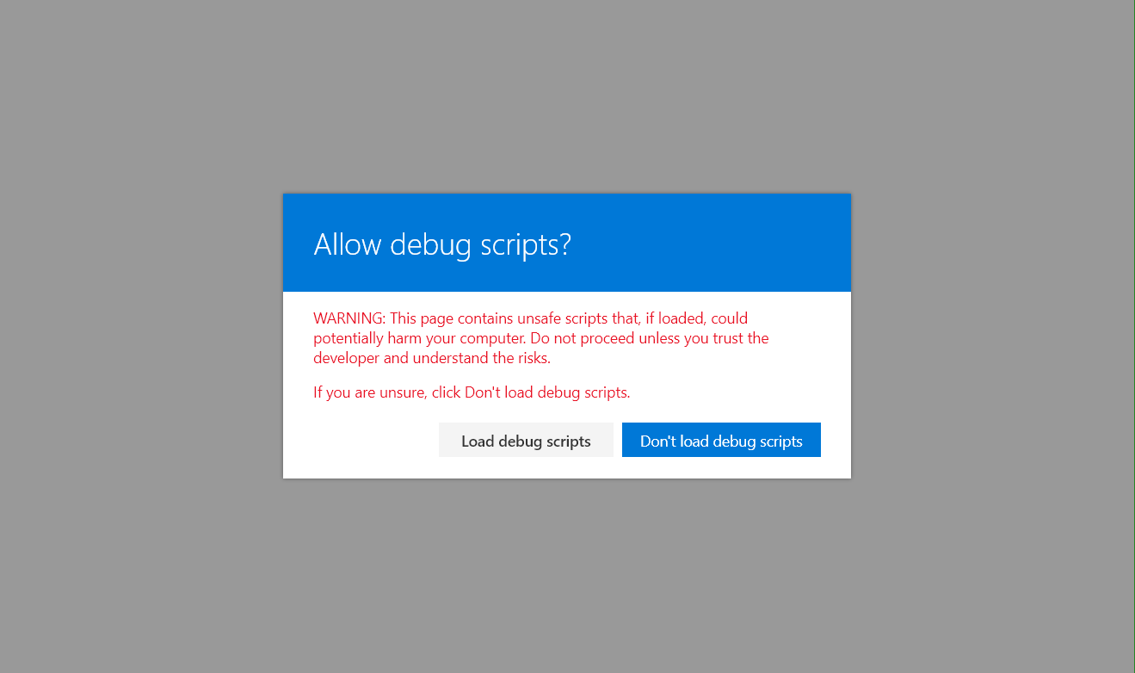
Notes:
The warning when using the debug query strings

Slide 39
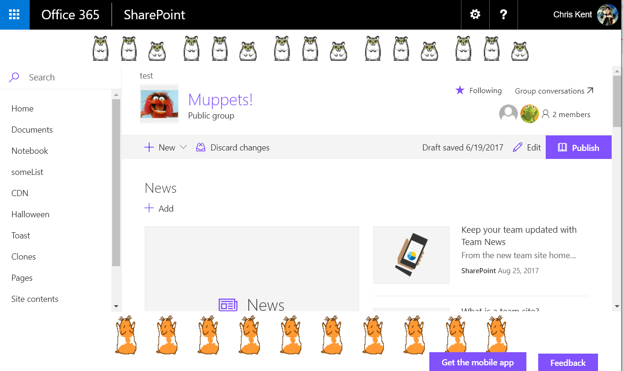
Notes:
The placeholders in action! Why would I include the hamster animations from hamsterdance.com?
Query String:
?loadSPFX=true&debugManifestsFile=https://localhost:4321/temp/manifests.js&customActions={"b58ca197-a89a-47a9-b283-7c1df361eaf3":{"location":"ClientSideExtension.ApplicationCustomizer","properties":{}}}

Slide 40
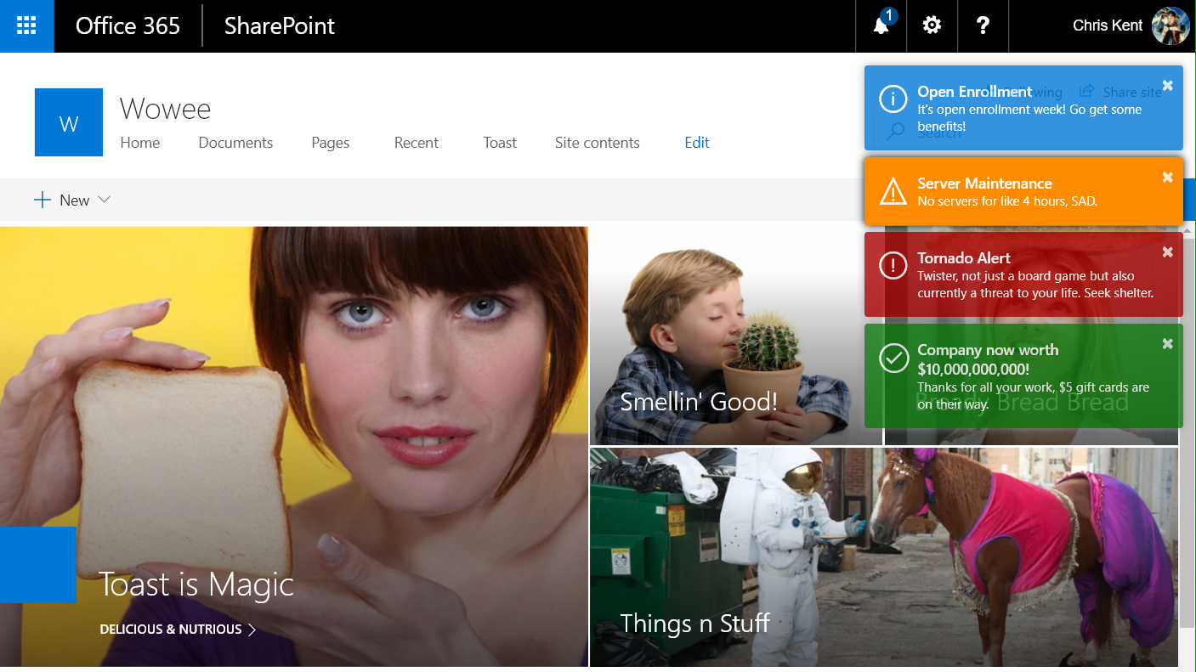
Toastr Notifications
DEMO
Application Customizer
List to manage content
Caching with localStorage
Chris Kent
@thechriskent

Slide 41
Notes:
A communications site without the Toastr Application Customizer applied

Slide 42
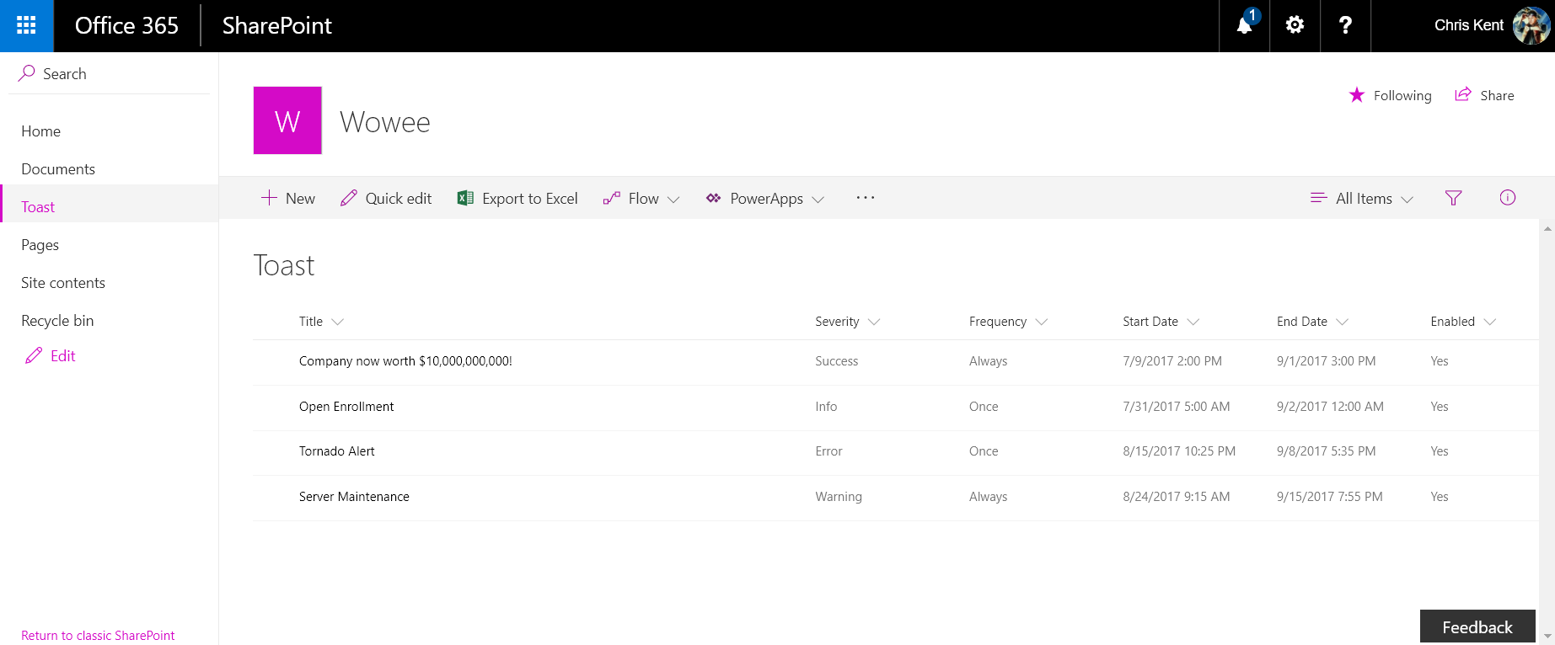
Notes:
The backing list for Toast. The toast colors are determined by Severity, the Frequency controls how often the toast show up, and the other columns determine when the toast is displayed.

Slide 43
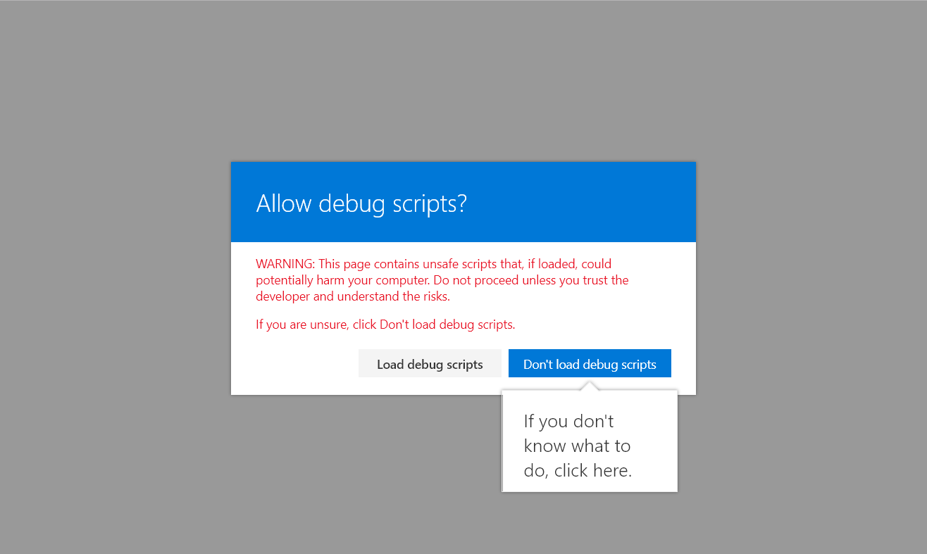
Notes:
The warning when using the debug query strings

Slide 44
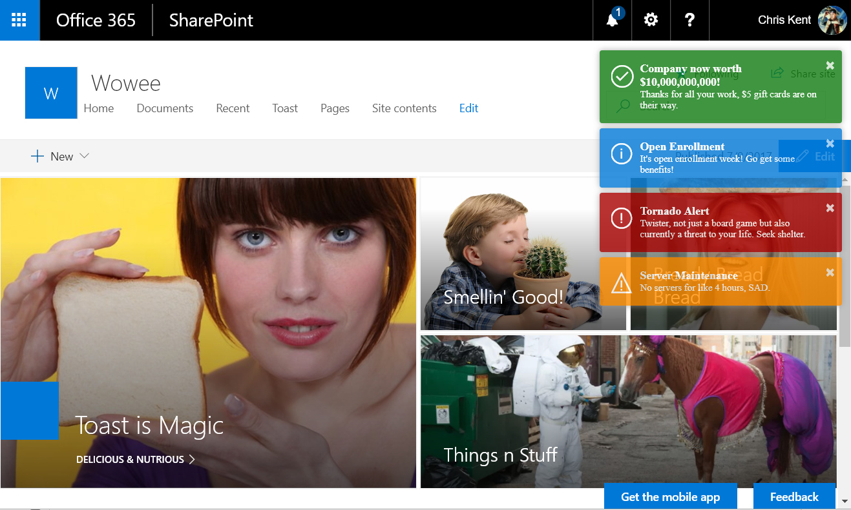
Notes:
Toast!
Query String:
?loadSPFX=true&debugManifestsFile=https://localhost:4321/temp/manifests.js&customActions={"a861c815-e425-416d-9520-04bcdf557e27":{"location":"ClientSideExtension.ApplicationCustomizer","properties":{}}}

Slide 45
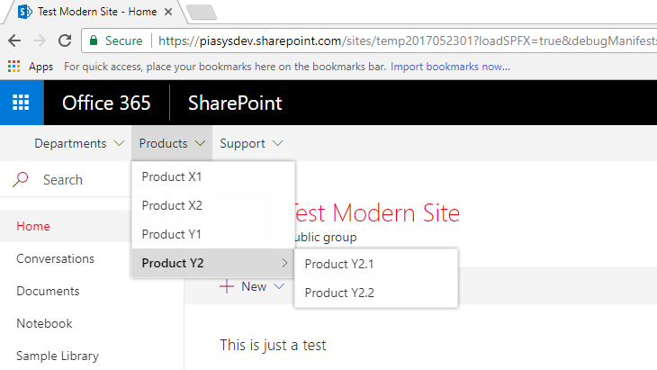

Tenant Global NavBar
DEMO
Application Customizer
Uses Term Sets
Works across Site Collections
Paolo Pialorsi
@PaoloPia

Slide 46
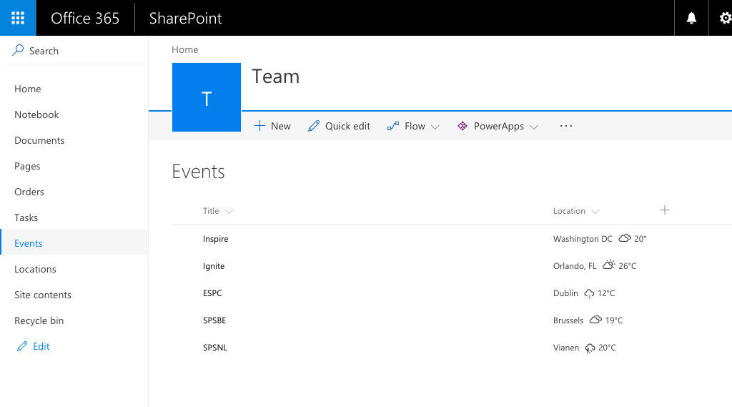

Weather Field
DEMO
Field Customizer
Custom CSS for Cells
jQuery Plugin Usage
Config Through Parameters
Waldek Mastykarz
@waldekm

Slide 47
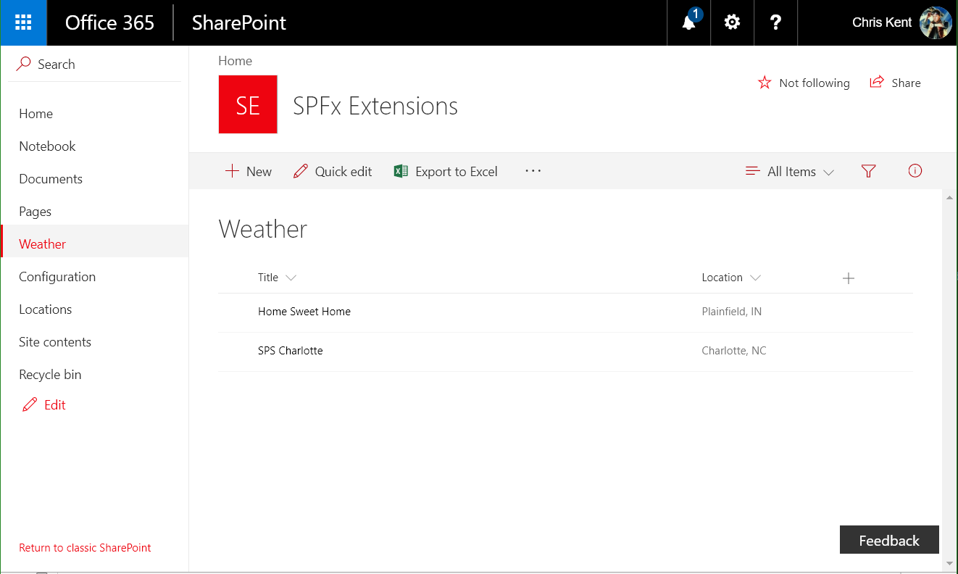
Notes:
A list without the Field Customizer applied (specifically the Location column)

Slide 48
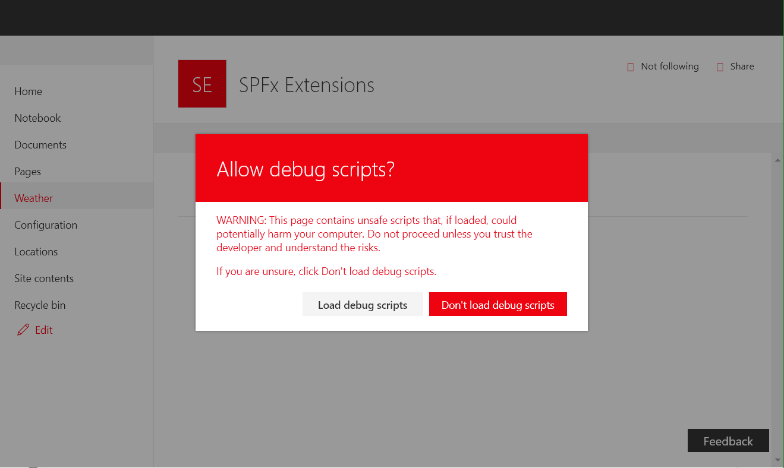
Notes:
The warning when using the debug query strings

Slide 49
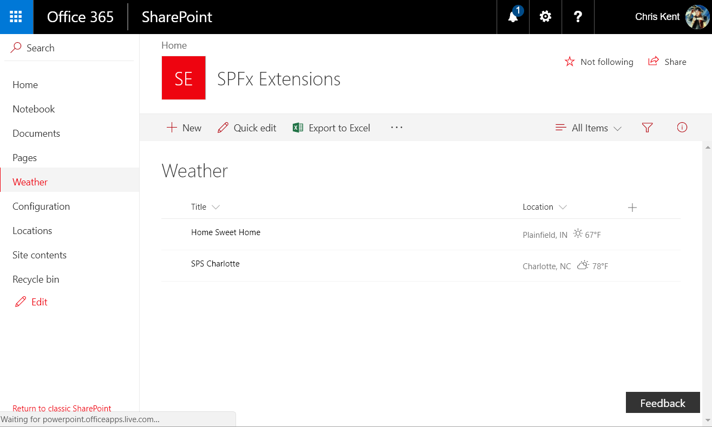
Notes:
Weather in Fahrenheit
Query String:
?loadSPFX=true&debugManifestsFile=https://localhost:4321/temp/manifests.js&fieldCustomizers={"Location":{"id":"b754b644-6821-4ce7-94b4-e374e7b657e0","properties":{"unit":"f"}}}

Slide 50
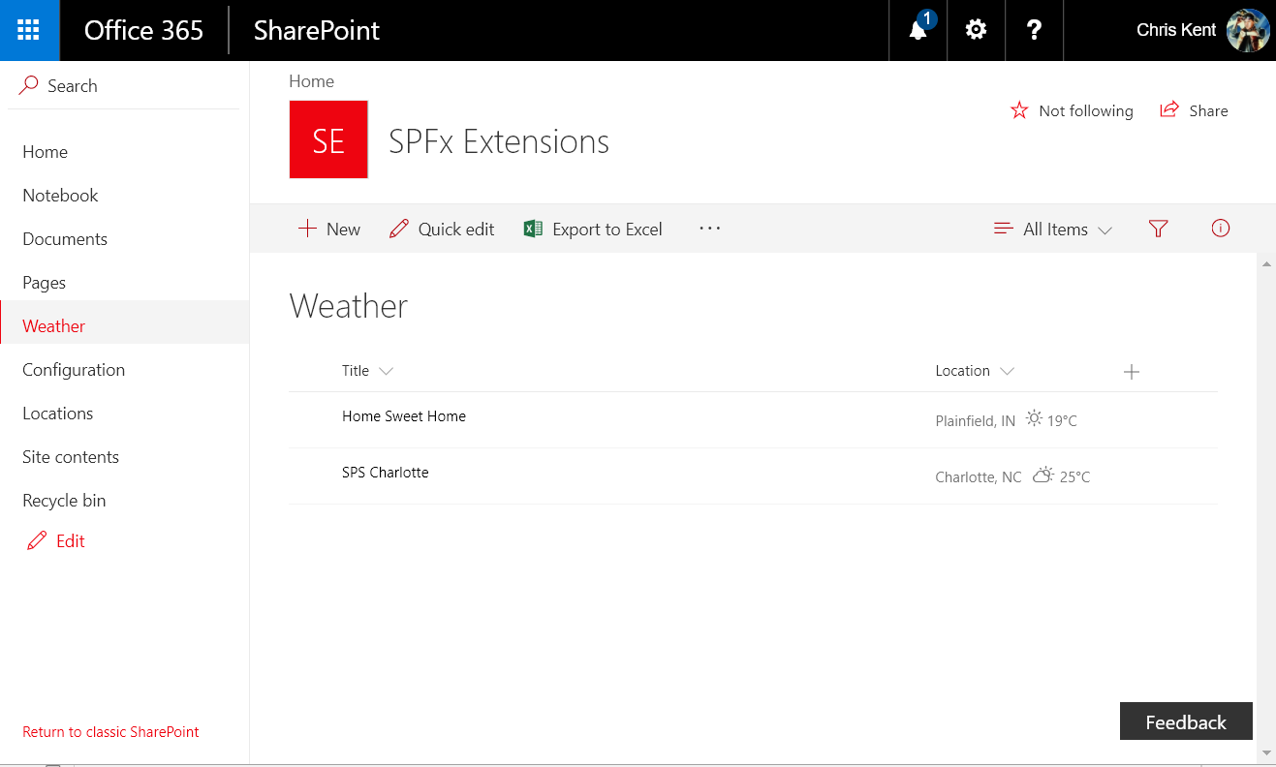
Notes:
Weather in Celsius
Query String:
?loadSPFX=true&debugManifestsFile=https://localhost:4321/temp/manifests.js&fieldCustomizers={"Location":{"id":"b754b644-6821-4ce7-94b4-e374e7b657e0","properties":{"unit":"c"}}}

Slide 51
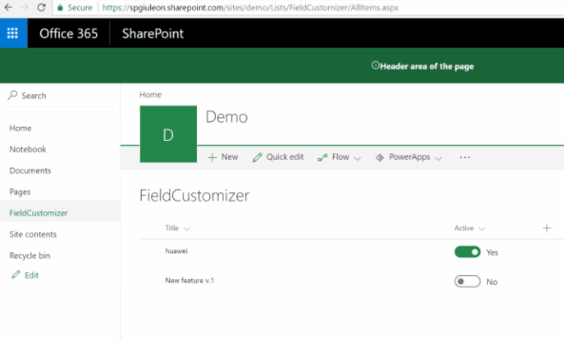

Toggle Field
DEMO
Field Customizer
Office UI Fabric React Components
Inline Editing from View
Giuliano De Luca
@giuleon

Slide 52
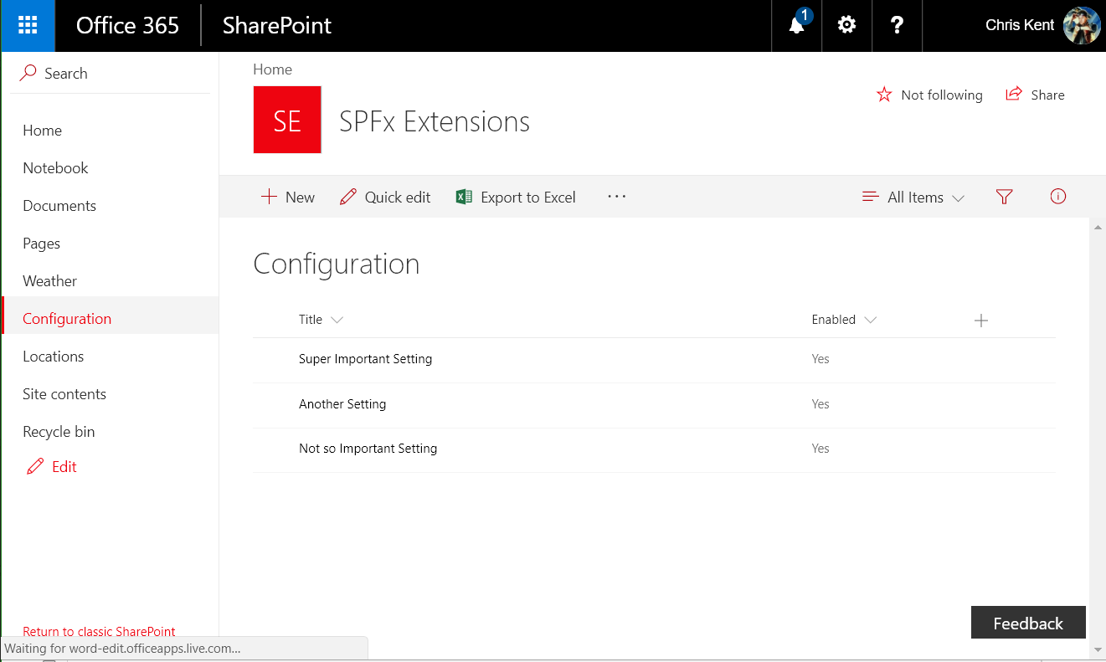
Notes:
List without the Field Customizer applied (specifically the Enabled field)

Slide 53
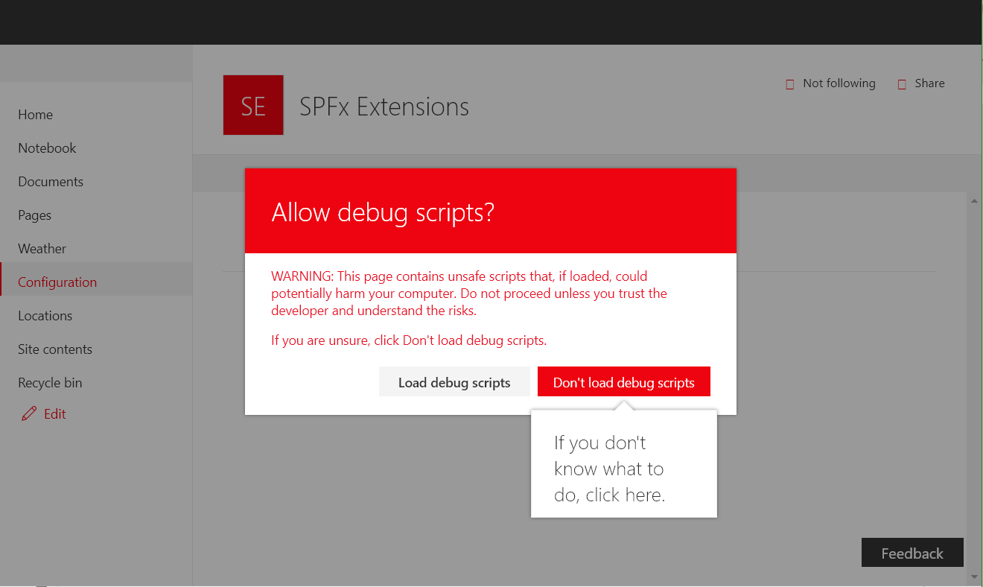
Notes:
The warning when using the debug query strings

Slide 54
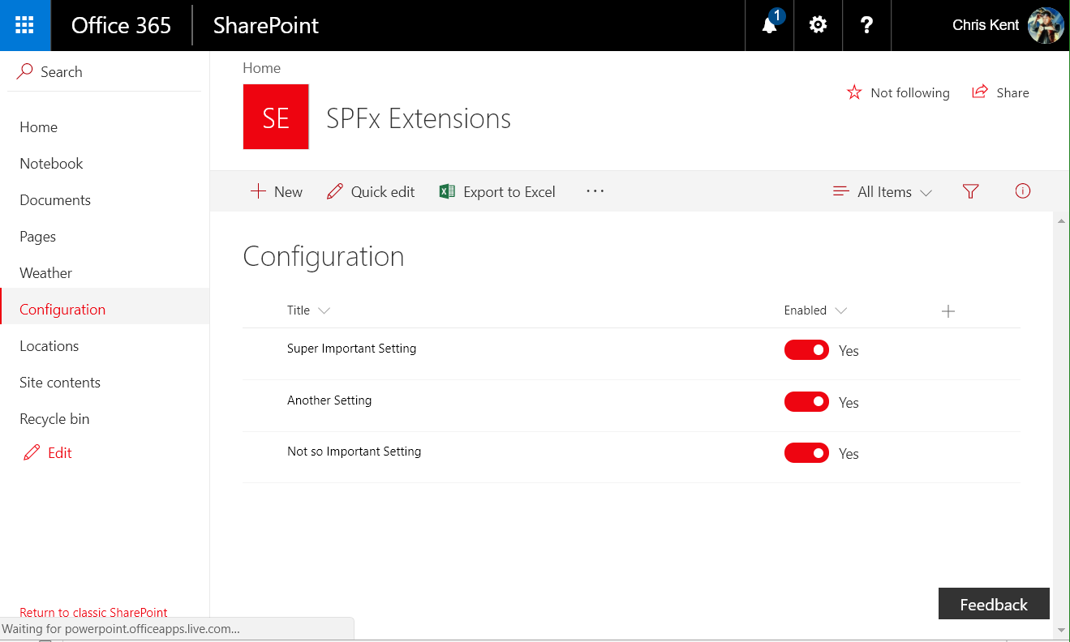
Notes:
Toggled!
Query String:
?loadSPFX=true&debugManifestsFile=https://localhost:4321/temp/manifests.js&fieldCustomizers={"Enabled":{"id":"972be477-1d2a-4656-a83a-63eb02552556","properties":{}}}

Slide 55
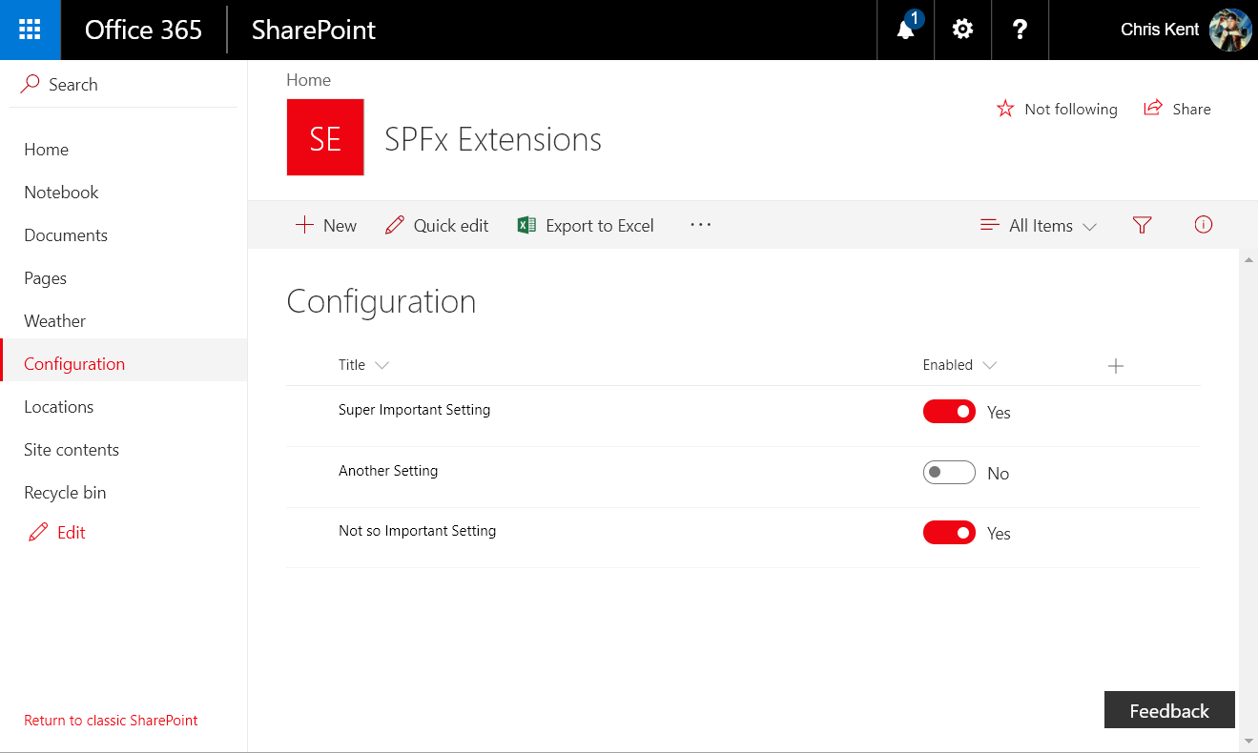
Notes:
You can switch the toggle right from the list view

Slide 56
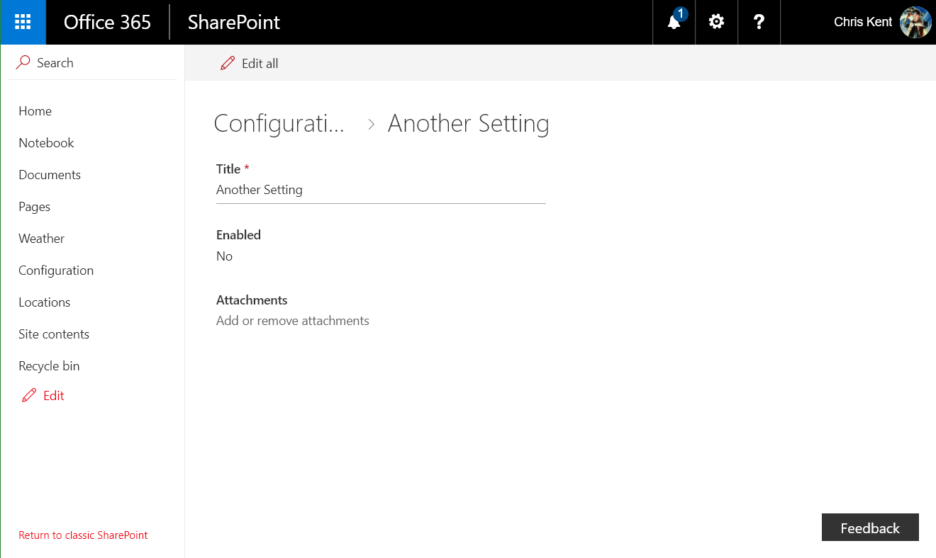
Notes:
The changes were actually applied!

Slide 57
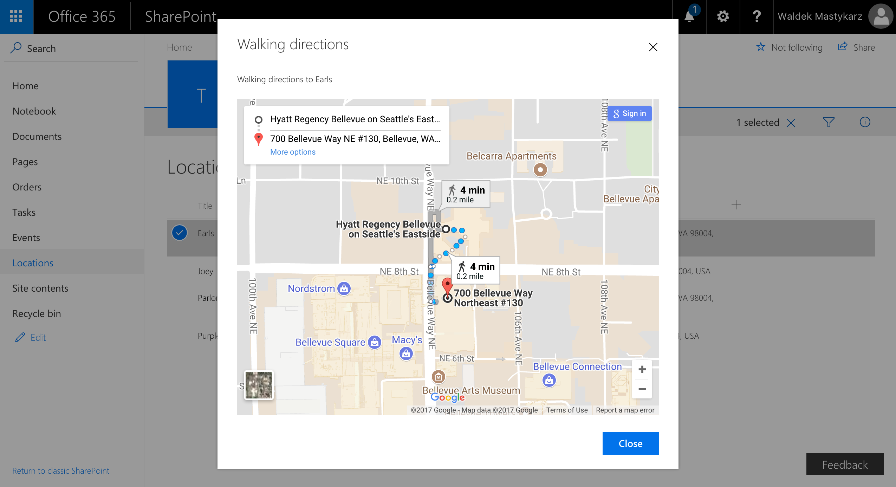
Directions Command
DEMO
ListView Command Set
Custom Dialog Component
Config Through Parameters
Waldek Mastykarz
@waldekm

Slide 58
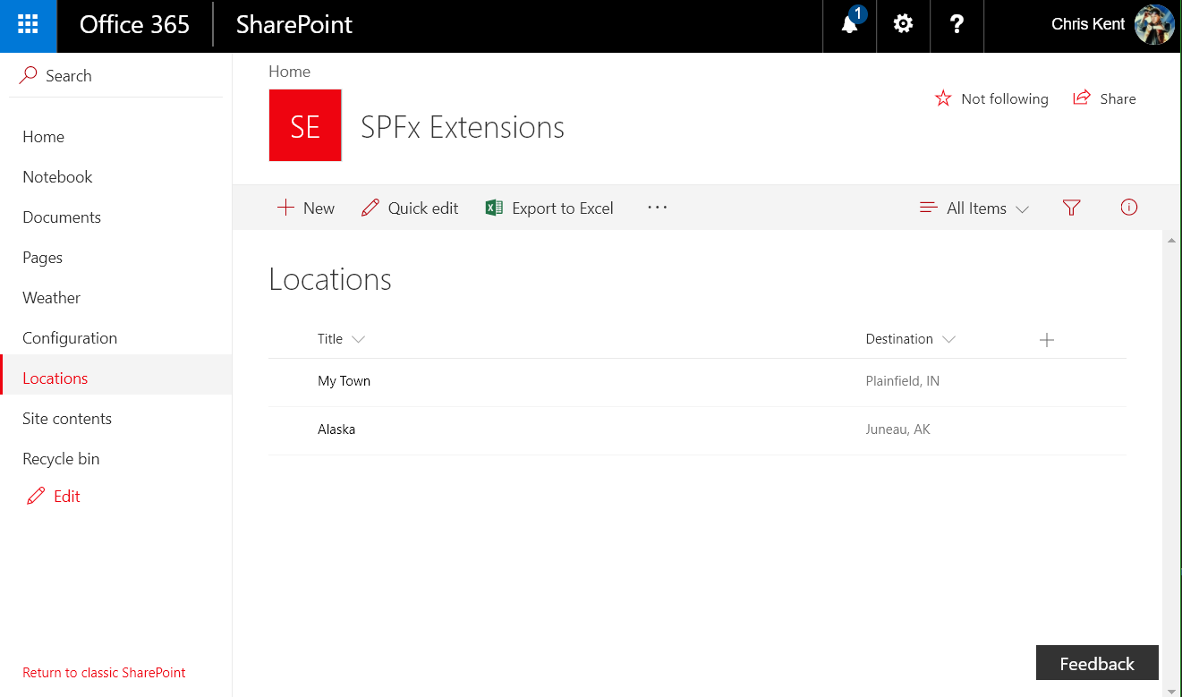
Notes:
The list view without the Command Set

Slide 59
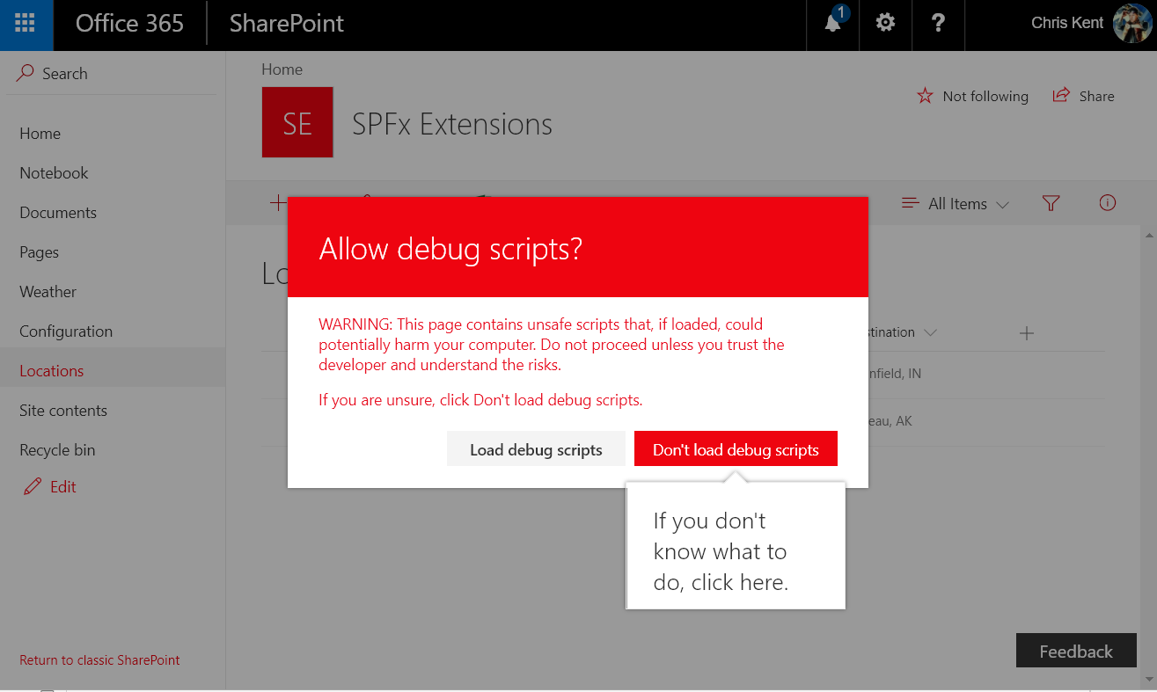
Notes:
The warning when using the debug query strings

Slide 60
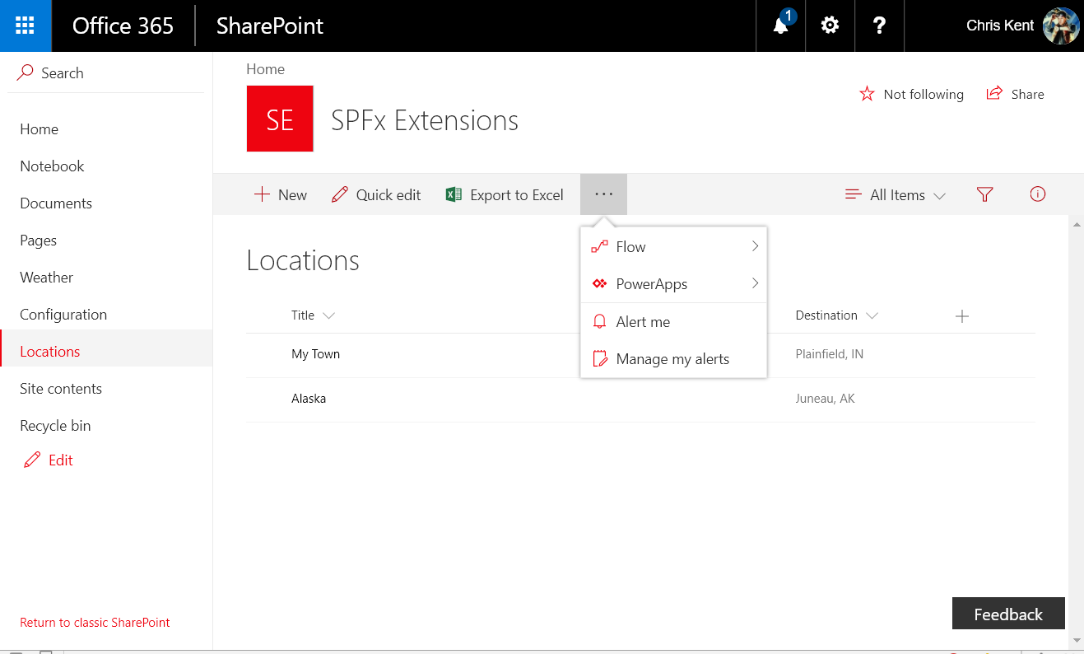
Notes:
The command set doesn’t show up until you’ve selected an item

Slide 61
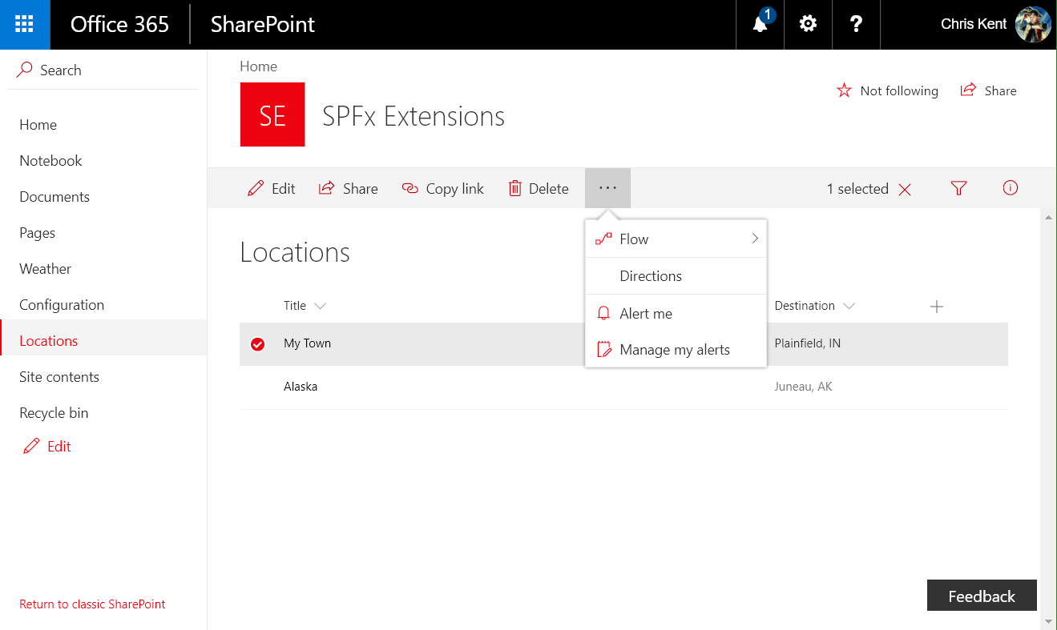
Notes:
The Directions command set
Query String:
?loadSPFX=true&debugManifestsFile=https://localhost:4321/temp/manifests.js&customActions={"0fdd064c-5ded-433c-9078-332226423322":{"location":"ClientSideExtension.ListViewCommandSet.CommandBar","properties":{"startingLocation":"Charlotte, NC","addressColumnName":"Destination","title":"All Roads Lead Home","message":"Directions to ","mode":"walking","mapsApiKey":“PROVIDE YOUR OWN GOOGLE MAPS API KEY HERE"}}}

Slide 62
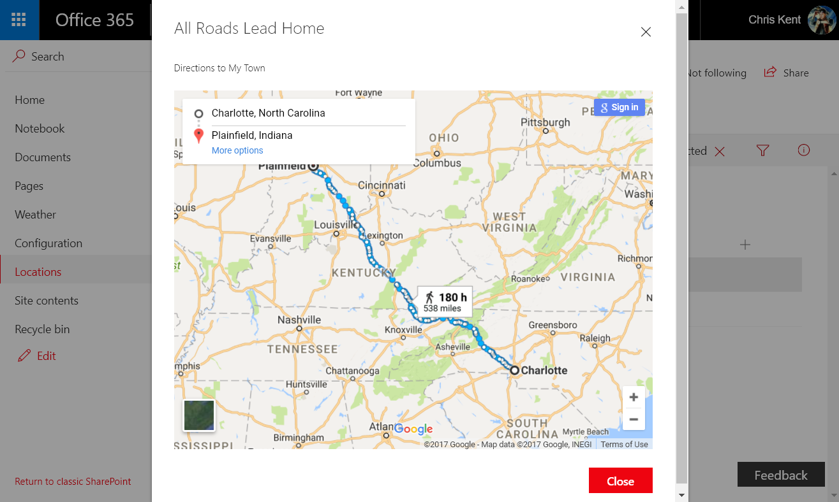
Notes:
Directions to Plainfield, IN!
Query String:
?loadSPFX=true&debugManifestsFile=https://localhost:4321/temp/manifests.js&customActions={"0fdd064c-5ded-433c-9078-332226423322":{"location":"ClientSideExtension.ListViewCommandSet.CommandBar","properties":{"startingLocation":"Charlotte, NC","addressColumnName":"Destination","title":"All Roads Lead Home","message":"Directions to ","mode":"walking","mapsApiKey":“PROVIDE YOUR OWN GOOGLE MAPS API KEY HERE"}}}

Slide 63
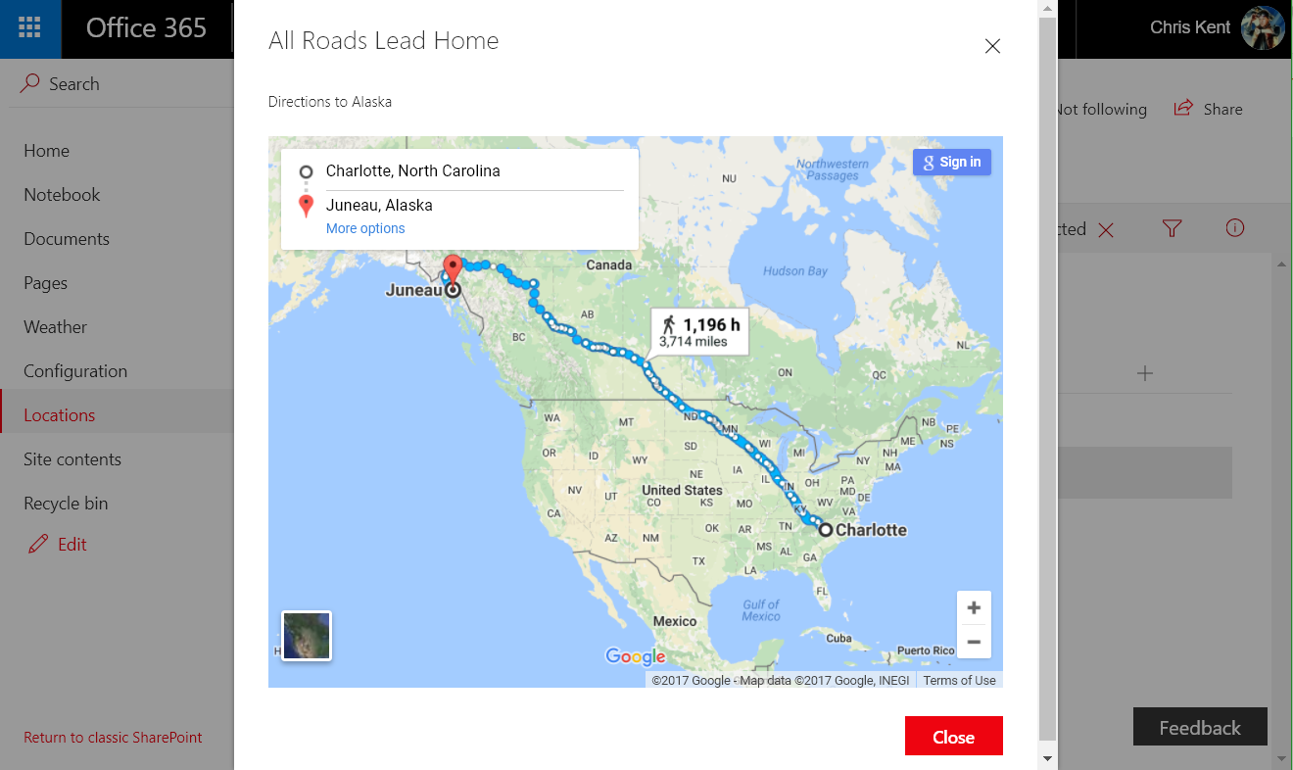
Notes:
Directions to Juneau, AK! Just a short walk.
Query String:
?loadSPFX=true&debugManifestsFile=https://localhost:4321/temp/manifests.js&customActions={"0fdd064c-5ded-433c-9078-332226423322":{"location":"ClientSideExtension.ListViewCommandSet.CommandBar","properties":{"startingLocation":"Charlotte, NC","addressColumnName":"Destination","title":"All Roads Lead Home","message":"Directions to ","mode":"walking","mapsApiKey":“PROVIDE YOUR OWN GOOGLE MAPS API KEY HERE"}}}

Slide 64
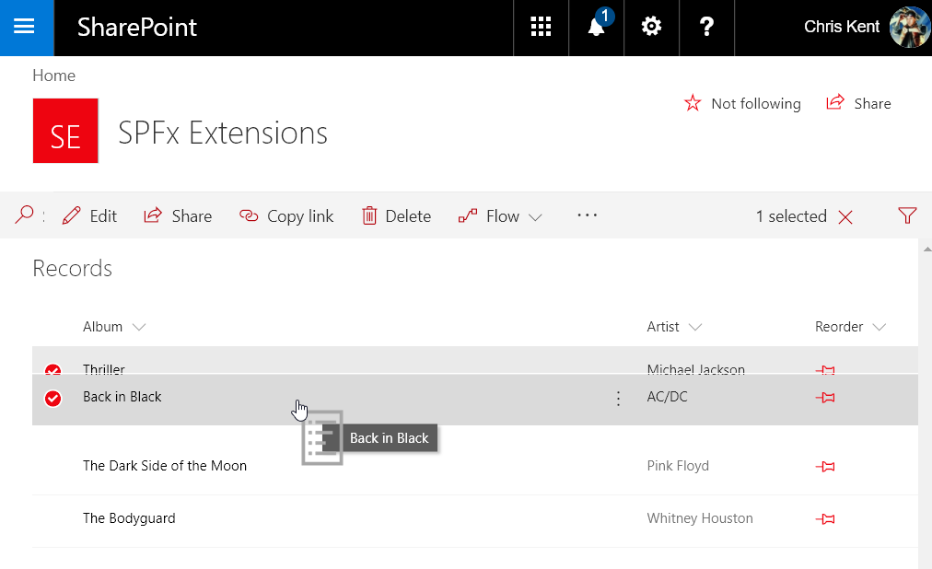
Item Order Field
DEMO
Field Customizer
PnP JS Core Batching
jQuery/jQuery UI
Custom Property
Chris Kent
@thechriskent

Slide 65
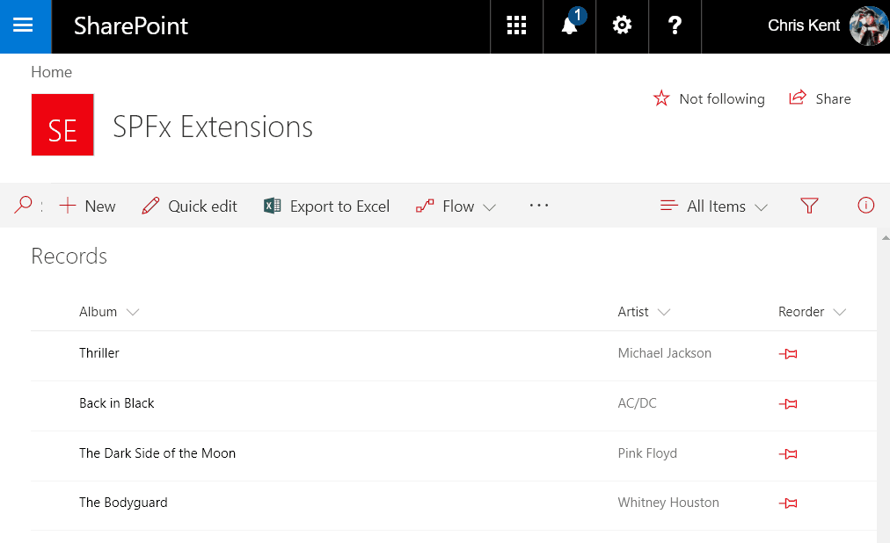
Notes:
Query String:
?loadSPFX=true&debugManifestsFile=https://localhost:4321/temp/manifests.js&fieldCustomizers={"Reorder":{"id":"e6bdc269-2080-47b8-b096-e7bf2a9263a9","properties":{}}}

Slide 66
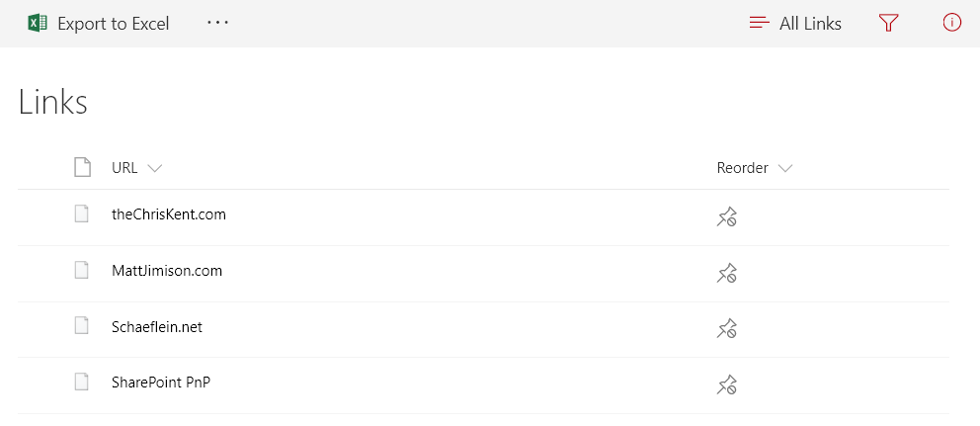
Notes:
Insufficient Permissions

Slide 67
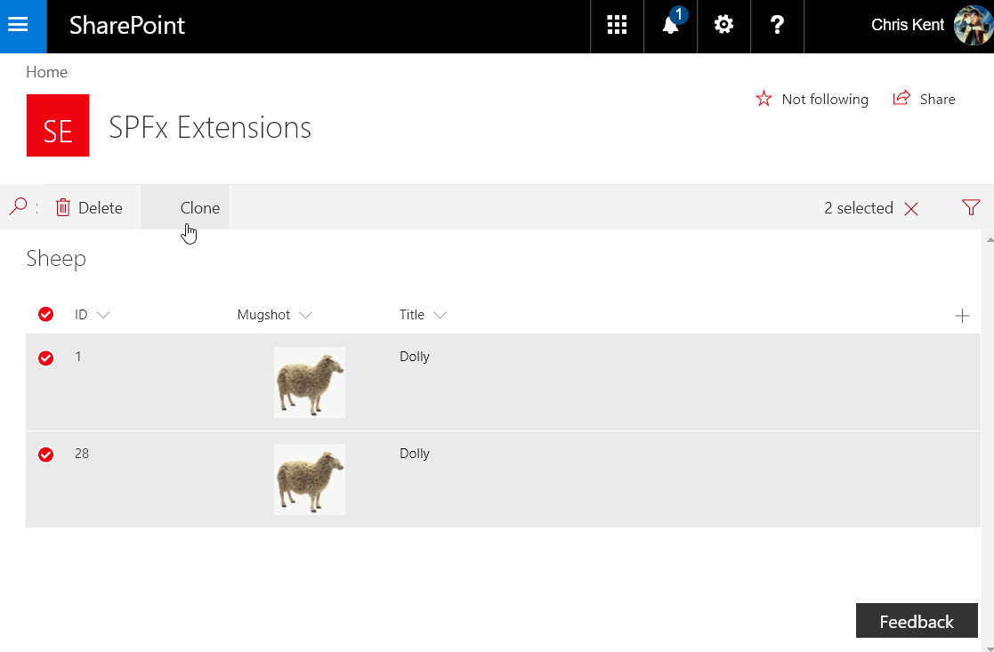
Clone Command
DEMO
ListView Command Set
Conditional Command
PnP JS Core Batching
Field specific formats for REST
Chris Kent
@thechriskent

Slide 68
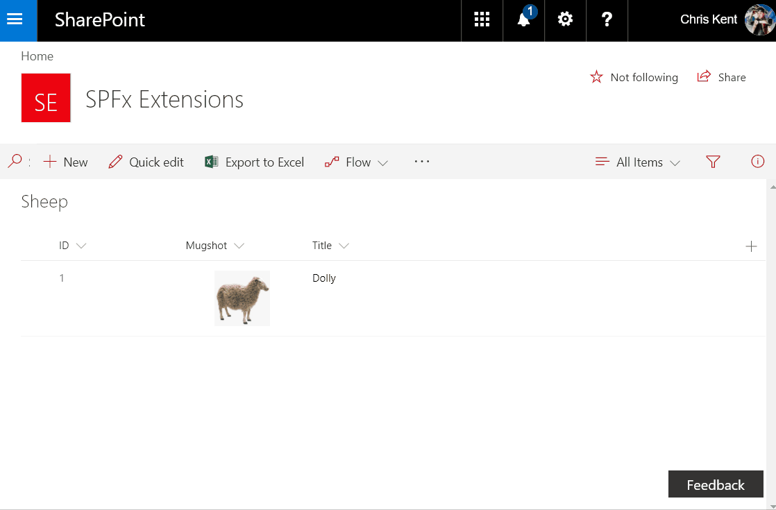
Notes:
Makin’ Sheep!
Query String:
?loadSPFX=true&debugManifestsFile=https://localhost:4321/temp/manifests.js&customActions={"bf6645bd-42e4-4a30-aad7-6ff12d61fa1f":{"location":"ClientSideExtension.ListViewCommandSet"}}

Slide 69
Column Formatting vs Field Customizer
When to use what

Slide 70
Demo
Column Formatting & Column Formatter
Notes:
Basic Hello World web part. Added custom color property to better illustrate how the properties immediately change things.

Slide 71
Column Formatting vs Field Customizer
Customization | Column Formatting | Field Customizer
Conditional Formatting based on item values | Supported | Supported

Slide 72
Column Formatting vs Field Customizer
Customization | Column Formatting | Field Customizer
Conditional Formatting based on item values | Supported | Supported
Action Links | Static links (no script) | Any type of link

Slide 73
Column Formatting vs Field Customizer
Customization | Column Formatting | Field Customizer
Conditional Formatting based on item values | Supported | Supported
Action Links | Static links (no script) | Any type of link
Visualizations | Simple Visualizations (HTML & Styles) | Whatever!

Slide 74
Column Formatting vs Field Customizer
Customization | Column Formatting | Field Customizer
Conditional Formatting based on item values | Supported | Supported
Action Links | Static links (no script) | Any type of link
Visualizations | Simple Visualizations (HTML & Styles) | Whatever!
Page Context | @now, @me | Full context!

Slide 75
Column Formatting vs Field Customizer
Customization | Column Formatting | Field Customizer
Conditional Formatting based on item values | Supported | Supported
Action Links | Static links (no script) | Any type of link
Visualizations | Simple Visualizations (HTML & Styles) | Whatever!
Page Context | @now, @me | Full context!
JS Libraries | Nope | Go for it!
Custom CSS Classes | Nope, limited subset & inline styles | Go for it!
Interactivity | Nope (not even hover) | Go for it!

Slide 76
Column Formatting vs Field Customizer
Customization | Column Formatting | Field Customizer
Conditional Formatting based on item values | Supported | Supported
Action Links | Static links (no script) | Any type of link
Visualizations | Simple Visualizations (HTML & Styles) | Whatever!
Page Context | @now, @me | Full context!
JS Libraries | Nope | Go for it!
Custom CSS Classes | Nope, limited subset & inline styles | Go for it!
Interactivity | Nope (not even hover) | Go for it!
Developer Required | “No” | Yes
Solution Deployment | Not needed | Required
Use Column Formatting whenever possible, but know it’s limits

Slide 77

SharePoint
Patterns & Practices
Learn. Reuse. Share.

Slide 78






“The SharePoint Patterns and Practices (PnP) is an open source initiative coordinated by SharePoint engineering”
Libraries
Reusable Components
Tutorials
Videos
Samples
Documentation
Tools
+ Way More People, Maybe even You?

Slide 79
Staying Up to Date with PnP
https://dev.office.com/pnp
Join the calls (or watch on YouTube later)
  http://aka.ms/sppnp-videos
  Monthly Update call
  Bi Weekly Special Interest Groups
    JavaScript
    Core & PowerShell
Read the Updates
  http://dev.office.com/blogs
Visit the Tech Community
  http://aka.ms/sppnp-community

