Slide 1
Getting the Most out of
SharePoint
Patterns & Practices
Chris Kent
Office 365 Practice Lead, DMI

Slide 3














“Me”
Indianapolis, IN
Office Development
Office 365 Practice Lead
@theChrisKent
theChrisKent.com
Notes:
Can I possibly get my name on a single slide even more? Wow.

Slide 4

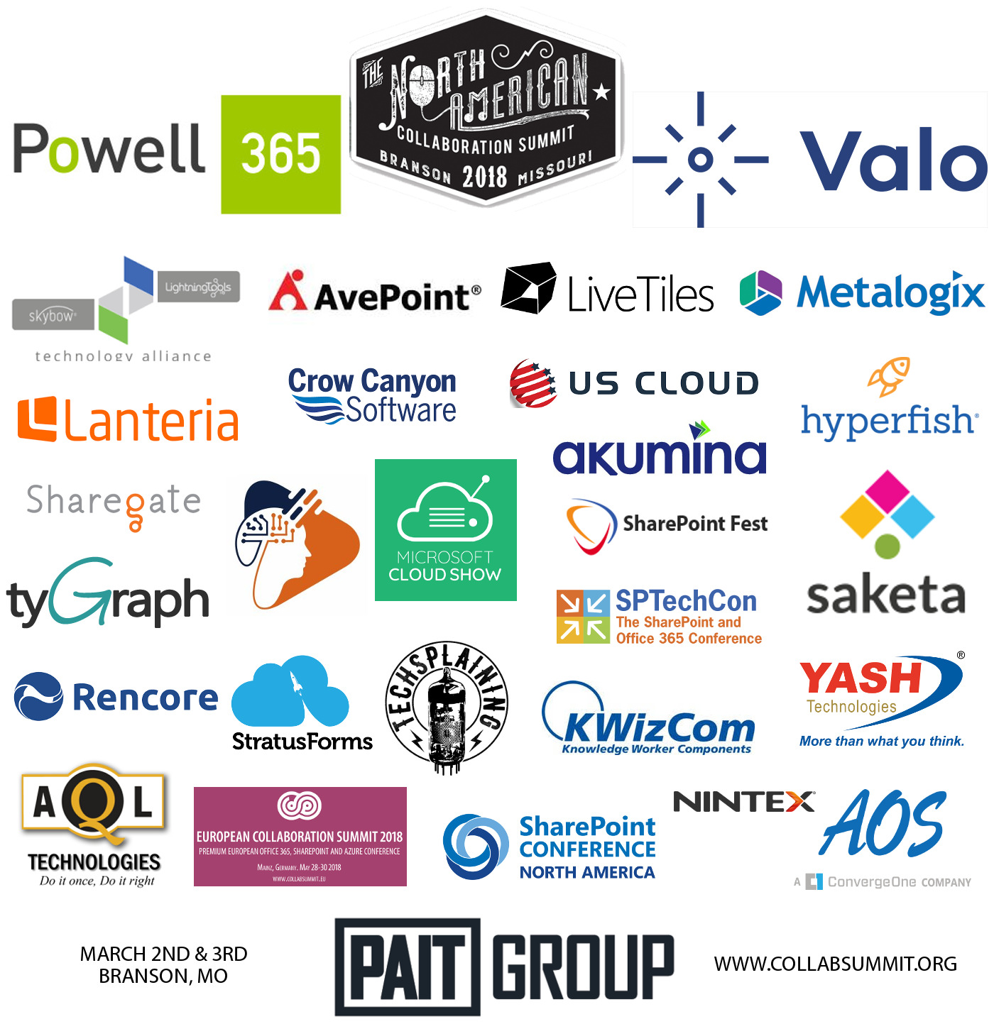
MAKE SURE TO THANK OUR SPONSORS!
WEAR YOUR NACS WRISTBAND FOR LUNCH SPECIALS ON BRANSON LANDING
PLAY VENDOR BINGO FOR YOUR CHANCE TO WIN A i7 16GB 1TB SURFACE BOOK

Slide 5
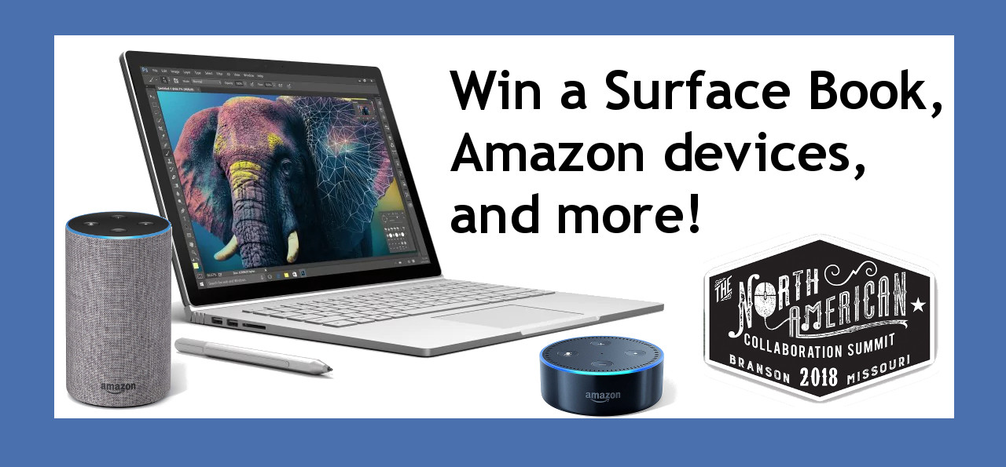
PRIZE DRAWINGS HAPPEN AFTER THE END OF THE DAY SESSIONS ON FRIDAY AND SATURDAY. YOU MUST ATTEND THE END OF THE DAY SESSION TO WIN.

Slide 6
Goals

Slide 7
Patterns & Practices
Why | What | How

Slide 8
Staying INFORMED
Videos | Calls | Updates

Slide 9
SHARING IS CARING
How to Contribute

Slide 10
Audience Participation!
Your
Role(s)
IT Pro
Flavor of SharePoint
On-Premises
Experience with PnP
Heard of it
PnP Interest
None
Management
Developer
Other
O365
None
Used a little
Contributor
Not Sure
SPFx Guidance
Use it all the time!
Remote Provisioning
PnP PowerShell
Samples
Tools
I’m Vesa Juvonen

Slide 11
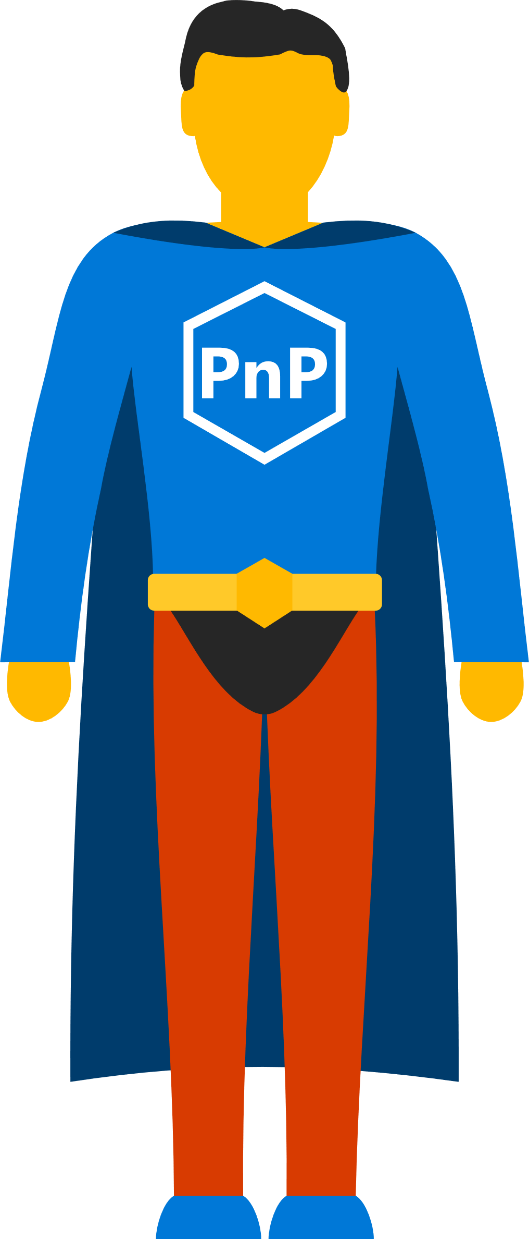
SharePoint
Patterns & Practices
Learn. Reuse. Share.

Slide 12

Wouldn’t it be great, if you had peers to share with and learn from?

Slide 13



Practical lessons shared by the community for the community

Slide 15








“The SharePoint Patterns and Practices (PnP) is an open source initiative coordinated by SharePoint engineering”
Libraries
Reusable Components
Tutorials
Videos
Samples
Documentation
Tools
+ Way More People, Maybe even You?

Slide 16
2013
Internal
Internal initiative in Microsoft to start collecting learnings from add-in model
2014
Going public
Going first public in CodePlex, then moved to GitHub. Concentration on add-in model enterprise scenarios.
2015
Reusability
PnP Provisioning Engine introduced. Reusable components and solutions, like PnP Partner Pack introduced. Weekly webcasts started.
2016
Partnership
PnP ownership moved to engineering, team works with a partnership on aligning roadmap. Work with SP Framework starts.
2017
Integration
SharePoint Dev Ecosystem = SharePoint PnP. End-to-end coordination of the SharePoint development guidance and community activities.
More than 7.2 billion requests using PnP reusable controls during December 2017
More than 250 samples to learn from and take advantage of in your work
More than 300 contributors in SharePoint GitHub organization.
More than 31,000 unique
visitors during past 2 weeks in SharePoint organization repositories
More than 20,000 tenants have used PnP reusable components and controls in SharePoint Online.

Slide 17




Personal
Areas of Contribution
Documentation
Grammar Fixes
Updates
Samples
WebParts
Application Customizers
Field Customizers
ListView Command Sets
Presentations
Internal
External
SIG Calls
Code
Bug Fixes
New Features
Issue Submission

Slide 18
Personal
Areas of Contribution
- Official PnP Repositories -
SP-Dev-Docs
SharePoint Developer Documentation
SP-Dev-Fx-Extensions
SPFx Extension Code Samples
SP-Dev-Fx-Property-Controls
Reusable SPFx Property Pane Controls
PnP-JS-Core
JS Core Component for SP Rest and MS Graph
PnP-PowerShell
SP/O365 PnP PowerShell CmdLets
SP-Dev-Solutions
Reusable SharePoint solutions
- Other Areas -
SPFx WebParts, Client Side Rendering, VS Code Debugging, Remote Provisioning, Traditional SP Development, etc.

Slide 19




The Magical World of PnP
Scratching the surface

Slide 20

What’s in PnP (Selective Highlights)
PnP Core - https://github.com/SharePoint/PnP-Sites-Core
PnP PowerShell - https://github.com/SharePoint/PnP-PowerShell
PnP Remote Provisioning - https://github.com/SharePoint/PnP-Provisioning-Schema
PnP JS-Core - https://github.com/SharePoint/PnP-JS-Core
SharePoint Docs - https://github.com/SharePoint/sp-dev-docs
SPFx Web Part Samples - https://github.com/SharePoint/sp-dev-fx-webparts
SPFx Extension Samples - https://github.com/SharePoint/sp-dev-fx-extensions
Dev Solutions - https://github.com/SharePoint/sp-dev-solutions

Slide 21


Tenant Administration
Remote Provisioning
Programmatic Configuration
And More
2013, 2016, O365
Works with (not replaces)
SP PowerShell
What Can You Do With:
PNP PowerShell

Slide 22
PnP-PowerShell Cmdlets
285+ CmdLets
Apps (11)
Base Cmdlets (13)
Branding (18)
Client-Side Pages (9)
Content Types (9)
Diagnostic Utilities (3)
Document Sets (5)
Event Receivers (3)
Features (4)
Fields (7)
Files and Folders (18)
Information Management (4)
Lists, Views, & Items (18)
Microsoft Graph (13)
Provisioning (13)
Publishing (13)
Records Management (6)
Search (4)
SharePoint Recycle Bin (5)
SharePoint WebHooks (4)
Sites (11)
Taxonomy (17)
Tenant Administration (23)
User and Group Management (12)
User Profiles (3)
Utilities (1)
Web Parts (11)
Webs (17)
Workflows (10)
https://github.com/SharePoint/PnP-PowerShell/blob/master/Documentation/readme.md

Slide 23
Important Basic Cmdlets
Cmdlet | Description | Platforms
Connect-PnPOnline | Connects to a SharePoint site and creates a context that is required for other PnP Cmdlets (Do this first) | All
Disconnect-PnPOnline | Disconnects the context (Do this last) | All
Get-PnPContext | Returns a Client Side Object Model context | All
Connect-PnPOnline https://mytenant.sharepoint.com/sites/MySite -CurrentCredentials
https://thechriskent.com/2018/02/14/using-sharepoint-pnp-powershell-modules-side-by-side-2013-2016-online/

Slide 24
Demo: PnP PowerShell
Notes:
Connect-PnPOnline https://thechriskent.sharepoint.com/sites/fun
Add-PnPClientSidePage -Name "Magic" –CommentsEnabled
Add-PnPClientSideText -Page "Magic" -Text “Yo dawg, welcome to my site"
Add-PnPClientSideWebPart -Page "Magic" -DefaultWebPartType BingMap -WebPartProperties "{pushPins:[{title:'Home Sweet Home',address:'Plainfield, IN'}],center:{latitude:39.7044,longitude:-86.3978,altitude:0,altitudeReference:-1},zoomLevel:13}"

Slide 25

Site Columns
Content Types
Lists
Data Rows
Pages
Custom Actions
Remote Provisioning
What Can You Do With:

Slide 26


PnP Provisioning Engine
Uses the Client Side Object Model (CSOM) to provision artifacts instead of using the Feature Framework
  Removes the need to use declarative XML!
Can use the SharePoint UI to create artifacts
Creates a Template file
  XML with resources, or a PnP archive

Slide 27
Remote Provisioning Supported Environments
SharePoint 2013
  Minimum required version: April 2015 CU
  Full functionality required version: January 2016 CU
SharePoint 2016
SharePoint Online
  Best Coverage
  Includes full support for SPFx Web Parts & extensions
  Modern pages, Modern sites

Slide 28
Important Provisioning Cmdlets
Cmdlet | Description | Platforms
Get-PnPProvisioningTemplate | Generates a provisioning template from a web | All
Apply-PnPProvisioningTemplate | Applies a provisioning template to a web | All
Connect-PnPOnline https://mytenant.sharepoint.com/sites/MySite -CurrentCredentials
Get-PnPProvisioningTemplate -Out MyTemplate.xml
Disconnect-PnPOnline

Slide 29

Demo: Remote
Provisioning
Notes:
Create list on Model site with 1 or 2 columns
Create new Comm site Target, go to site contents
Connect-PnPOnline https://thechriskent.sharepoint.com/sites/Model
Get-PnPProvisioningTemplate -Out "MyTemplate.xml" -Handlers Lists
Disconnect-PnPOnline
Open MyTemplate.xml
Connect-PnPOnline https://thechriskent.sharepoint.com/sites/Target
Apply-PnPProvisioningTemplate -Path "MyTemplate.xml" -Handlers Lists
Disconnect-PnPOnline

Slide 30

Site Designs & Remote Provisioning
Brand New (January 2018, Targeted Release)
O365 Modern Site Provisioning
JSON Schema
  Add Lists & Fields
  Add Navigation Links
  Set Theme and Logo
  Join Hub Site
  Trigger a Flow
Flow
Http Call
Azure Queue
Azure Function
Apply Template
Additional Configuration
https://docs.microsoft.com/en-us/sharepoint/dev/declarative-customization/site-design-pnp-provisioning

Slide 31

Demo: Site Design with
Remote Provisioning
Notes:
Show MySpecialTemplate.xml
Show Site Design JSON
Show Flow
Create Site

Slide 32

Fluent API
Batching
Caching
The best way to access the REST API via JS
PnPJS
What Is:

Slide 33
Choose your functionality
@pnp/common
@pnp/config-store
@pnp/graph
@pnp/logging
@pnp/nodejs
@pnp/odata
@pnp/pnpjs
@pnp/sp
@pnp/sp-addinhelpers
Rollup (mimics sp-pnp-js)
Fluent API for SharePoint REST
String Concatenation
api/web/lists/getbytitle(‘Things’).items?$select=Title,Author/Id$expand=Author&$top=50
Fluent API
sp.web.lists.getByTitle("Things").items.select("Title","Author/Id").expand("Author").top(50)

Slide 34

Demo: PnPJS

Slide 35

Documentation
Best Practices
Tutorials
Videos & Webcasts
Sample Solutions
Full Solutions
Use what makes sense
You don’t need to start at the “beginning”
What’s Available:
PnP Guidance

Slide 36
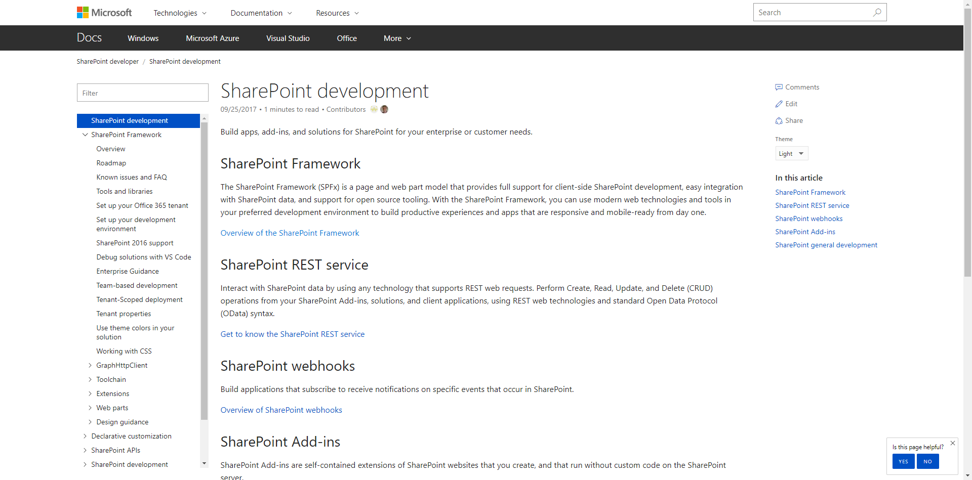
Documentation and guidance
aka.ms/spdev-docs
  Consolidated location for documentation and guidance
  SharePoint Framework, including API reference
  SharePoint add-ins
  Declarative customizations, etc.

Slide 37

Documentation and guidance
aka.ms/spdev-docs
  Consolidated location for documentation and guidance
  SharePoint Framework, including API reference
  SharePoint add-ins
  Declarative customizations, etc.
Great spot to start contributing!

Slide 38

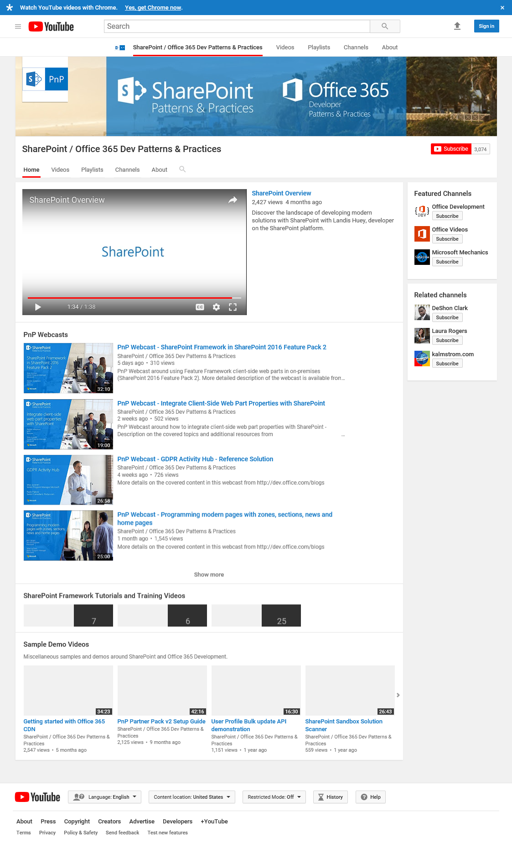

Videos &
Webcasts
aka.ms/spdev-videos
200+ Videos!
  Web cast recordings
  Quick Guidance Videos
  Tutorial Videos
  Training Videos
  Weekly and monthly community call recordings

Slide 39
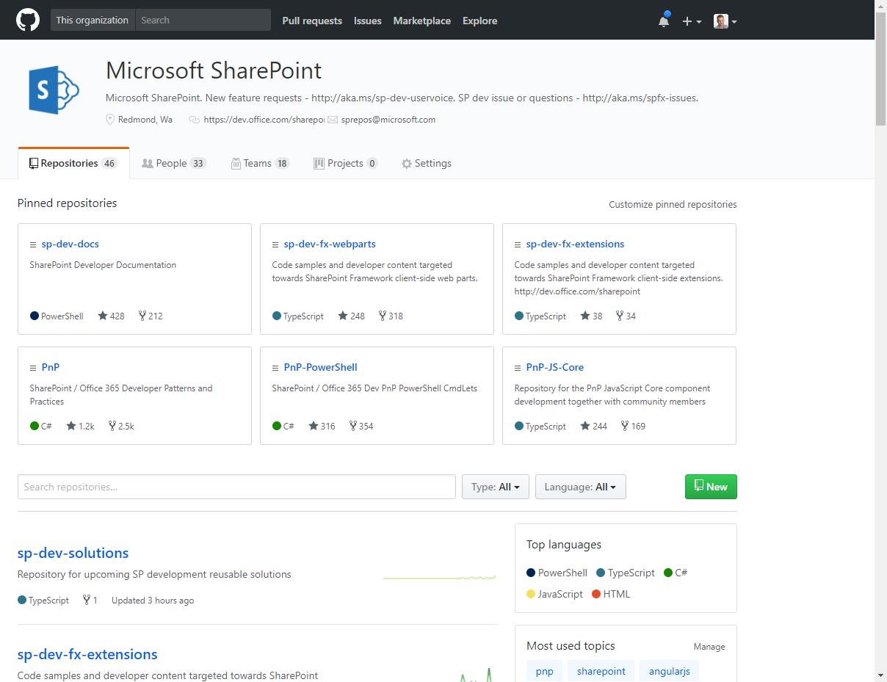
Samples and
Solutions
github.com/sharepoint
300+ Samples!
  SPFx Webparts & Extensions
  Provider hosted Add-ins
  Reusable controls and components
  PnP PowerShell and Scripts
  Build extensions
  Full Solutions

Slide 40


The Modern Listview
Responsive
Fancy
Boring
No XSLT
No Calculated Column Trickery

Slide 41


Dapper
The Modern Listview

Slide 42



Slide 43














Todd
the Hero
Sad

Slide 44
Column Formatter
Easy editor for modern listview Column Formatting
github.com/SharePoint/SP-Dev-Solutions/tree/master/Solutions/ColumnFormatter

Slide 45
Demo: Column Formatter

Slide 46

Staying Informed
Keeping up to date with PnP

Slide 47
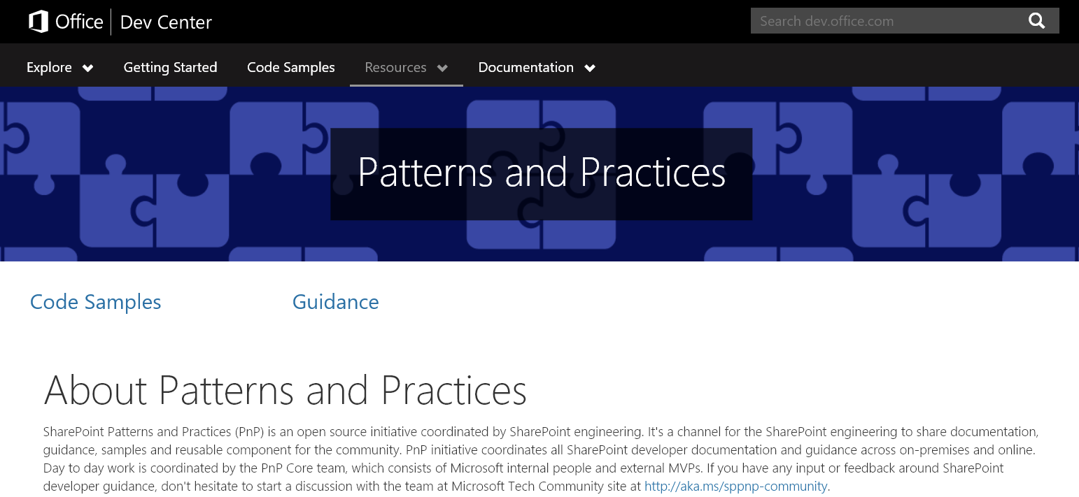
aka.ms/sppnp

Slide 48


  Bi-Weekly
  SP General Development
  aka.ms/sppnp-core-sig-call
  PowerShell, Provisioning, CSOM
  Next Call: Thursday, 1/25
  Bi-Weekly
  SharePoint Framework
  aka.ms/sppnp-js-sig-call
  SPFx, PnP JS Core
  Next Call: Thursday, 2/1
  Monthly
  Community Calls
  aka.ms/sppnp-call
  Monthly Summary
  Next Call: Tuesday, 2/13

Slide 49



CONSUME & INTERACT
Official Blog
dev.office.com/blogs
Twitter
@OfficeDevPnP
Tech Community
aka.ms/sppnp-community

Slide 50


Sharing is Caring
Contributing to Patterns and Practices

Slide 51


How to participate to the PnP initiative?
Get visibility in the internal and external community
Help others on their journey to recommended patterns
Find peers who work on similar topics and engage with customers and partners also using this channel
Report and fix issues
Contribute with new samples, guidance and documentation
Participate on the discussion around needed capabilities
aka.ms/SPPnP
Microsoft
Tech
Community

Slide 52


























Why contribute?
Get acknowledged as contributors in communications
  dev.office.com blog posts
  Monthly community calls
  MSDN pages
Help others by sharing your knowledge of Office 365 and SharePoint development

Slide 53

Demo: Contribution

Slide 54
Learn
Reuse
Share

