Slide 1


Slide 2
List Formatting in O365
(and SharePoint 2019)
Chris Kent
O365 Practice Lead
DMI

Slide 3
BRK064
Session information [hidden slide]
Populate your session information here
List Formatting in O365 and SharePoint 2019
Did you know you can quickly and easily provide dynamic visualizations directly in List views? Both non developers and developers can change how fields and rows look in modern list views by creating simple JSON objects. Learn how to conditionally format fields and rows to take your lists from simple tables to meaningful views. We'll cover the basics of list formatting, tips and tricks, and the tools and resources available to enable you to get started immediately.
SharePoint Conference 2019
https://sharepointconference.com/#!/session/List%20formatting%20in%20O365%20and%20SharePoint%202019/3564
May 21, 2019
1:45pm
Premier Ballroom 313
Chris Kent

Slide 5















“Me”
Indianapolis, IN
Office Development
Office 365 Practice Lead
@theChrisKent
Member of the Core Team
theChrisKent.com
Notes:
Can I possibly get my name on a single slide even more? Wow.

Slide 6
Goals

Slide 7
Column Formatting
What | Why | How

Slide 8
View
Formatting
What | Why | How

Slide 9
Resources
Samples | Guidance | Tools
Notes:
Slides are intended for reuse. Lots of information on them, we’ll be moving quickly. Goal is to make you aware of what you can do and provide guides for when you do it later.

Slide 11


The Modern Listview
Responsive
Fancy
Boring
No XSLT
No Calculated Column Trickery

Slide 12


Dapper
The Modern Listview

Slide 13



Slide 14

List Formatting
Declarative modern listview customization
Column Formatting
View Formatting

Slide 15
List formatting allows you to quickly and easily add instant meaning, visual appeal, and dynamic visualizations directly to your lists.

Slide 16
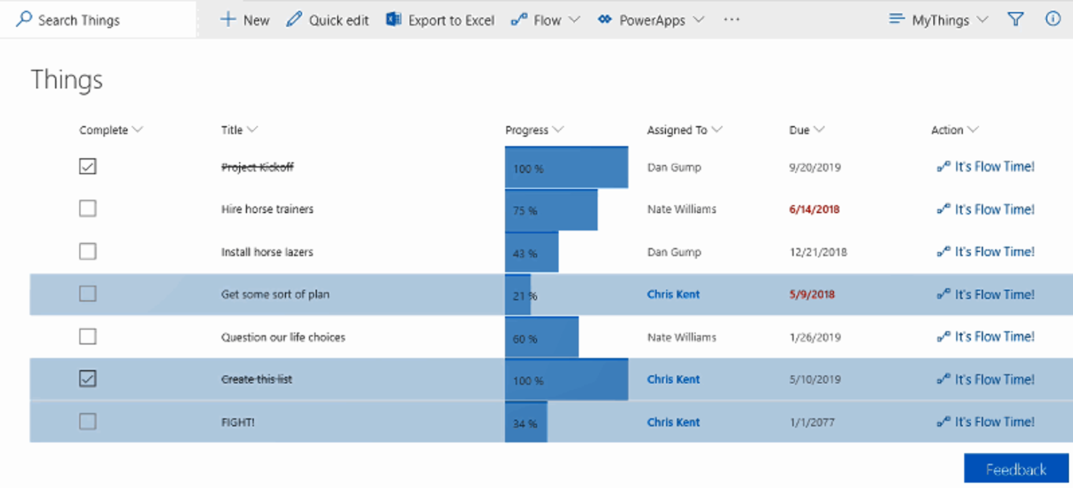

List formatting allows you to quickly and easily add instant meaning, visual appeal, and dynamic visualizations directly to your lists.
List formatting allows you to quickly and easily add instant meaning, visual appeal, and dynamic visualizations directly to your lists.
Missed Due Dates in Red
Checkboxes
vs
Yes/No

Slide 17

List formatting allows you to quickly and easily add instant meaning, visual appeal, and dynamic visualizations directly to your lists.

Slide 18
List formatting allows you to quickly and easily add instant meaning, visual appeal, and dynamic visualizations directly to your lists.
Dynamic Progress Bars
Items Assigned To the Current User

Slide 19
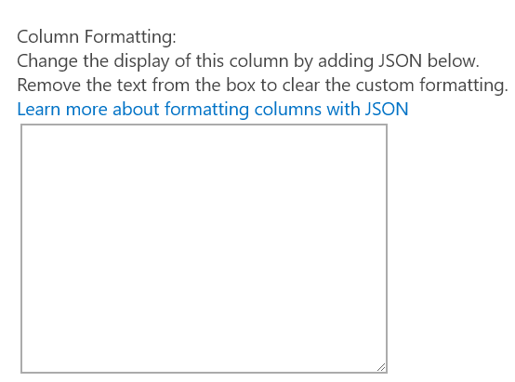
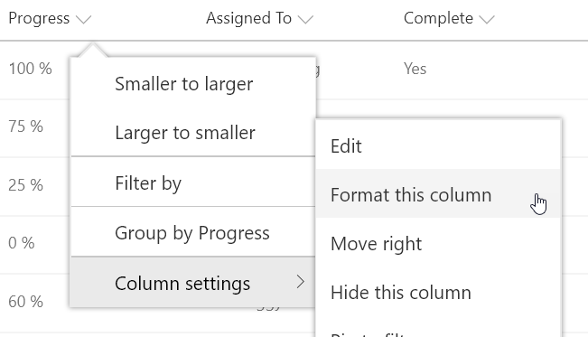
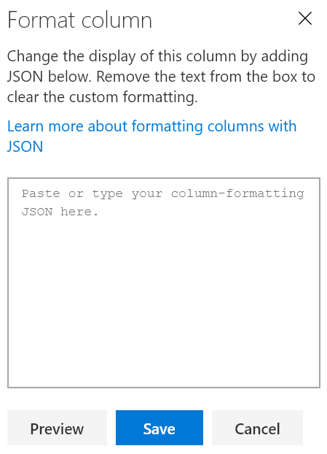

Column Formatting
JavaScript Object Notation (JSON)
Apply directly to list fields or site columns
  Field Settings
  Format this column menu
Stored with the Field
Paste Here
O365 & 2019

Slide 20
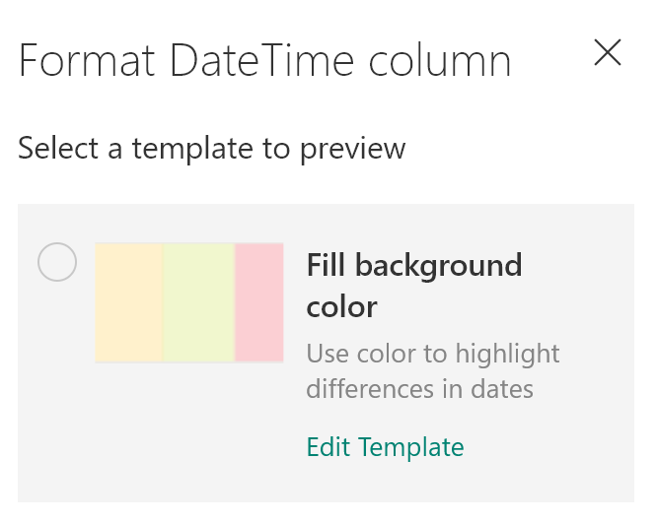
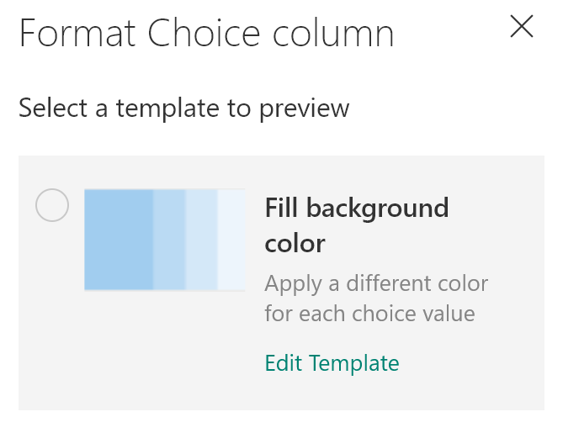
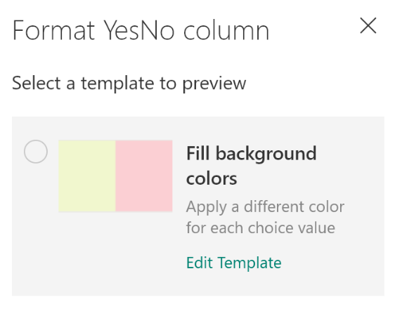
Calculated Date Columns Too
Calculated Yes/No Columns Too
Column Formatting Design Mode

Slide 21
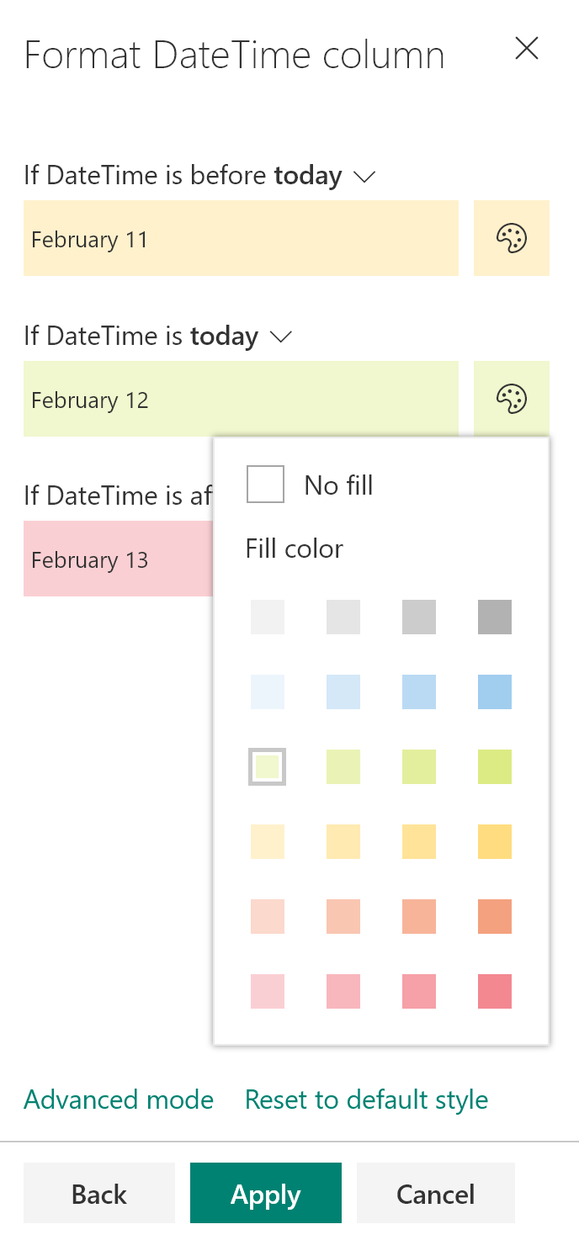
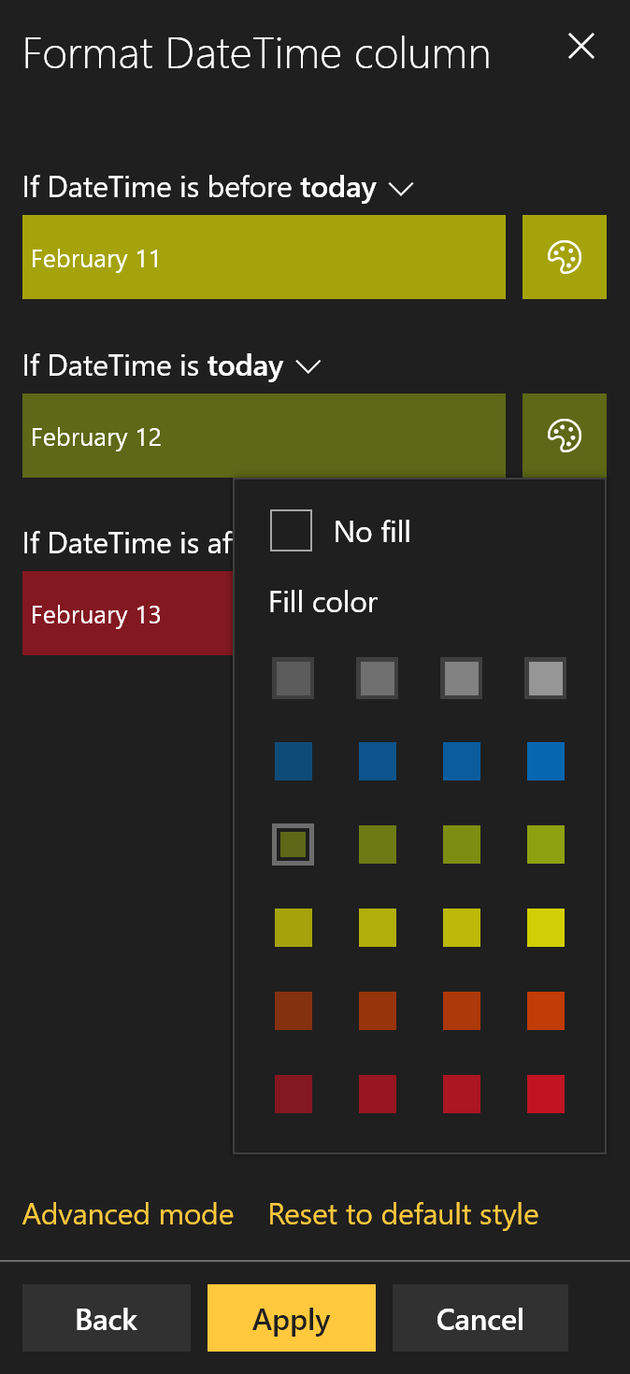
Pre-selected Color Classes
Adjusts for Dark Themes
Switch to JSON
Column Formatting Design Mode

Slide 22
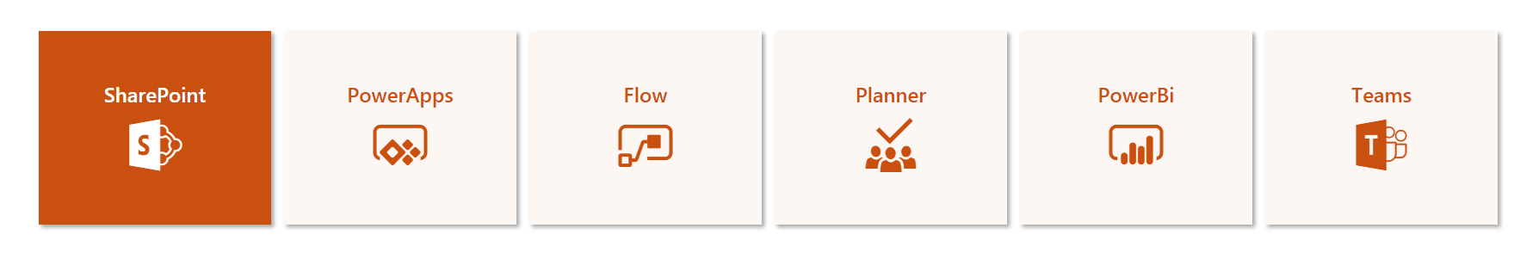
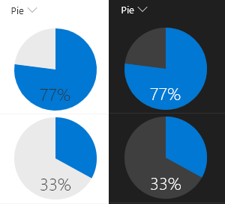
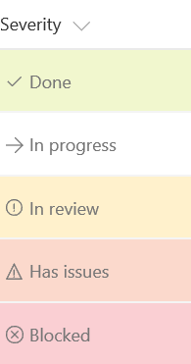
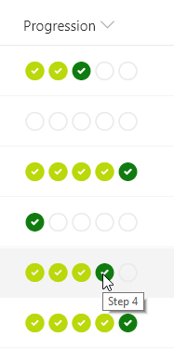
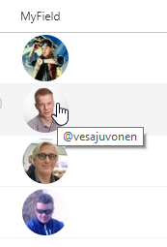
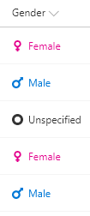
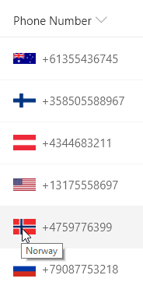
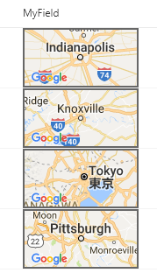
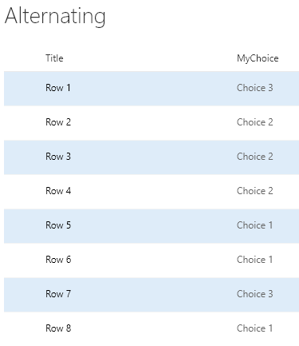
SP-Dev-List-Formatting Samples
50+ Sample Formats
Instructions & Screenshots
Copy & Paste directly from GitHub
bit.ly/LF-samples

Slide 23

Demo: Column Formatting
Notes:
Design Mode
Samples
Very Basic Syntax

Slide 24
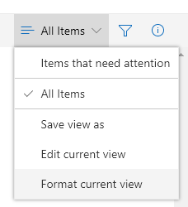
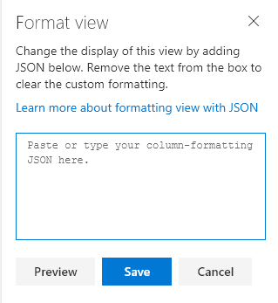

View Formatting
Online Only
Superset of Column Formatting
Apply directly to views
  Format current view menu
Stored with the View
Overrides Column Formats (Row Formats)
Paste Here

Slide 25



View Formatting Flavors
Online Only
Row Class
Row Format
Uses additionalRowClass
Applies class(es) to each row
Can be conditionally applied
Ignored when rowFormatter is used
Uses rowFormatter
Responsible for full rendering of the row

Slide 26
Demo: View Formatting
Notes:
Demonstrate Contact Card Row Format View Formatting Sample: https://github.com/SharePoint/sp-dev-list-formatting/tree/master/view-samples/contact-card-format

Slide 27


Supported Column Types
Calculated
Choice
ContentType
Counter (ID)
Currency*
Date/Time
Hyperlink
Lookup
Multi-Choice
Multi-Line Text*
Multi-Person
Number
Person
Picture
Single line of text
Title (in Lists)
Yes/No
Can’t Reference:
Managed Metadata
Retention Label
Filename (in Document Libraries)
Same support applies to both Column and View Formatting
*Apply Format through Field Settings

Slide 28
JSON Syntax Crash Course
{
“elmType”: “div”,
“debugMode”: false
}
An object is a set of name/value pairs
Objects begin with a { and end with a }
Each name is followed by a :
Name/value pairs are separated by a ,
Adapted from json.org

Slide 29
JSON Syntax Crash Course
{
“elmType”: “div”,
“debugMode”: false,
“children”: [
{
“elmType”: “span”,
“txtContent”: “Yo”
},
{
“elmType”: “span”,
“txtContent”: “ Dawg!”
}
]
}
An object is a set of name/value pairs
Objects begin with a { and end with a }
Each name is followed by a :
Name/value pairs are separated by a ,
An array is an ordered collection of values
Arrays begin with a [ and end with a ]
Array values are separated by a ,
Adapted from json.org

Slide 30
JSON Syntax Crash Course
{
“elmType”: “div”,
“debugMode”: false,
“children”: [
{
“elmType”: “span”,
“txtContent”: “Yo”
},
{
“elmType”: “span”,
“txtContent”: “ Dawg!”
}
],
“style”: {
“color”: “red”,
“padding-left”: “4px”
}
}
An object is a set of name/value pairs
Objects begin with a { and end with a }
Each name is followed by a :
Name/value pairs are separated by a ,
An array is an ordered collection of values
Arrays begin with a [ and end with a ]
Array values are separated by a ,
A value can be a string in double quotes, a number, true, false, null, object, or array
Adapted from json.org

Slide 31
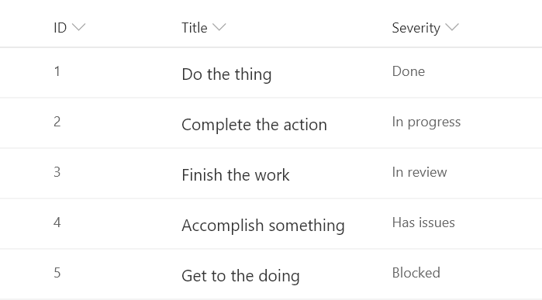
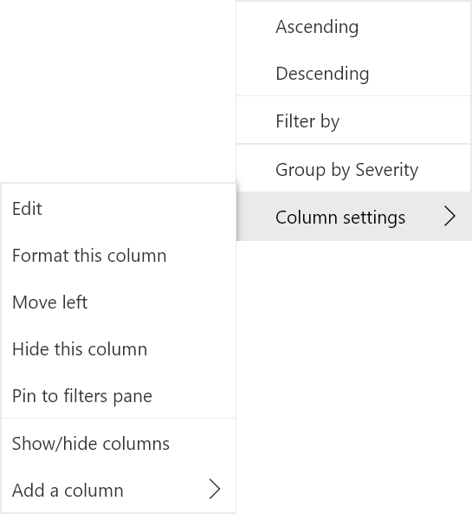

Slide 32


- FORMATTING -

Slide 33

- FORMATTING -

Slide 34
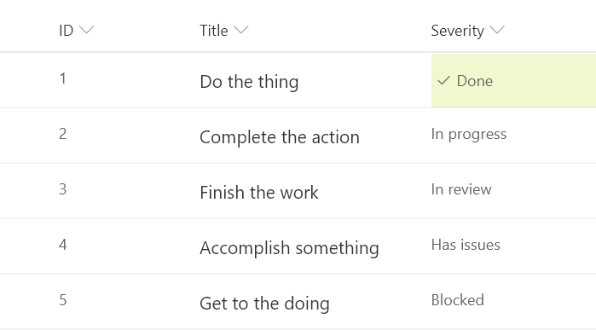
- FORMATTING -

Slide 35
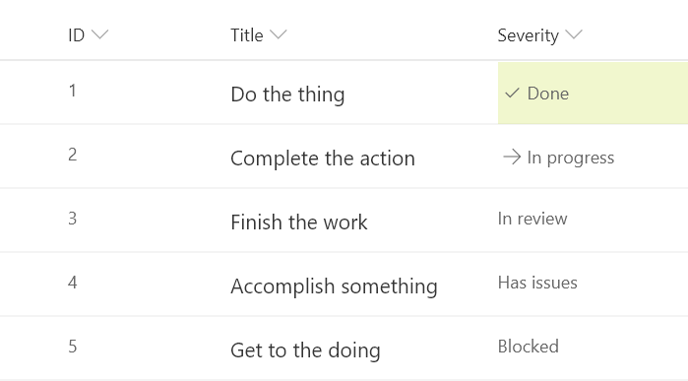
- FORMATTING -

Slide 36
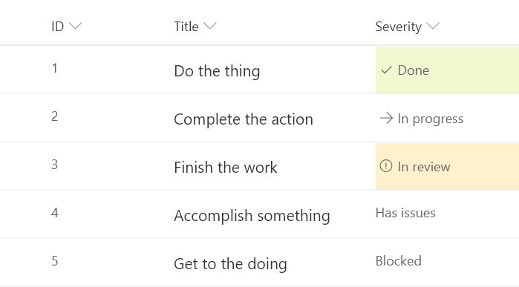
- FORMATTING -

Slide 37
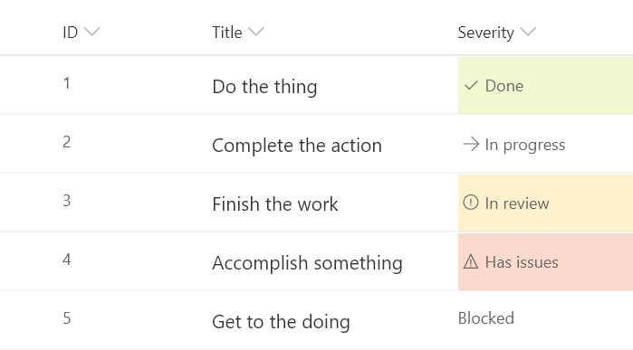
- FORMATTING -

Slide 38

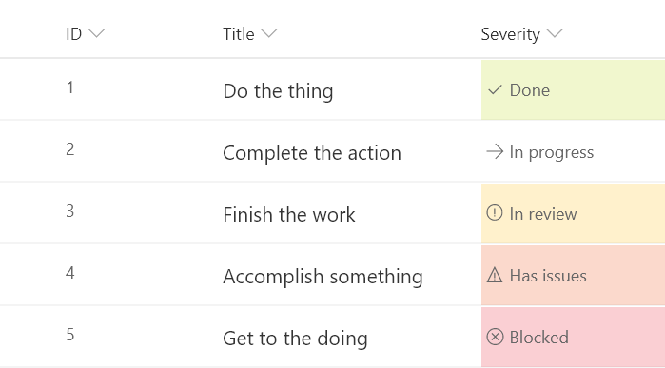
- FORMATTING -

Slide 39
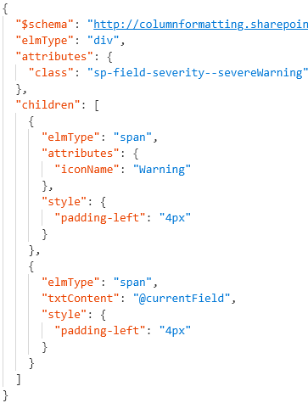

Format JSON
Rendered Column
Element Visualization
div
span
span
Generated HTML
<div class="sp-field-customFormatter sp-field-severity--severeWarning">
<span style="padding-left:4px;" iconname="Warning" class=" css-148"></span>
<span style="padding-left:4px;">Wise Polar Bear</span>
</div>

Slide 40
View Formatting Syntax
Top level props
hideColumnHeader
  When true, the view won’t have any column headers
hideSelection
  When true, users can’t select rows
additionalRowClass
  Class(es) to apply to the whole row
  You can use expressions
  Only applied when rowFormatter is not specified
rowFormatter
  Column Formatting syntax to create elements

Slide 41

“elmType”: “”
Only Required Property
div (box)
span (inline box)
a (link)
img (picture)
button (clicky thing)
svg (fancy picture)
  path (part of the fancy picture)

Slide 42

Element Content
What’s in the Box
txtContent
  Text value
  OR
children
  Sub elements
  Ignored when txtContent is specified

Slide 43

“attributes”: { }
Directly in the element
a (links)
  href – where to go
  target – open in new window or not
  rel – relationship
Everybody
  class – CSS class(es)
  title - tooltip
  iconName – UIFabric icon
  role - accessibility
  aria-* -accessibility
img
  src – image location
path
  d – path to be drawn

Slide 44

“style”: { }
Nest in the style attribute
background-color
fill
background-image
border
border-bottom
border-bottom-color
border-bottom-style
border-bottom-width
border-color
border-left
border-left-color
border-left-style
border-left-width
border-right
border-right-color
border-right-style
border-right-width
border-style
border-top
border-top-color
border-top-style
border-top-width
border-width
outline
outline-color
outline-style
outline-width
border-bottom-left-radius
border-bottom-right-radius
border-radius
border-top-left-radius
border-top-right-radius
box-decoration-break
box-shadow
box-sizing
overflow-x
overflow-y
overflow-style
rotation
rotation-point
opacity
cursor
height
max-height
max-width
min-height
min-width
width
flex-grow
flex-shrink
flex-flow
flex-direction
flex-wrap
flex
justify-content
align-items
box-align
box-direction
box-flex
box-flex-group
box-lines
box-ordinal-group
box-orient
box-pack
font
font-family
font-size
font-style
font-variant
font-weight
font-size-adjust
font-stretch
grid-columns
grid-rows
margin
margin-bottom
margin-left
margin-right
margin-top
column-count
column-fill
column-gap
column-rule
column-rule-color
column-rule-style
column-rule-width
column-span
column-width
columns
padding
padding-bottom
padding-left
padding-right
padding-top
bottom
clear
clip
display
float
left
overflow
position
right
top
visibility
z-index
border-collapse
border-spacing
caption-side
empty-cells
table-layout
color
direction
letter-spacing
line-height
text-align
text-decoration
text-indent
text-transform
unicode-bidi
vertical-align
white-space
word-spacing
hanging-punctuation
punctuation-trim
text-align-last
text-justify
text-outline
text-shadow
text-wrap
word-break
word-wrap
132

Slide 45

“customRowAction”: { “action”: “”}
defaultClick – opens the info pane
editProps – opens the info pane in edit mode
share – opens the sharing dialog
delete – opens the delete confirmation dialog
executeFlow – launches the flow panel
Only work within button elements
(Use the style and children properties to get fancy!)
You cannot use expressions in the action property

Slide 46
“customRowAction”: { “actionParams”: “”}
Online Only
Only used for “action”: “executeFlow”
Escaped JSON
\”ID\”: required
  ID of Flow to launch
\”headerText\”: optional
  Sets the text at the top of the flow panel
\”runFlowButtonText\” optional
  text of the primary button

Slide 47

Live List Updates
Online Only
Formats are automatically redrawn as items update
Magic
Does NOT (yet?) work in the list/library web parts
  sadness

Slide 48
Demo: customRowAction
Notes:
Demonstrate Generic Start Flow Column Formatting Sample: https://github.com/SharePoint/sp-dev-list-formatting/tree/master/column-samples/generic-start-flow
Demonstrate Secret Lab with Live List Updates
Additional Details here: https://thechriskent.com/2018/08/29/list-formatting-quick-tip-format-only-columns/

Slide 49
Placeholder Tokens
…
“txtContent”: “@currentField”
…
“@currentField”
  Get the current item’s value
Works great for simple values (text, choice, yes/no, and numbers)
Type is respected
Dates should use one of the format operations:
  “toLocaleString()” – date and time
  “toLocaleDateString()” – just the date
  “toLocaleTimeString()” – just the time
Always resolves to Title in view formatting

Slide 50
Placeholder Tokens
…
“txtContent”: “@currentField.title”
…
“@currentField”
  Get the current item’s value
  Person field props
Can’t use “@currentField” directly, use dot-notation to get properties:
  “@currentField.title”
  “@currentField.id”
  “@currentField.email”
  “@currentField.sip”
  “@currentField.picture”
  “@currentField.department”
  “@currentField.jobTitle”

Slide 51
Placeholder Tokens
…
“txtContent”:
“@currentField.lookupValue”
…
“@currentField”
  Get the current item’s value
  Person field props
Can’t use @currentField directly, use dot-notation to get properties:
  “@currentField.lookupValue”
  “@currentField.lookupId”
  Lookup field props

Slide 52
Placeholder Tokens
…
“txtContent”:
“@currentField.desc”
…
“@currentField”
  Get the current item’s value
  Person field props
Can use @currentField directly AND dot-notation to get properties:
  “@currentField” – URL value
  “@currentField.desc” - Description
  Lookup field props
  Hyperlink field props

Slide 53
Placeholder Tokens
…
“txtContent”: “[$Title]”
…
“@currentField”
  Get the current item’s value
  Person field props
Wrap internal name in [$FIELD]
Access Person/Lookup/URL properties in same way as with @currentField
  “[$Author.email]”
  “[$OtherListItem.lookupValue]”
  Lookup field props
  Hyperlink field props
Other Fields (same row)

Slide 54
Placeholder Tokens
…
“txtContent”: “@me”
…
“@currentField”
  Get the current item’s value
  Person field props
“@me” resolves to the current user’s email address
“@now” resolves to the date/time
at render (doesn’t keep getting evaluated)
  Uses the browser’s timezone!
  Lookup field props
  Hyperlink field props
Other Fields (same row)
“@me”
“@now”

Slide 55
Placeholder Tokens
Online Only
…
“txtContent”:
“@window.innerHeight”
…
“@currentField”
  Get the current item’s value
  Person field props
“@window.innerHeight” resolves to a number equal to the height of the browser window (in pixels) at render
“@window.innerWidth” resolves to a number equal to the width of the browser window (in pixels) at render
  Lookup field props
  Hyperlink field props
Other Fields (same row)
“@me”
“@now”
These do NOT update as the window resizes
“@window”

Slide 56

Placeholder Tokens
Online Only
…
“txtContent”: “@currentWeb”
…
“@currentField”
“[$FieldName]”
Other Fields (same row)
“@me”
“@now”
Same as page context webAbsoluteUrl
Does not end with a slash
“@window”
“@currentWeb”
Hardcoded URL
  Always works
  Not reusable across sites
Relative URL
  Reusable across sites
  URLs dependent on relative location

Slide 57

Placeholder Tokens
Online Only
…
“txtContent”: “@rowIndex”
…
“@currentField”
“[$FieldName]”
“@me”
“@now”
Evaluates to the rendered index of a row within a view
  Independent of sorts or filters
Starts at 0
Alternating Rows!
“@window”
“@currentWeb”
“@rowIndex”

Slide 58
Placeholder Tokens
Online Only
…
“src”: “@thumbnail.medium”
…
“@currentField”
“[$FieldName]”
Provides the URL to the thumbnail of a file (document libraries only)
  No value for list items or folders
    “@thumbnail.small”
    “@thumbnail.medium”
    “@thumbnail.large”
    @thumbnail.<width>x<height>
      “@thumbnail.100x200”
    @thumbnail.<width>
      “@thumbnail.150”
Aspect ratio is maintained
Only value of src, auto hidden when unavailable
“@me”
“@now”
“@window”
“@currentWeb”
“@rowIndex”
“@thumbnail”

Slide 59

Expressions
Abstract Syntax Tree (AST)
  operator/operands
  Nest additional expressions
Excel-style expressions
  Single line
  Combine expressions
  Online Only

Slide 60
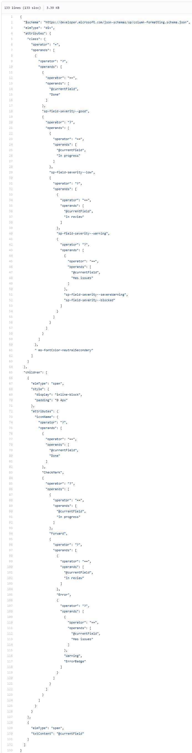
Expressions
Abstract Syntax Tree (AST)
  operator/operands
  Nest additional expressions
Excel-style expressions
  Single line
  Combine expressions
  Electrolytes

Slide 61
Expressions
Abstract Syntax Tree (AST)
  operator/operands
  Nest additional expressions
Excel-style expressions
  Single line
  Combine expressions
  Electrolytes

Slide 62
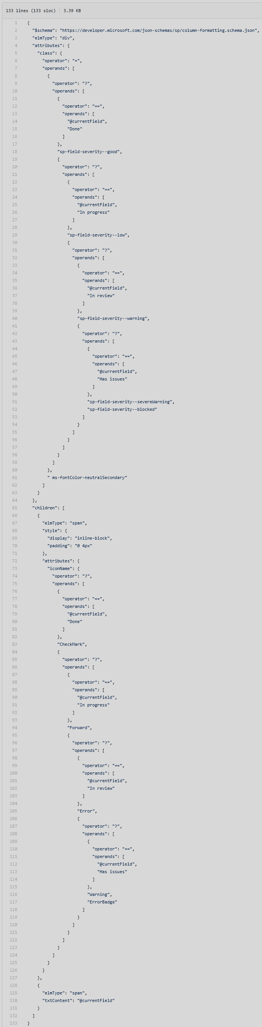
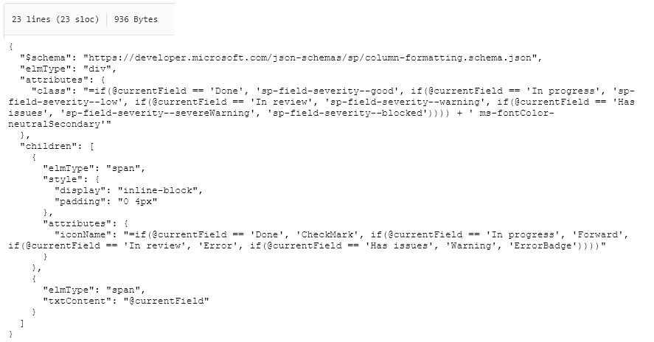
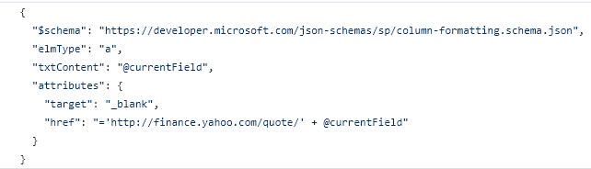
Expressions
Abstract Syntax Tree (AST)
  operator/operands
  Nest additional expressions
Excel-style expressions
  Single line
  Combine expressions
  Electrolytes

Slide 63

Arithmetic Operators
*Online Only
Operator | Does | Examples | Results
+ | Adds stuff (numbers & text) | “=4 + 5” “=@currentWeb+‘/lists‘” | 9 https://t.sharepoint.com/sites/s/lists
- | Subtracts stuff | “=97 - 10” | 87
/ | Divides stuff | “=25 / 5” | 5
* | Multiplies stuff | “=5 * 5” | 25
% | Modulus* (remainder) | “=@rowIndex % 2” | 1 or 0
cos | Cosine | “=cos(5) | 0.28366218546322625
sin | Sine | “=sin(90)” | 0.8939966636005579
abs | Absolute Value* | “=abs(-45)” | 45

Slide 64

Conditional & Logical Operators
Operator | Does | Examples | Results
? or if | if(condition, when true, when false)
< | Less than | “=if(1 < 2, ’cat’, ’dog’)” | cat
> | Greater than | “=if(1 > 2, ’cat’, ’dog’)” | dog
<= | Less than or Equal | “=if(2 <= 2, ’horse’, ’duck’)” | horse
>= | Greater than or Equal | “=if(2 >= 3, ’horse’, ’duck’)” | duck
== | Equals | “=if(5 == 5, ’badger’, ’hen’)” | Badger
!= | Not equals | “=if(7 != 7, ’badger’, ’hen)” | hen
|| | Or | “=if(1<2 || 1<0, ‘man’, ‘elf’)” | man
&& | And | “=if(1<2 && 1<0, ‘man’, ‘elf’)” | elf
This Photo by Unknown Author is licensed under CC BY-SA-NC

Slide 65

Conversion Operators
*Online Only
Operator | Does | Examples | Results
toString | To text | “=toString(45)” | “45”
Number | To a number | “=Number(‘365’)” “=Number(‘Wowee’)” “=Number(Date(‘12/26/1981’))” | 365 NaN 378190800000
Date | To datetime | “=Date(‘12/26/1981’)” “=Date(378190800000)” | 12/26/1981 12:00:00 AM 12/26/1981 12:00:00 AM
toLowerCase* | Text to lowercase | “=toLowerCase(‘DogFood’)” | dogfood
toLocaleString | Datetime to locale text | “=toLocaleString(@now)” | “5/21/2019, 2:25:12 PM”
toLocaleDateString | Datetime to locale date only text | “=toLocaleDateString(@now)” | “5/21/2019”
toLocaleDateTimeString | Datetime to locale time only text | “=toLocaleDateTimeString(@now)” | “2:25:12 PM”

Slide 66

Mulit-Value & Loop Operators
Online Only
Operator | Does | Examples | Results
indexOf | Character index (starting at 0) of some text within text | “=indexOf(‘DogFood’, ‘Dog’)” “=indexOf(‘DogFood’, ‘F’)” “=indexOf(‘DogFood’, ‘Cat’)” “=indexOf(‘DogFood’, ‘f’)” | 0 3 -1 -1
length | Number of multi-value values | “=length([$MultiChoice])” “=length(‘Some Text’)” “=length(‘’)” | 3 1 0
join | Turns multi-values into text with a separator | =“join([$MultiChoice], ‘, ‘)” =“join([$MultiChoice], ‘|‘)” | “A, B, C” “A|B|C”
loopIndex | Current index of an iterator (forEach) | “=loopIndex(‘personIterator’)” | 2

Slide 67
Demo: Operators & Tokens

Slide 68
Column Formatting vs Field Customizer

Slide 69
Column Formatting vs Field Customizer
Customization | Column Formatting | Field Customizer
Conditional Formatting | Supported | Supported

Slide 70
Column Formatting vs Field Customizer
Customization | Column Formatting | Field Customizer
Conditional Formatting | Supported | Supported
Actions | Simple actions and links (no script) | Any type

Slide 71
Column Formatting vs Field Customizer
Customization | Column Formatting | Field Customizer
Conditional Formatting | Supported | Supported
Actions | Simple actions and links (no script) | Any type
Visualizations | Static visualizations (HTML & Styles) | Whatever!

Slide 72
Column Formatting vs Field Customizer
Customization | Column Formatting | Field Customizer
Conditional Formatting | Supported | Supported
Actions | Simple actions and links (no script) | Any type
Visualizations | Static visualizations (HTML & Styles) | Whatever!
Page Context | @now, @me, @window, @currentWeb | Full context!

Slide 73
Column Formatting vs Field Customizer
Customization | Column Formatting | Field Customizer
Conditional Formatting | Supported | Supported
Actions | Simple actions and links (no script) | Any type
Visualizations | Static visualizations (HTML & Styles) | Whatever!
Page Context | @now, @me, @window, @currentWeb | Full context!
JavaScript | Nope | Yep
Custom CSS Classes | Nope, limited subset & inline styles | Yep
Interactivity | Nope | Yep

Slide 74


Column Formatting vs Field Customizer
Customization | Column Formatting | Field Customizer
Conditional Formatting | Supported | Supported
Actions | Simple actions and links (no script) | Any type
Visualizations | Static visualizations (HTML & Styles) | Whatever!
Page Context | @now, @me, @window, @currentWeb | Full context!
JavaScript | Nope | Yep
Custom CSS Classes | Nope, limited subset & inline styles | Yep
Interactivity | Nope | Yep
Developer Required | “No” (but also yes) | Yes
Solution Deployment | Anyone with Designer Permissions | App/Site Catalog
90% of list customization use cases can be covered by Column Formatting*
Another 5% by View Formatting*
For everything else, use SPFx
*made up by me

Slide 75
Thursday - 11:30am
Boulevard Ballroom

Slide 76

List Formatting Limitations
No Real String Operations
No Custom Date Formats or Date Parts
No viewbox attribute for SVG elements
Unable to use parenthesis in style props (except for rgba)
  No Gradients
  No image backgrounds
Numbers are floats and you can’t round them
Missing ms-Grid support
Schema discrepancies
No localization
List Web Part Inconsistencies & Limits
Standard User Interface is lacking

Slide 77

List Formatting Awesomeness
Quick & “easy” visualizations that can have a significant impact
Site Column integration
Text based (easy source control)
Can be applied by Site Designers
Supported in Site Designs & Remote Provisioning
Great performance
Getting better all the time
NO Solution Package deployment required
List Formatter fills the UI gap

Slide 78










Slide 79

List Formatter
Easy editor for modern listview Formatting
ListFormatter.com

Slide 80
Final Tips & Tricks
Dapper
The Modern Listview
UI Fabric Classes
  Theme Colors
  Hover Styles
  Font Sizes & Weights
Purge AST from your brain
Turn debugMode off
Write HTML 1st
Dynamic Images
1000+ icons – use them!
Test in multiple themes
Use List Formatter

Slide 81



PnP SIG
SharePoint General Development Call
Previous List Formatting Tips covered
currentWeb
forEach, loopIndex
Contains, StartsWith, indexOf
Design Mode
Alternating Row Styles
Conditionally launching flows
Multi-line field formats
ContentTypes
Custom Row Actions
UI Fabric Classes (themed formats)
Customizing the Flow Panel
SVG Icons
Every other Thursday, 10am EST
Recorded to YouTube
Next call on 5/30
Recurring List Formatting tips & tricks
Notes:
https://aka.ms/spdev-sig-call

Slide 82



Action plan
Read the Docs
  Column & View Formatting
  bit.ly/LF-docs
Join the Call
  PnP Special Interest Group for General SharePoint Development
  aka.ms/spdev-sig-call
Use ListFormatter
  New version coming soon!
  ListFormatter.com

Slide 83

Thank you

Slide 84
Thank you
Final slide
Leave this up while you answer questions.
People will take photos of this slide, so it should have readable and actionable leave-behinds.
Questions
CTAs
Repeat CTAs from ACTION PLAN slide.
Insert a column for 4 CTAs.
Read the Docs | Join the Call | Use ListFormatter
aka.ms/SPC/Sessions/BRK064 | Share slides and resources from this session
aka.ms/SPC/Sessions/<product> | Learn more from related sessions at SPC19
aka.ms/<product>/Resources | Explore resources for deployment and adoption
aka.ms/<product>/Blog | Stay up to date on the latest product news
aka.ms/<product>/Blog/SPC19 | Review the news and announcements from SPC19
aka.ms/<product>/Community | Join the conversation in the Microsoft Technical Community
aka.ms/<product>/Feedback | Give us feedback and input to shape the future
aka.ms/M365Roadmap | Discover what’s coming with the Microsoft 365 Roadmap
@theChrisKent #SPC19 | Follow me and share this session
Resources
Try to stick as closely as possible to this list of resources, but delete or modify rows where necessary.
If you have a lot of resources, create a resource page and point to it with aka.ms/SPC19/Sessions/<Session Code>.
PMMs own getting the resources online with AKAs.

Slide 86

Extra stuff just for you!
The next few slides were cut for time
They still (mostly) have valuable content
Reach out with any questions (@theChrisKent)
Enjoy!

Slide 87
Predefined Classes
sp-field-severity--good |  | background-color
sp-field-severity--low |  | background-color
sp-field-severity--warning |  | background-color
sp-field-severity--severeWarning |  | background-color
sp-field-severity--blocked |  | background-color
sp-field-dataBars |  | background-color, padding, color, border-top
sp-field-trending--up | text | color
sp-field-trending--down | text | color
sp-field-quickActions |  | font, padding (used with icons)
Use UIFabric.io color & typography classes to match theme

Slide 88
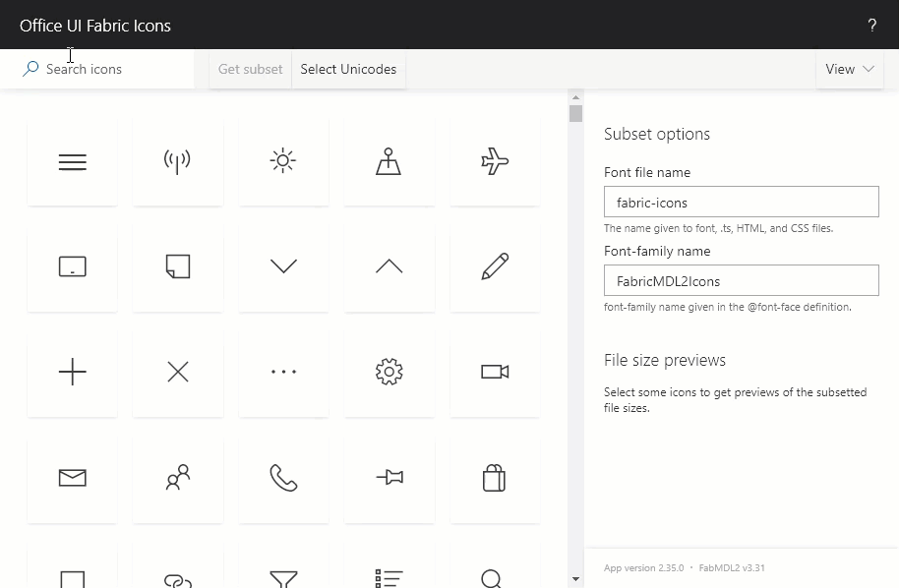
“attributes”: { “iconName”: “Cat” }
uifabricicons.azurewebsites.net

Slide 89
Design Mode Classes
sp-css-backgroundColor-
neutralBackground (50,40,30)
blueBackground07 (17,27,37)
successBackground (50,40,30)
warningBackground (50,40,30)
blockingBackground (50,40,30)
errorBackground (50,40,30)

Slide 90


Don’t Use Rich Text
List Formatting encodes values
Rich text values contain HTML
HTML will be encoded and displayed

Slide 91



forEach
“VirtualFieldName in ArrayField”
@currentField
or
[$SomeOtherField]
Cannot add to Root Element
Turns element into a template
  Repeated for each item in the array
Creates Virtual Field
  Access using Field Syntax [$personIterator]
  Name appropriately (don’t clobber your fields)
Can be nested

Slide 92
loopIndex
Zero-Based
Position in forEach loop
  Meaningless outside of loop
Specify the iterator name
  “=loopIndex(‘personIterator’)”
Rhymes with PoopWindex

Slide 93


Scalable Vector Graphics (SVGs)
“elmType”: “svg”
  “elmType”: “path”
No viewbox attribute
  Makes them just VGs
Provides lots of options, but can get confusing
  Use with care
Dynamic SVGs using expressions in d attribute!

Slide 94

aka.ms/sppnp

Slide 95


Slide 96


  Bi-Weekly
  SP General Development
  aka.ms/sppnp-core-sig-call
  List Formatting, PowerApps, CSOM, PowerShell, Provisioning, Flow
  Next Call: Thursday, 5/30
  Bi-Weekly
  SharePoint Framework
  aka.ms/sppnp-js-sig-call
  SPFx, PnP JS Core
  Next Call: Thursday, 5/23
  Monthly
  Community Calls
  aka.ms/sppnp-call
  Monthly Summary
  Next Call: Tuesday, 6/11
  Bi-Weekly
  SP General Development
  aka.ms/sppnp-core-sig-call
  List Formatting, PowerApps, CSOM, PowerShell, Provisioning, Flow
  Next Call: Thursday, 2/21
  Bi-Weekly
  SharePoint Framework
  aka.ms/sppnp-js-sig-call
  SPFx, PnP JS Core
  Next Call: Thursday, 2/14
  Monthly
  Community Calls
  aka.ms/sppnp-call
  Monthly Summary
  Next Call: Tuesday, 3/12

Slide 97



Official Blog
dev.office.com/blogs
Twitter
@OfficeDevPnP
Tech Community
aka.ms/sppnp-community

Slide 98


