Slide 1


Slide 2
Understanding SPFx Extensions
Chris Kent
O365 Practice Lead
DMI

Slide 3
BRK107
Understanding SharePoint Framework (SPFx) Extensions
SharePoint Framework Extensions are the replacement for Custom Actions, JS Link, and more for Modern Pages in Office 365 and SharePoint 2019. Whether you've started experimenting with the SharePoint Framework or not, come find out exactly what the Extensions are, when to use them, limitations, and advantages. SharePoint Framework Extensions are not only powerful and flexible tools to customize SharePoint, when it comes to modern pages, they're the only way.
SharePoint Conference 2019
https://sharepointna.com/#!/session/Understanding%20SharePoint%20Framework%20(SPFx)%20Extensions/3565
May 23, 2019
11:30am
Boulevard Ballroom 163
Chris Kent

Slide 5















“Me”
Indianapolis, IN
Office Development
Office 365 Practice Lead
@theChrisKent
Member of the Core Team
theChrisKent.com
Notes:
Can I possibly get my name on a single slide even more? Wow.

Slide 6
Goals

Slide 7
SharePoint Framework
Overview | Context

Slide 8
SPFx
Extensions
Types | How | Manage

Slide 9
Resources
Samples | Guidance | PnP

Slide 11
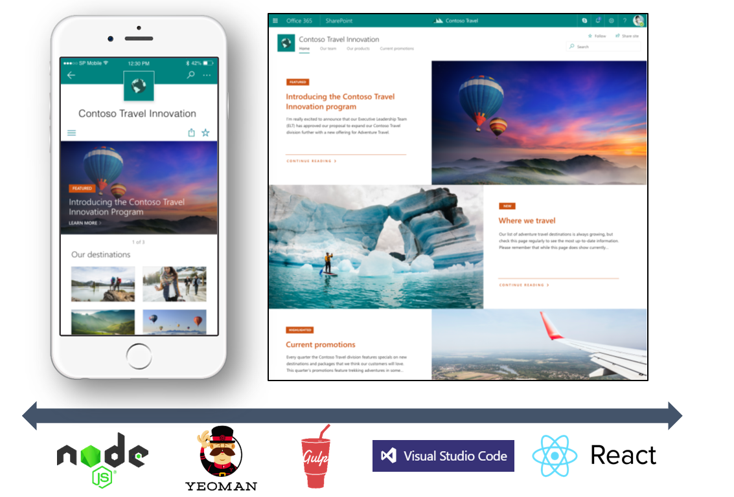
SharePoint Framework (SPFx)
Modern client-side development
Powers OOTB experiences
Supports open source tools
and JavaScript web frameworks
Built to be Responsive
SharePoint Framework
Microsoft Graph
LOB Systems and Cloud Services
Slide adapted from Microsoft

Slide 12
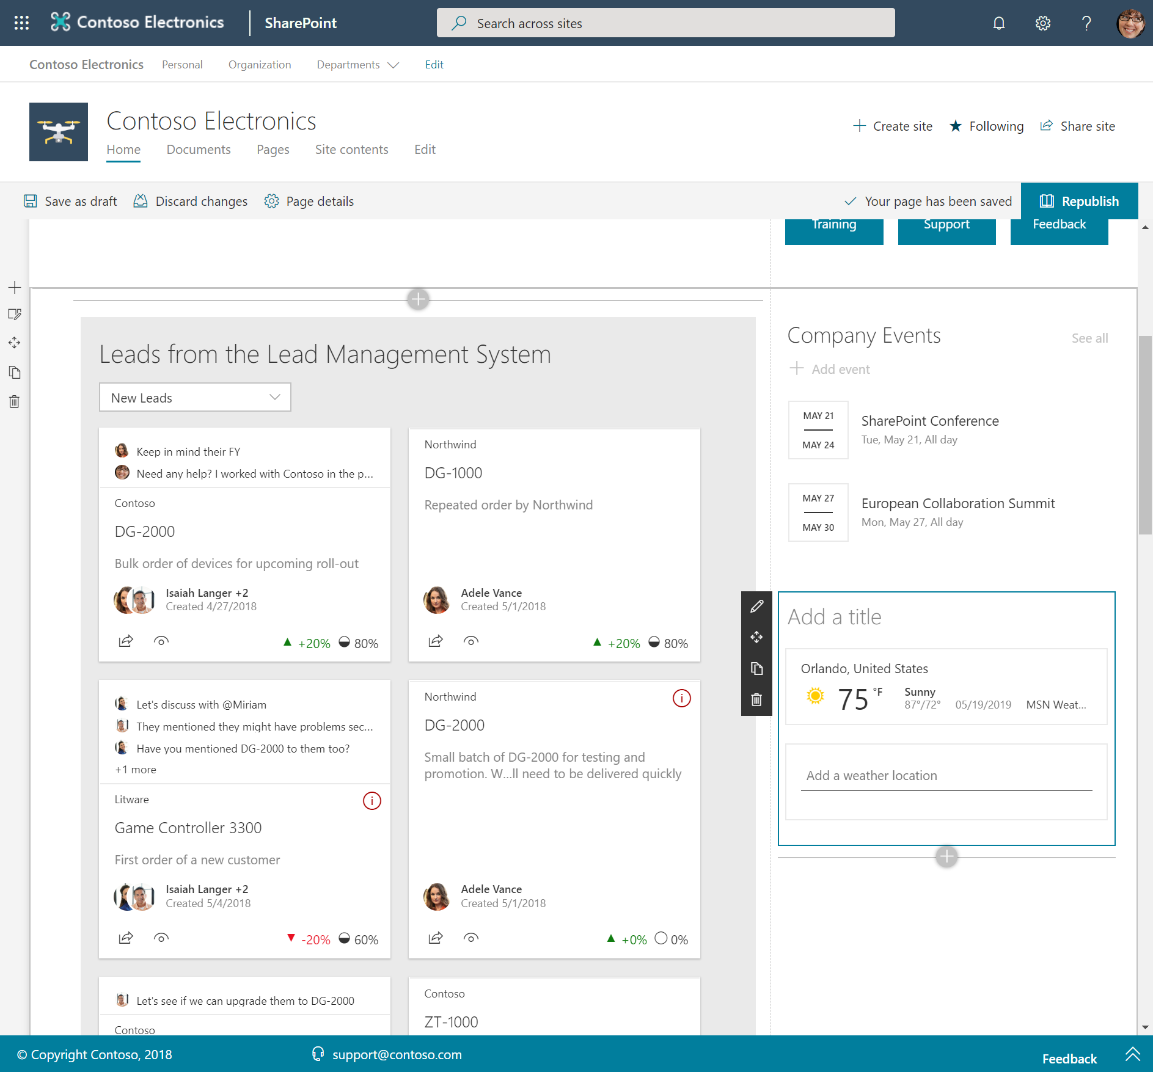
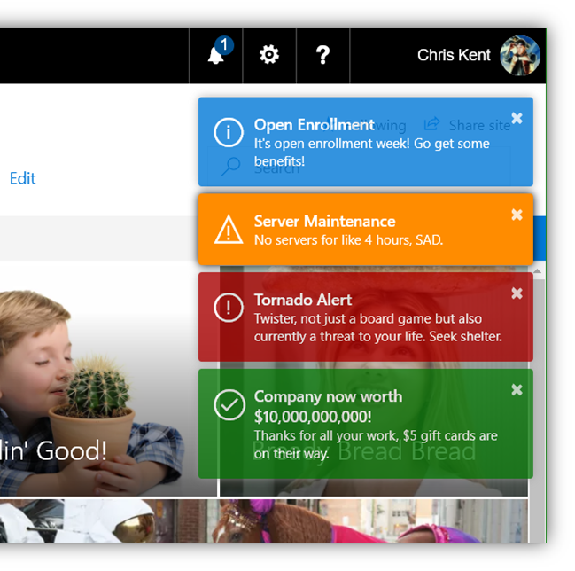
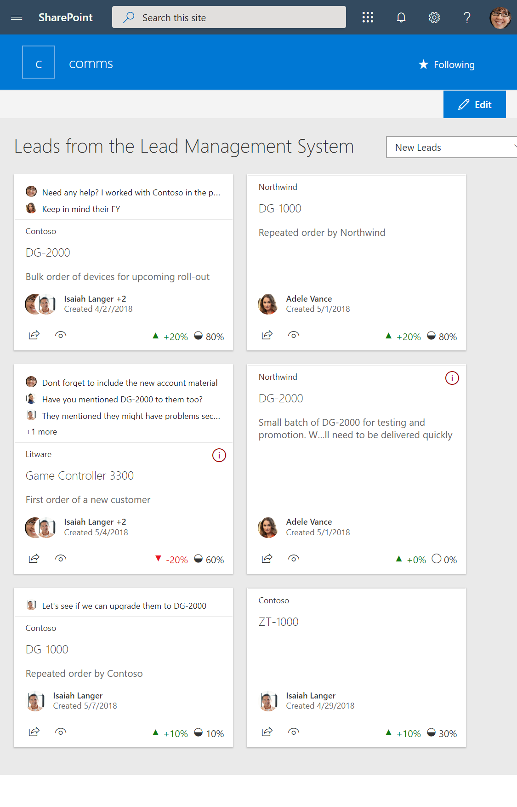
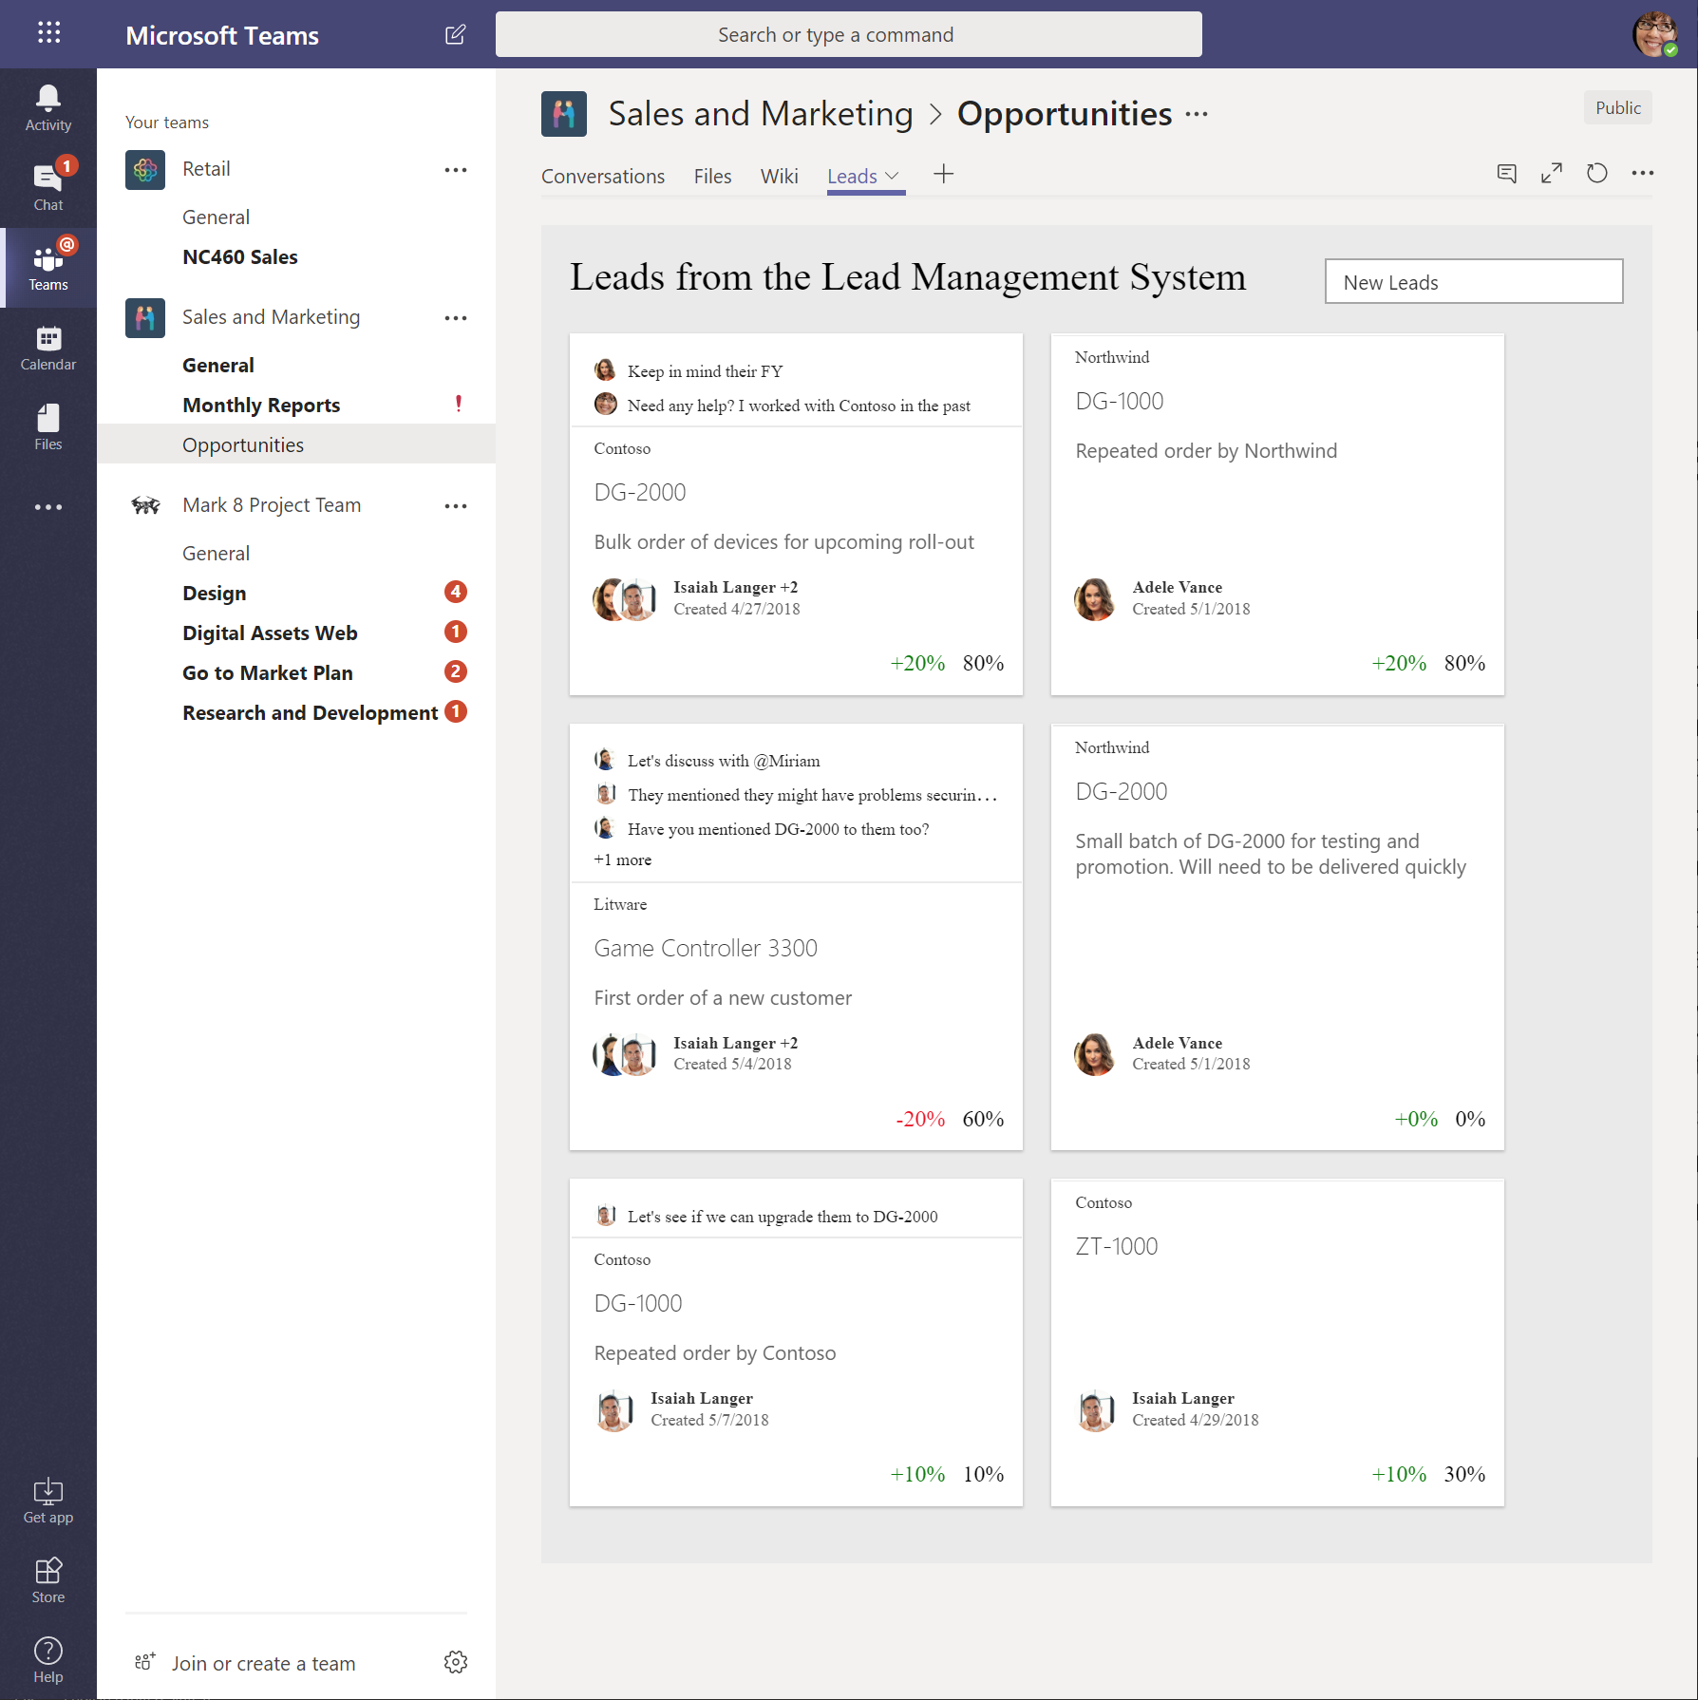
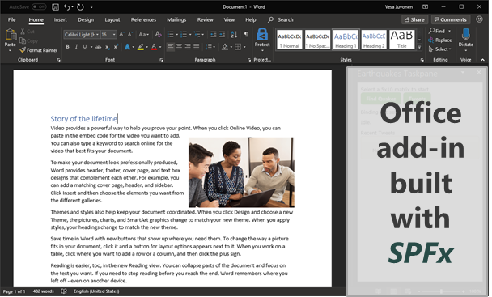
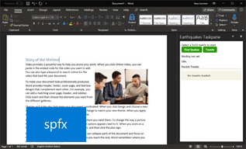
SharePoint Framework platform
Web Parts
Extensions
App pages
Teams Tabs
Office add-ins
Slide adapted from Microsoft

Slide 13
SharePoint Framework platform
Chris’ Perspective
Web Parts
Extensions
App pages
Teams Tabs
Office add-ins
Application Customizers
Command Sets
Field Customizers
Slide adapted from Microsoft

Slide 14
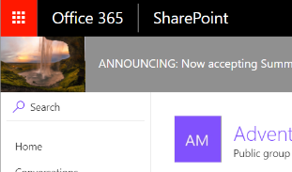
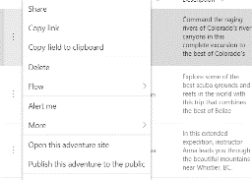
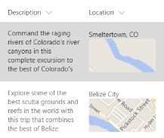
SharePoint Framework (SPFx) Extensions
Extend the user experience of SharePoint
Application customizer
Command set
Field customizer
Add script to modern pages
Adjust top and bottom sections of page with custom renderings
Extend the modern list command surface with new actions that run custom code
Visualize data inside columns in the list view
Slide adapted from Microsoft

Slide 15

SPFx Extensions are really Powerful

Slide 16
github.com/SharePoint/sp-dev-fx-extensions
30
Application Customizers
9
Field Customizers
19
Command
Sets
FREE
OPEN-SOURCE

Slide 17


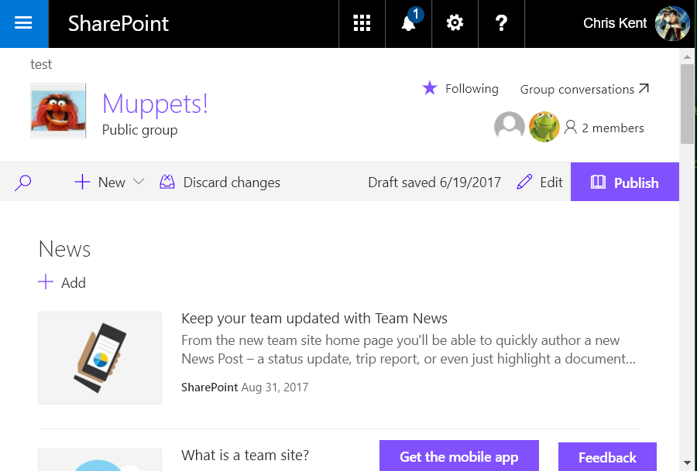
Application Customizers
Adds scripts to the page
Provides access to Placeholders
  Top
  Bottom

Slide 18
Demo: Application Customizer
jquery-application-toastr
Notes:
Demonstrate Generic Start Flow Column Formatting Sample: https://github.com/SharePoint/sp-dev-list-formatting/tree/master/column-samples/generic-start-flow
Demonstrate Secret Lab with Live List Updates
Additional Details here: https://thechriskent.com/2018/08/29/list-formatting-quick-tip-format-only-columns/

Slide 19

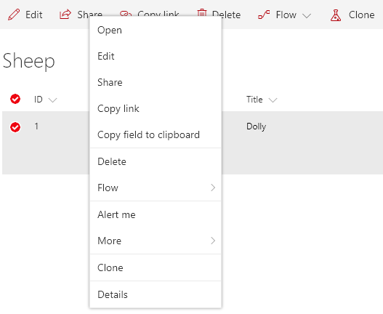
Command Sets
Adds 1 or more Commands to a modern List View
Commands can be added to:
  Context Menu
    ClientSideExtension.ListViewCommandSet.ContextMenu
  Command Bar
    ClientSideExtension.ListViewCommandSet.CommandBar
  Both
    ClientSideExtension.ListViewCommandSet

Slide 20

Demo: Command Sets
js-command-clone
Notes:
Demonstrate Generic Start Flow Column Formatting Sample: https://github.com/SharePoint/sp-dev-list-formatting/tree/master/column-samples/generic-start-flow
Demonstrate Secret Lab with Live List Updates
Additional Details here: https://thechriskent.com/2018/08/29/list-formatting-quick-tip-format-only-columns/

Slide 21

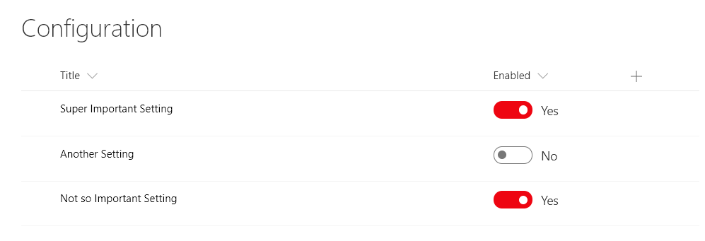
Field Customizers
Customize the display of a field in a List View
Add advanced functionality to a field
Display Only
Not rendered in the info panel
react-field-toggle by Giuliano De Luca

Slide 22
Demo: Field Customizer
jquery-field-itemorder
Notes:
Demonstrate Generic Start Flow Column Formatting Sample: https://github.com/SharePoint/sp-dev-list-formatting/tree/master/column-samples/generic-start-flow
Demonstrate Secret Lab with Live List Updates
Additional Details here: https://thechriskent.com/2018/08/29/list-formatting-quick-tip-format-only-columns/

Slide 23
Column Formatting vs Field Customizer

Slide 24
Column Formatting vs Field Customizer
Customization | Column Formatting | Field Customizer
Conditional Formatting | Supported | Supported

Slide 25
Column Formatting vs Field Customizer
Customization | Column Formatting | Field Customizer
Conditional Formatting | Supported | Supported
Actions | Simple actions and links (no script) | Any type

Slide 26
Column Formatting vs Field Customizer
Customization | Column Formatting | Field Customizer
Conditional Formatting | Supported | Supported
Actions | Simple actions and links (no script) | Any type
Visualizations | Static visualizations (HTML & Styles) | Whatever!

Slide 27
Column Formatting vs Field Customizer
Customization | Column Formatting | Field Customizer
Conditional Formatting | Supported | Supported
Actions | Simple actions and links (no script) | Any type
Visualizations | Static visualizations (HTML & Styles) | Whatever!
Page Context | @now, @me, @window, @currentWeb | Full context!

Slide 28
Column Formatting vs Field Customizer
Customization | Column Formatting | Field Customizer
Conditional Formatting | Supported | Supported
Actions | Simple actions and links (no script) | Any type
Visualizations | Static visualizations (HTML & Styles) | Whatever!
Page Context | @now, @me, @window, @currentWeb | Full context!
JavaScript | Nope | Yep
Custom CSS Classes | Nope, limited subset & inline styles | Yep
Interactivity | Nope | Yep

Slide 29


Column Formatting vs Field Customizer
Customization | Column Formatting | Field Customizer
Conditional Formatting | Supported | Supported
Actions | Simple actions and links (no script) | Any type
Visualizations | Static visualizations (HTML & Styles) | Whatever!
Page Context | @now, @me, @window, @currentWeb | Full context!
JavaScript | Nope | Yep
Custom CSS Classes | Nope, limited subset & inline styles | Yep
Interactivity | Nope | Yep
Developer Required | “No” (but also yes) | Yes
Solution Deployment | Anyone with Designer Permissions | App/Site Catalog
90% of list customization use cases can be covered by Column Formatting*
Another 5% by View Formatting*
For everything else, use SPFx
*made up by me

Slide 30

Extension Development

Slide 31






Tool Comparison
(nothing special required for extensions)
IIS Express
C#
MSBuild
Traditional
Project Templates
Dev Server
Templates
Packages
Editor
Language
Build Tasks
SPFx
VS Code

Slide 32

Tool Comparison (nothing special required for extensions)
IIS Express
C#
MSBuild
Traditional
Project Templates
Dev Server
Templates
Packages
Editor
Language
Build Tasks
SPFx
VS Code

Slide 33
Workbench
Nope

Slide 34
Debug directly on the Page
gulp serve --nobrowser
  Add Debug URL query parameters manually
Use serveConfigurations in config > serve.json
  Use multiple entries to make testing easier
  default, and then one per property combination
Outdated & Hard
Launch with Default
Launch with Named Config
gulp serve
gulp serve --config=yourConfigName

Slide 35
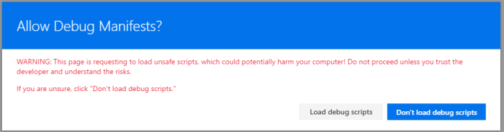

Allow Debug Manifests
Serve extensions from localhost but run on your actual page!
  Magic
For safety, always prompted before loading

Slide 36
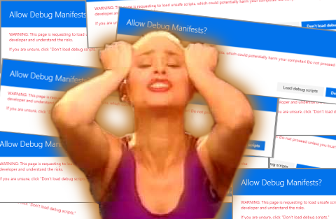

Slide 37
STOP THE INSANITY!
Sometimes (rarely) the site gets stuck in a loop
  Prompted for allow debug manifests regardless of
    No custom action on site loading from localhost
    No debug query strings
Fix by adding ?reset=true

Slide 38

Demo: Extension Development
Notes:
Demonstrate Generic Start Flow Column Formatting Sample: https://github.com/SharePoint/sp-dev-list-formatting/tree/master/column-samples/generic-start-flow
Demonstrate Secret Lab with Live List Updates
Additional Details here: https://thechriskent.com/2018/08/29/list-formatting-quick-tip-format-only-columns/

Slide 39




Deployment
Generate a Bundle (single JS file)
Create a Package (Zip with Bundle & Manifest)
Upload to the App Catalog
  Optionally, check box for Tenant Deployment
  If Public CDN is enabled, it will be used
gulp bundle --ship. .
gulp package-solution --ship. .

Slide 40


Tenant Wide Deployment
skipFeatureDeployment
  Extensions Available Across Tenant
  Admin approval required
  Extensions are available to be used if Custom Actions are added to site
  Feature Framework cannot be used
ClientSideInstance.xml
  Extensions Added Across Tenant
  Application Customizers & List View Command Sets
  Can specify site/list template (or all)
  Controlled by list in App Catalog
SPFx 1.4 +
SPFx 1.6 +

Slide 41
Placeholder for PowerShell
Add-PnPCustomAction
Add-PnPCustomAction -Title “Toastr” -Name “Toastr” -Location “ClientSideExtension.ApplicationCustomizer”-ClientSideComponentId a861c815-e425-416d-9520-04bcdf557e27 -ClientSideComponentProperties “{“”prop””:””value””}”
Get-PnPCustomAction
Get-PnPCustomAction -Scope Web
Remove-PnPCustomAction
Get-PnPCustomAction –Scope All | ? Name -eq “Item Clone” | Remove-PnPCustomAction

Slide 42

Demo: Extension Wrangling
Notes:
Demonstrate Generic Start Flow Column Formatting Sample: https://github.com/SharePoint/sp-dev-list-formatting/tree/master/column-samples/generic-start-flow
Demonstrate Secret Lab with Live List Updates
Additional Details here: https://thechriskent.com/2018/08/29/list-formatting-quick-tip-format-only-columns/

Slide 43


pnp.github.io/pnpjs
Fluent API
Batching
Caching
The best way to access the REST API via JS
PnPJS

Slide 44



PnP SIG
SharePoint
Framework Call
Common Discussions
PnPJS
O365 CLI
PnP Property Controls
PnP React Controls
PnP SPFx Generator
SharePoint Framework roadmap
Tons of demos from both Microsoft and the Community
Opportunity to talk directly with engineering
Every other Thursday, 10am EST
Recorded to YouTube
Next call on 6/6
Notes:
https://aka.ms/spdev-sig-call

Slide 45


Final tips
Get a developer tenant
Do the tutorials
Explore the samples
Use PnPJS
Cache it up
64-bit encoded images for Command Sets
Target Command Sets to specific lists
Minimal placeholder sizing – expand on demand
Understand the risks of DOM manipulation
Avoid the Feature Framework
PnP PowerShell is your friend
Join the calls
aka.ms/offdp

Slide 46



Action plan
Read the Docs
  SPFx Extensions
  bit.ly/extension-docs
Join the Call
  PnP Special Interest Group for SharePoint Framework
  aka.ms/spdev-spfx-call
Make Stuff
  Beep Boop! Extension! Share it!
  aka.ms/sppnp

Slide 47

Thank you

Slide 48

Thank you
@theChrisKent
theChrisKent.com
Bit.ly/extension-docs
aka.ms/spdev-spfx-call
aka.ms/sppnp
aka.ms/offdp

Slide 49

Extra stuff just for you!
The next few slides were cut for time
They still (mostly) have valuable content
Reach out with any questions (@theChrisKent)
Enjoy!

Slide 50

aka.ms/sppnp

Slide 51


Slide 52


  Bi-Weekly
  SP General Development
  aka.ms/sppnp-core-sig-call
  List Formatting, PowerApps, CSOM, PowerShell, Provisioning, Flow
  Next Call: Thursday, 5/30
  Bi-Weekly
  SharePoint Framework
  aka.ms/sppnp-js-sig-call
  SPFx, PnP JS Core
  Next Call: Thursday, 6/6
  Monthly
  Community Calls
  aka.ms/sppnp-call
  Monthly Summary
  Next Call: Tuesday, 6/11
  Bi-Weekly
  SP General Development
  aka.ms/sppnp-core-sig-call
  List Formatting, PowerApps, CSOM, PowerShell, Provisioning, Flow
  Next Call: Thursday, 2/21
  Bi-Weekly
  SharePoint Framework
  aka.ms/sppnp-js-sig-call
  SPFx, PnP JS Core
  Next Call: Thursday, 2/14
  Monthly
  Community Calls
  aka.ms/sppnp-call
  Monthly Summary
  Next Call: Tuesday, 3/12

Slide 53



Official Blog
dev.office.com/blogs
Twitter
@OfficeDevPnP
Tech Community
aka.ms/sppnp-community

